Slide 1



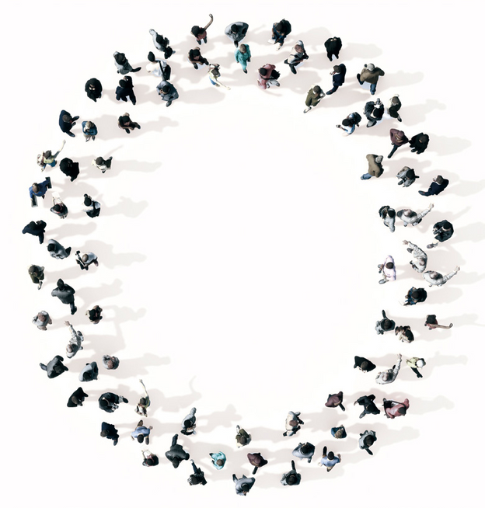

www.medicalsnj.com
Company Introduction
Healthier Life and Better Tomorrow
SNJ is a GMP and ISO 13485 certified company
specializing in the manufacturing of medical equipment.
www.snjamerica.com
1258 Quarry Lane Suite G
Pleasanton, CA 94566
A. No. 604, Ace-Techno Tower 2, Digital-ro 31-gil 19, Guro-gu, Seoul, Korea T. +82-2-866-9005 F. +82-2-866-9007 E. snj@medicalsnj.com www.medicalsnj.com
www.medicalsnj.com
SNJ
medicalsnj
SNJ Medical

Slide 2


SNJ is here for ‘Healthier Life and Better Tomorrow’
We will make healthier life and better tomorrow with our medical and aesthetic solutions
SNJ is here for ‘Healthier Life and Better Tomorrow’
We will make healthier life and better tomorrow with our medical and aesthetic solutions
MEDICAL & AESTHETIC SOLUTIONS
HISTORY
1998
Company Established
MAR
1999
SNJ is a GMP and ISO 13485 certified company specializing in the manufacturing of medical equipment. We have been supplying medical & aesthetic lasers, especially for CO2 laser systems, since 1998. Most of our products are FDA, CE, and KFDA certified to
ensure their performance and safety.
APR
Certified as Manufacturer from KFDA
2000
APR
1st Product : SNJ-1000
2nd Product : SNJ-1000U
FEB
2003
2005
SEP
Certified for ISO 13485 & CE
3rd Product : SNJ-1000N
FEB
2007
Now we are expanding our business around the world and
looking for good business partners.
Wherever you are, SNJ is ready to partner with you.
2011
OCT
Certified for GMP
4th Product : SNJ-1000U stamp
JAN
2013
2014
DEC
5th Product : SNJ-1000U scanner
SNJ
provides
medical and aesthetic solutions
based on
6, 7th Product : Selriah, Evero
MAR AUG
quality laser technology.
8th Product : Du:sonic
2016
Please visit our website,
www.medicalsnj.com
to get more
JAN
9th Product : Finexel
information.
2017
NOV
10th Product : Blue Eva
11th Product : Finebeam Dual
MAR OCT
12th Product : Blue Ice
2019
NOV
13, 14th Product : Blue Eva 2, Blue Ice 2
2020
DEC
15th Product : Finebeam Max
16th Product : U-Pulse Premium
MAR
2023
JAN
18th Product : Selriah Tri
2024
DEC
Product : N-Pulse Premium
Product : U-pulse Dual, U-pulse Single
Mar
www.medicalsnj.com
3
www.medicalsnj.com
4

Slide 3

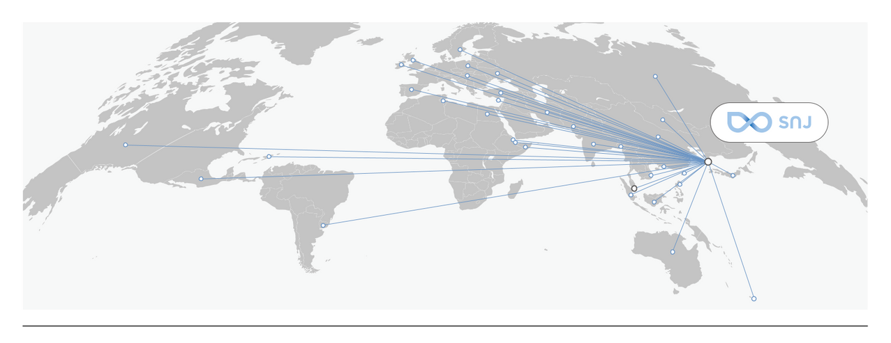

SNJ is here for ‘Healthier Life and Better Tomorrow’
We will make healthier life and better tomorrow with our medical and aesthetic solutions
SNJ is here for ‘Healthier Life and Better Tomorrow’
We will make healthier life and better tomorrow with our medical and aesthetic solutions
VISION
GLOBAL PARTNER
Europe
Asia
Middle East
America
Oceania
Better Quality of Life with New Solutions of Aesthetic Healthcare
Bangladesh China Hong Kong India Indonesia Japan Malaysia
Mongolia Pakistan Philippines Singapore Taiwan Vietnam
Iran Oman Qatar
Turkey UAE
Cyprus Hungary Ireland Poland Russia
Spain UK Ukraine Sweden
Canada Dominican Republic
Mexico Uruguay
Australia
Fiji
USA
Africa
Egypt
Tunisia
MISSION
Par tner
Customer
Society
Smarter, Quality and Balanced Work
Best Solution to Our Customers
More Beautiful and Healthier Society
www.medicalsnj.com
5
www.medicalsnj.com
6

Slide 4

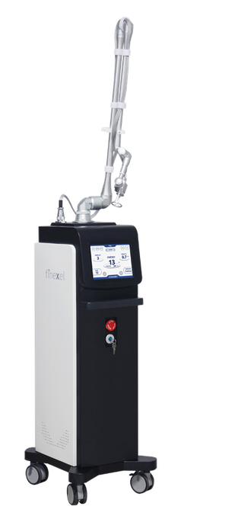
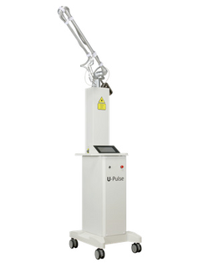
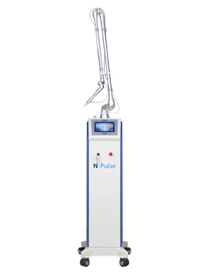
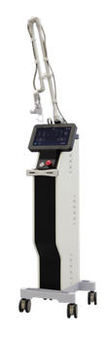
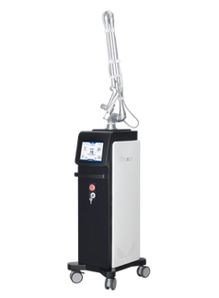
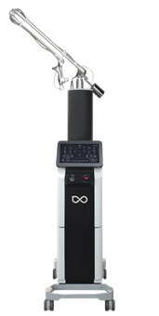


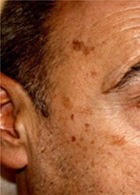
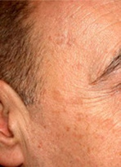



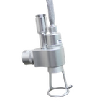




SNJ is here for ‘Healthier Life and Better Tomorrow’
We will make healthier life and better tomorrow with our medical and aesthetic solutions
SNJ is here for ‘Healthier Life and Better Tomorrow’
We will make healthier life and better tomorrow with our medical and aesthetic solutions
Medical & Aestethic Solution SNJ
CO2 LASER SYSTEMS
Unparalleled CO Laser systems with a variety of models
Medical & Aestethic Solution SNJ
CO2 LASER
2
•
Lower PIH with finer spots thanks to shorter pulse duration.
Over 25 years of dedication to CO2 laser tech allows SNJ to provide the most advanced CO2 laser systems.Its quality has been proven through its installation in all of Korea’s top 5 hospitals.
We have the option to satisfy all of your Co2 laser system needs.
•
Remarkable CO2 performance for everything from gentle superficial peeling to deep scar care.
•
Optimized skin care depending on indicators with 4 different spot sizes and parameters tested in the market long-term.
•
Lessen residual thermal damage for deep layer focusing with Max. 10 overlaps in Fractional mode.
Premium
Indications
Specification
•
Surgical : Mole, Wart, Age Spot, Acne Scar, Verruca plana, Seborrhoeic keratosis, Syringoma,
Laser Medium Wavelength Max. Scan Area
CO
Milium etc.
2
•
Fractional : Whitening, Brightening, Skin Rejuvenation, Skin texture, Acne Scar, Striae,
10600nm 30W(Glass tube), 40W(RF tube) 20X20 mm
Skin Resurfacing, Enhancing the Drug delivery etc.
Courtesy of M.D. Roumbas
Courtesy of M.D. Y.H. Hwang Pore Tightening
CO2 Surgical Hand Pieces
f-100mm Spot size : 0.25mm
f-50mm Spot size: 0.2mm
Before
CO2 Fractional Hand Piece
- Basic (spot : 100µm)
Fractional tips - optional (spot: 80, 180, 500µm)
Max.100W Glass tube FRX, Surgical
Max. 30W Glass tube Surgical
Max. 30W Glass tube FRX, Surgical
Max.30W Glass tube Max.40W RF tube FRX, Surgical
U-Pulse Single : surgical mode only U-Pulse Dual : FRX, Surgical New Concept, New CO2, 60W CO2
Before
1 session after
2 Sessions After
4 Sessions After
www.medicalsnj.com
7
www.medicalsnj.com
8

Slide 5
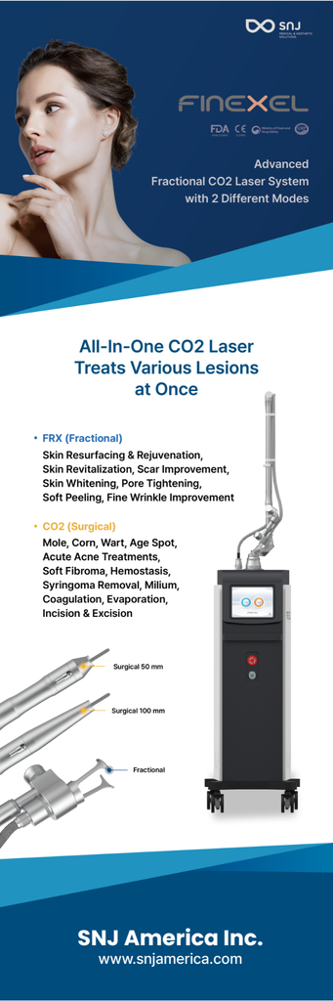
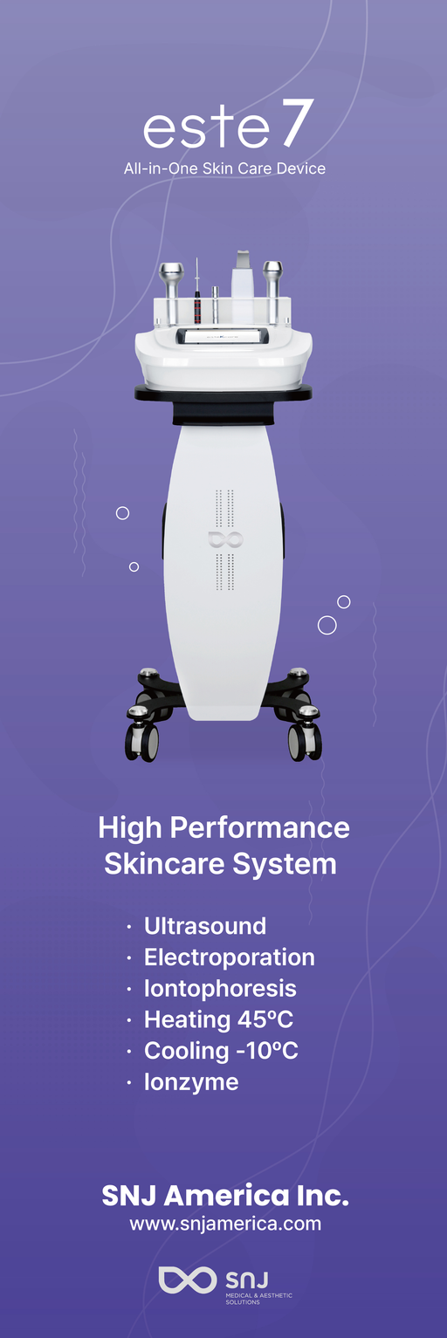
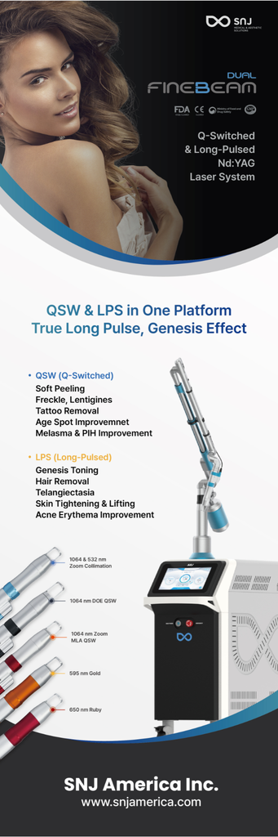


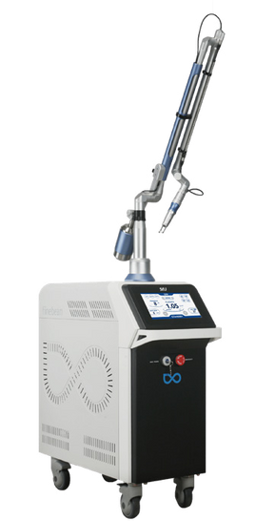
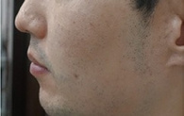
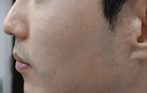
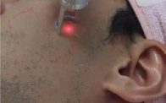
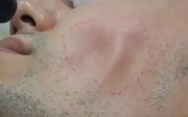
SNJ is here for ‘Healthier Life and Better Tomorrow’
We will make healthier life and better tomorrow with our medical and aesthetic solutions
SNJ is here for ‘Healthier Life and Better Tomorrow’
We will make healthier life and better tomorrow with our medical and aesthetic solutions
Medical & Aestethic Solution SNJ
Nd:yag laser
•
Stable energy delivery and high durability are assured via the advanced dual-chamber resonator technology.
•
Proven effectiveness of ZOOM MLA for pore, scar, and skin texture with high, stable max power of 1.3J for Qplus and 1.6J Dual with single pulse
•
Offers the outstanding versatility of Q-Switched and Long pulse laser indications
•
Exceptionally high power PTP of 2.2J for Dual and 2.0J for Qplus safely and effectively treats pigmentation and tattoo ink in the dermis without epithermal thermal damage.
Indications
Specification
Q-switched: Melasma & PIH improvement, Nevus of Ota& ABNOM removal, Soft Peeling, Tattoo Removal, Freckle, Lentigines, Caf-au-lait Spot, Becker’s Nevus, Age Spot Improvement etc. Long-Pulsed: Genesis, Skin Tightening & Lifting, Acne Erythema Improvement, Telangiectasia, Hair Removal, Gold PTT etc.
Laser Medium Wavelength Pulse duration Repetition rate
Nd:Yag 1064nm, 532nm, 650nm, 595nm QSW: 5 ~ 10ns LPS: 0.3 ~ 300ms 1 ~ 10HZ
Male / Ice Pick Scar, Acne Scar
Courtesy of Y.H. Hwang M.D
Product Name
Finebeam Qplus
Finebeam Dual
1064 Q Single : 100~1300mJ
1064 Q Single : 100~1600mJ
1064 Q Double : 500~2000mJ
1064 Q Double : 500~2200mJ
Pulse Energy
532 Q Single : 20~500mJ
532 Q Single : 20~500mJ
(Max)
1064 Quasi-Long : 100~3000mJ
1064 Quasi-Long : 100~3500mJ
1064 Long : 1~60mJ
Before
1 Sessions
After
Hair Removal (LPS)
Zoom Colli
Zoom MLA
(4, 7, 10mm)
595 Gold
(5mm)
(1064: 2~10, 532: 1~7mm)
DOE
(7mm)
650 Ruby
(3mm)
Before
After
1304
www.medicalsnj.com
9
www.medicalsnj.com
10

Slide 6
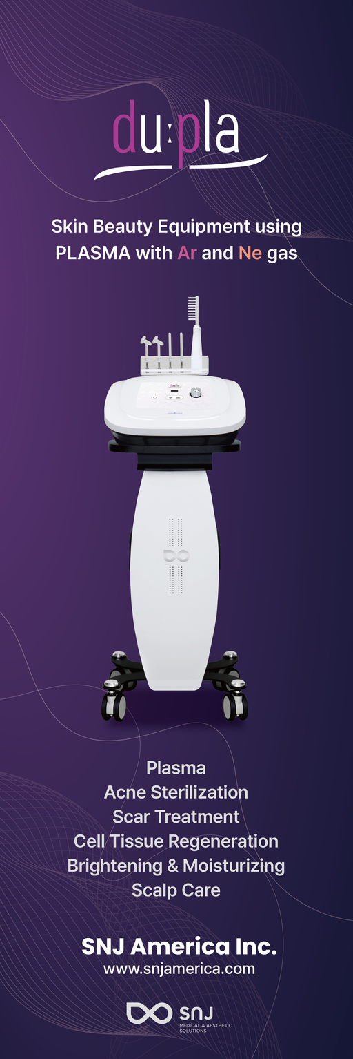
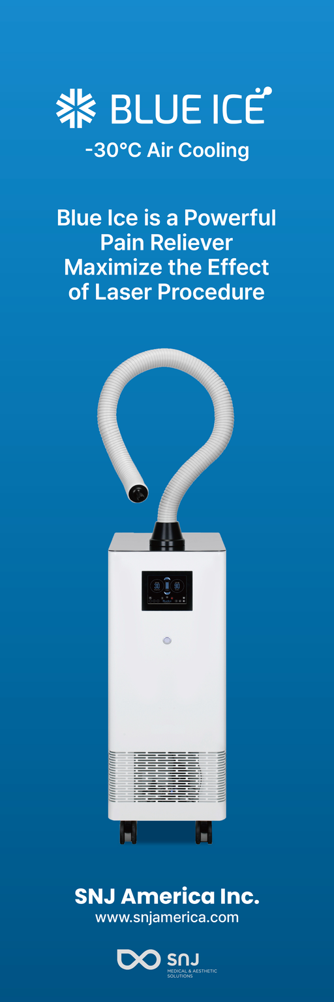
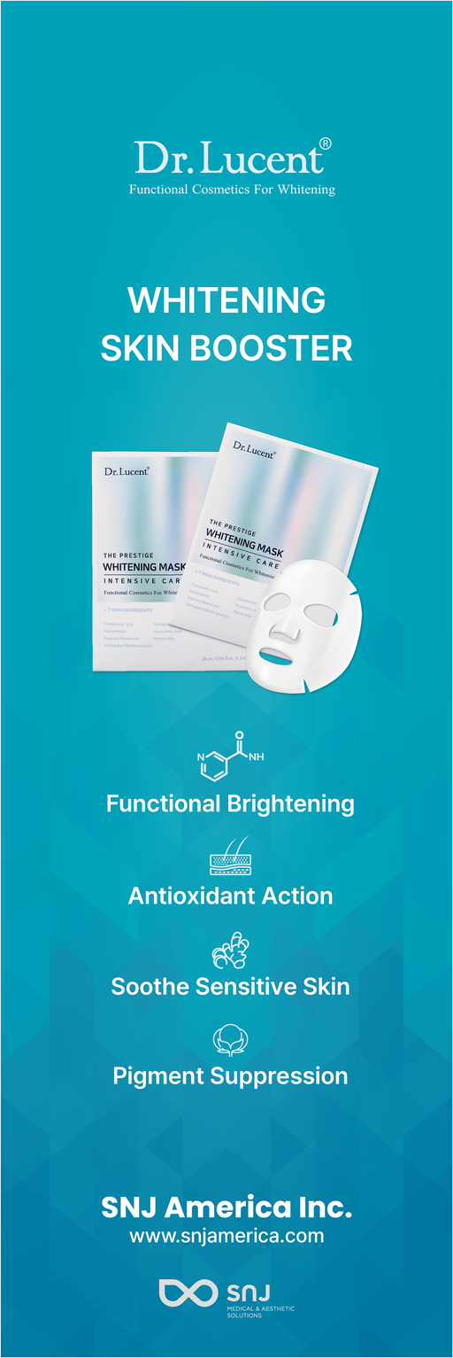
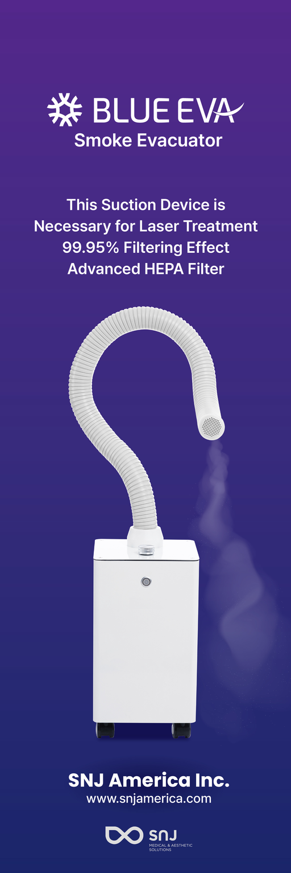
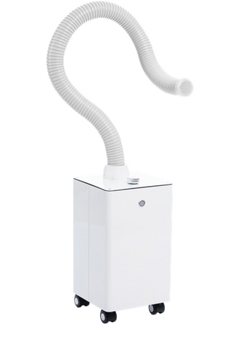
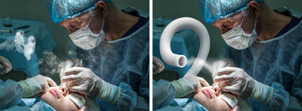
SNJ is here for ‘Healthier Life and Better Tomorrow’
We will make healthier life and better tomorrow with our medical and aesthetic solutions
SNJ is here for ‘Healthier Life and Better Tomorrow’
We will make healthier life and better tomorrow with our medical and aesthetic solutions
Medical & Aestethic Solution SNJ
Smoke Evacuator
PRO
•
Small and simple device to protect the operators and patients from hazardous smoke generated during laser use and energy-based device operation
•
Two options offering the Hepa filter by Blue Eva and Ulpa filter by Blue Eva Pro
•
Medical grade filtering system with a 99.95% filtering effect using the Blue Eva Hepa filter and 99.95% with the Blue Eva Ulpa filter
•
Makes the operating room look great and provides a clean and pleasant image to patients.
Indications
Specification
Evacuate the smoke produced by Energy-Based instruments : Plume, Aerosol, Smoke, Cautery Smoke, Diathermy Plume, Smoke
Blue Eva
Blue Eva Pro
Plume etc.
Filter type Filtering rate Size of Dust Dimention(Main unit) Weight
Hepa Filter 99.95% > 0.3µm 250(W) x 250(L) x 500(H)mm 12kg
Ulpa Filter 99.9995% > 0.1µm 300(W) x 300(L) x 800(H)mm 25kg
World-Wide Market is expected to see a 26% increase from 2020’ to 2025’ and the need for these systems has surged since the Covid pandemic
www.medicalsnj.com
11
www.medicalsnj.com
12

Slide 7
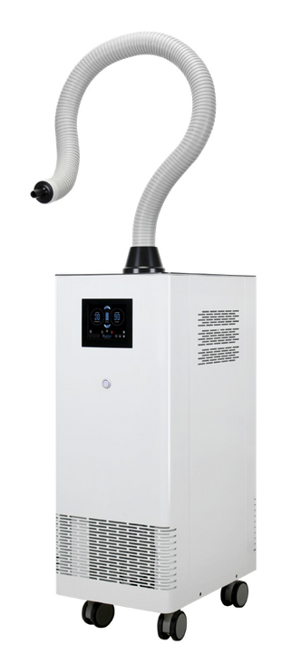
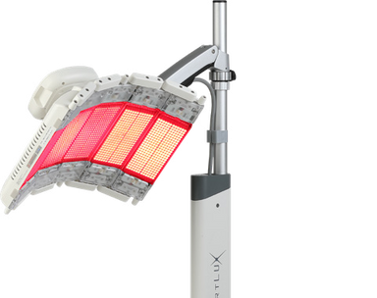

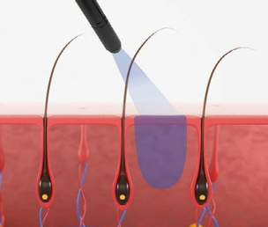
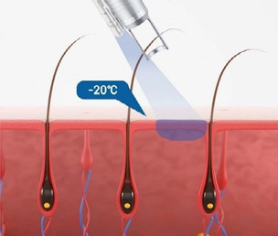
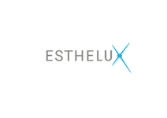
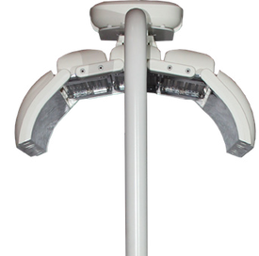
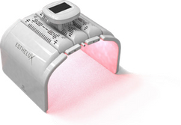
SNJ is here for ‘Healthier Life and Better Tomorrow’
We will make healthier life and better tomorrow with our medical and aesthetic solutions
SNJ is here for ‘Healthier Life and Better Tomorrow’
We will make healthier life and better tomorrow with our medical and aesthetic solutions
Medical & Aestethic Solution SNJ
Diode laser
Medical & Aestethic Solution SNJ
Super Luminous Diode Photo therapy device
•
Complete skin protection and pain reduction with a constant maximum of - 30ºC air cooling
•
Improve patient satisfaction by lowering pain and edema rate by combining it with numerous othe.r types of skin treatments.
•
Hands-free hose and no-consumable system for economical procedures.
•
Provides versatility with a universal adapter for all types of long-pulse lasers.
•
The 4,320 PCS SLD (Super Luminescent Diode), which has the highest output power in its class, offers optimal visible results
Output power(Max.)
Indications
Specification
Wavelength
Yellow (590nm) Red (635nm) IR (830nm) Blue (420nm)
Actual
21mW/㎠ 65mW/㎠ 28mW/㎠ 41mW/㎠
•
The PIH rate was lowered by shortening the natural skin recovery time Inflammation ->
•
Proliferation -> Remodeling
Protects skin from burning, reduces pain during laser and other energy-based treatments, lowers PIH rate, shortens recovery time, less injection pain
Blue Eva
•
Proven effectiveness with several SCI class clinical reports
Filter type Filtering rate Size of Dust Dimention
(Main unit)
Weight
Hepa Filter 99.95% > 0.3µm
No worries about secondary inflammation due to non-contact therapy
Blue Ice is the ideal system for cooling skin before, during, and after laser treatment as it goes down to -30℃
3 different types of Head Head 1 : Blue + Red + IR Head 2 : Yellow + Red + IR
250(W) x 250(L) x 500(H)mm
Head 3 : Blue + Red + Yellow
12kg
Blue Eva Pro
Filter type Filtering rate Size of Dust Dimention
(Main unit)
Weight
Ulpa Filter 99.9995% > 0.1µm
Output power(Max.)
The 1,296 PCS SLD (Super Luminescent Diode), which has the highest output power in the esthetic care class, offers great effects along with a reasonable price
Wavelength
Yellow(590nm) IR(830nm) Blue(420nm)
Actual
18mW/㎠ 25.8mW/㎠ 16.9mW/㎠
300(W) x 300(L) x 800(H)mm
25kg
DCD Cooling
Blue Ice Air Cooling
www.medicalsnj.com
13
www.medicalsnj.com
14

Slide 8
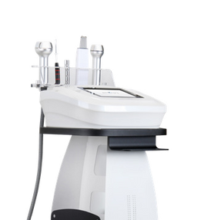
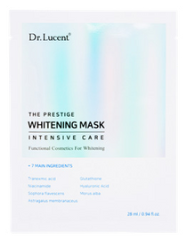



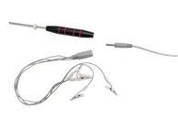
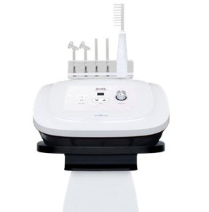
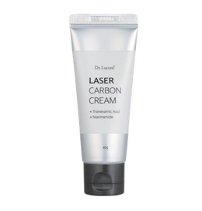




SNJ is here for ‘Healthier Life and Better Tomorrow’
We will make healthier life and better tomorrow with our medical and aesthetic solutions
SNJ is here for ‘Healthier Life and Better Tomorrow’
We will make healthier life and better tomorrow with our medical and aesthetic solutions
Medical & Aestethic Solution SNJ
Post care
Medical & Aestethic Solution SNJ
Dr.Lucent series
Tranexamic Acid
Mask Pack
AFTER CO2 Laser
– Prevent PIH, Intensive whitening effect
AFTER Nd : Yag Laser
– Enhances of Q-switched, PICO laser effect for melisma
•
7 functions in one device: Ultrasound (1MHZ), Heating (Max. 45°) + Electroporation, Cryo (Max.-10°) + Electroporation, Iontophoresis clip, Scrubber
5 different hand pieces
An invaluable item for SKIN Balance after laser care
•
Complete skin care after laser for the prevention of skin barrier collapse or skin changes to sensitivity and dryness
Iontophoresis Tweezer
1st step
2nd step
3’rd step
•
Apply Dr. Lucent skin booster and rub with
Apply Dr. Lucent mask pack on the face and use
Recommend to use it every day for 2 weeks
Completely digitalized device for convenience
Ultrasound 1MHZ
the este7 ionzyme function
after laser care
Effect
Effect
Effect
This prevents skin barrier collapse and changes due to sensitive skin and dryness after laser care.
This ionizes the skin booster solution and physically
This guarantees superior brightening and skin
Scrubber
Ultrasound
Electroporation + Cryo + Heating
Ionzyme clips
pushes it into the deep dermal layer.
whitening results.
This offers safe and effective peeling and toning effects through the use of special ingredients. Enhance satisfaction further with Dr. Lucent Carbon cream, effective and safe for both patients and operators.
•
Plasma with Argon for lower inflammation and better sterilization and bacterial elimination.
4 different hand pieces
With
Without
•
Plasma with Neon for skin regeneration and cell activation promoting skin rejuvenation
•
Du: Pla care - Acne care - Scalp care
- Whitening & Moisturizing
Tranexamic Acid
Melanin Inhibitor
Niacinamide
Functional Brightening
Parabens
Oil
Ne
Ar
Ne
Ne
www.medicalsnj.com
15
www.medicalsnj.com
16

