Slide 1
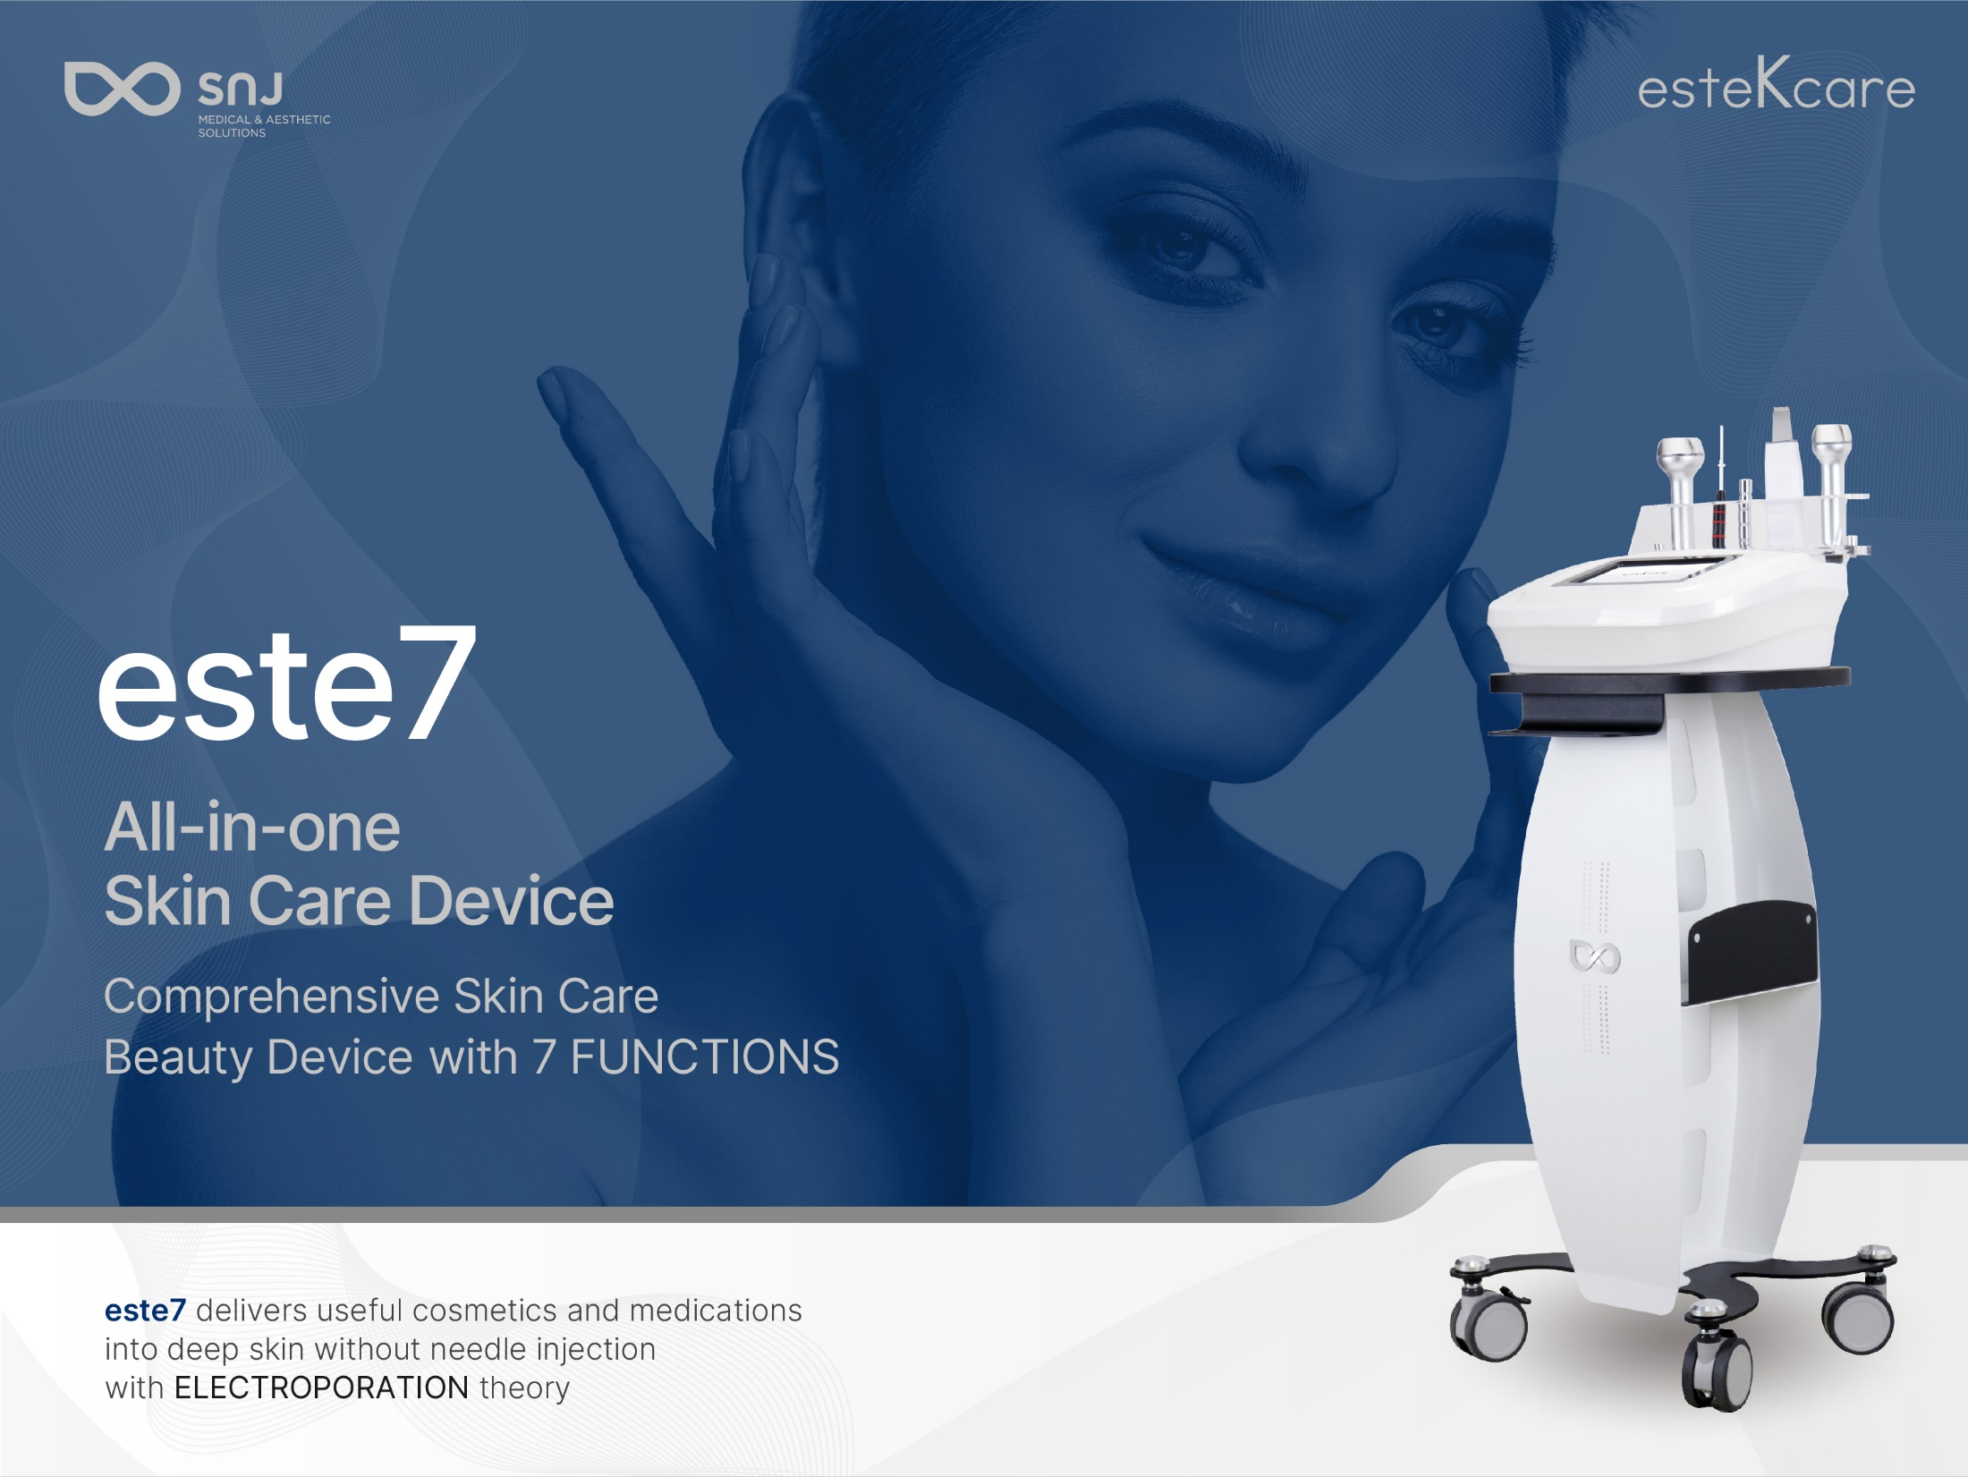
Issue date: Aug. 20, 2021

Slide 2
Digitalized ion polarity of active electrode converting function
Push the + and - ionized product into dermis by just pressing “+, - “ ion button
+ ion button: Push the + Ionized into the dermis
- Ion button: Push the - Ionized product like Vitamin C into the dermis
The active electrodes from most of others are fixed with negative current or to change polarity, user should change the connecting port. Este6 is digitalize the polarity converting function therefore users able to simply convert polarity and effectively increase product penetration rate according to applied product.

Slide 3
How do cosmetics move and are penetrated into the dermis?
When you apply positive charged cosmetics to the face, they move toward to the opposite charged electrode flow through deep dermis, and majority of them is penetrated in dermis during this procedure.

Slide 4
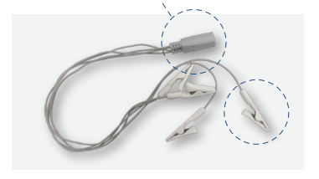
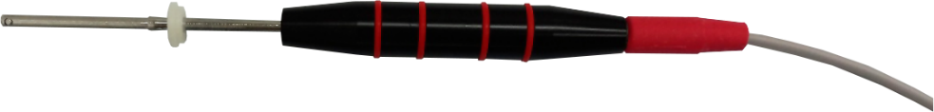
Iontophoresis, Ionzyme
Iontophoresis - Tweezer type
Ionzyme - Clip type
Vitamin C

Slide 5
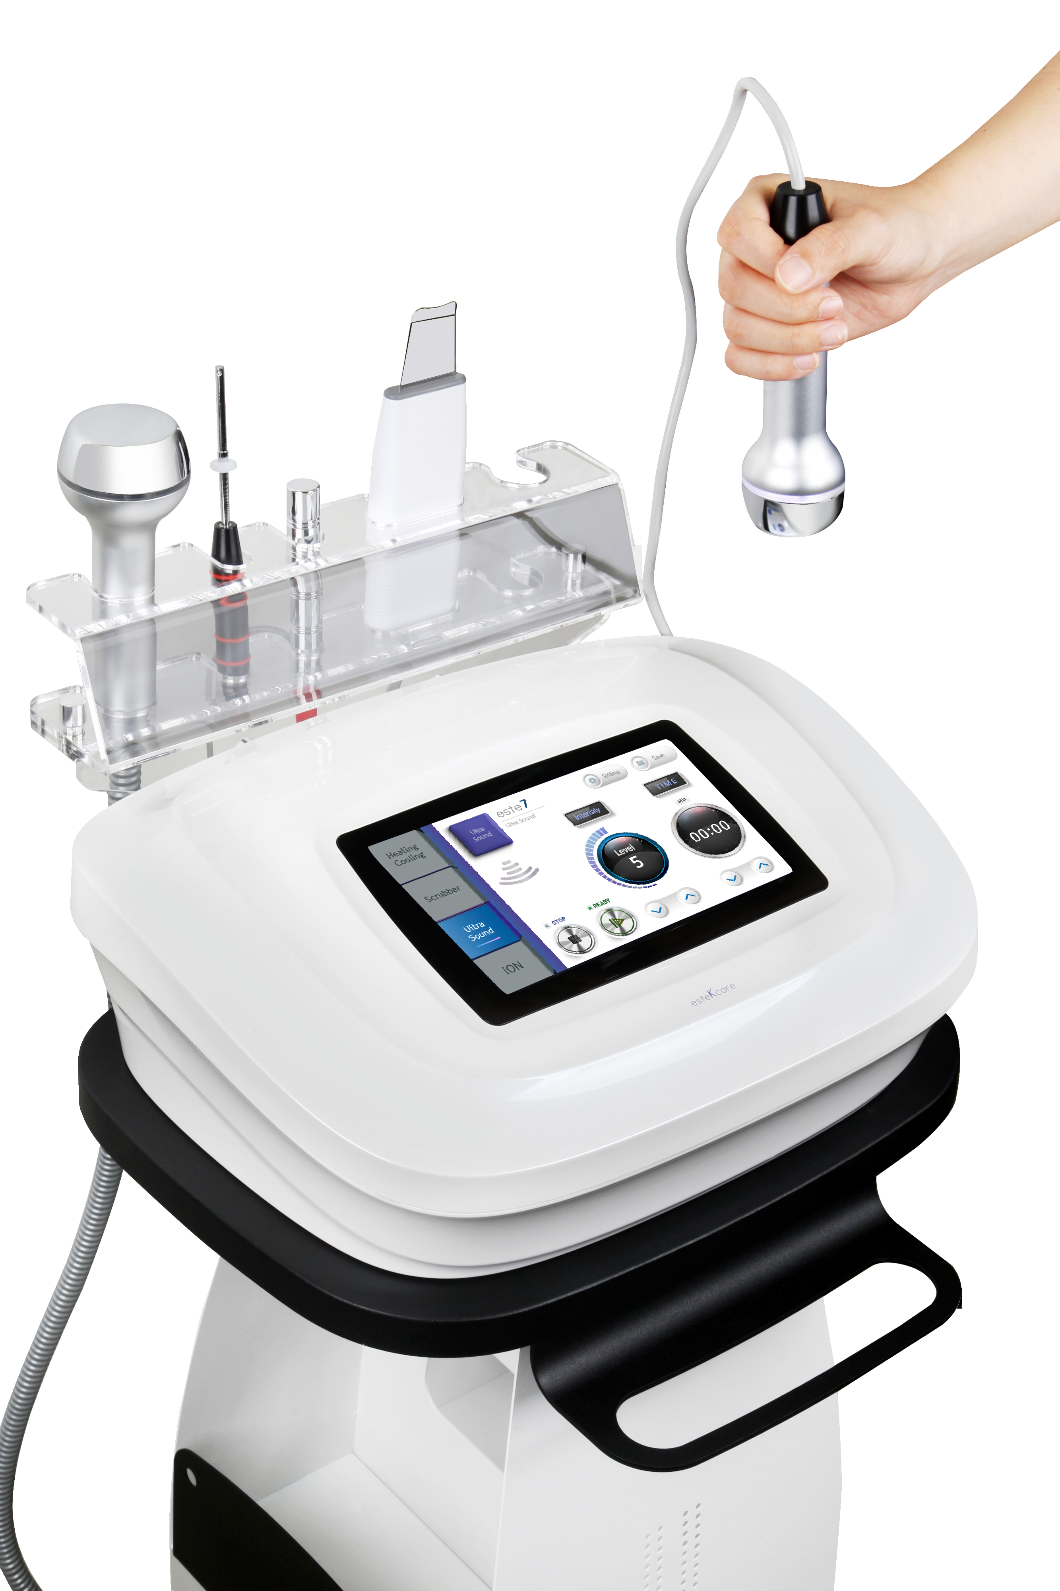
Applications
7 cares in 1 device present Variety usages
01 Deliver effective solutions into deep dermis
02 Skin sedation after IPL, lasers, MTS any painful care
03.Skin tightening and TDDS(products absorption) simultaneously
04.Achieve Synergy effect followed by toning

Slide 6
Complete Basic skin care
Full Skin care
Variety Program with other medical esthetic skin cares
Step 1. Heating
Skin regeneration Program
Ultrasound + Q-Switched, Long Pulsed Nd:Yag (MLA, Genesis) + Cryo
Step 2. Scrubber
Step 3. Ultrasound
Step 4.Cryo+Electroporation
Whitening Program
Q-Switched Nd:Yag(Toning) + Cryo
+ Iontophoresis with Vitamin C
+ Ionzyme with Mask Pack
Step 5.Iontophoresis
Step 6.Ionzyme

Slide 7
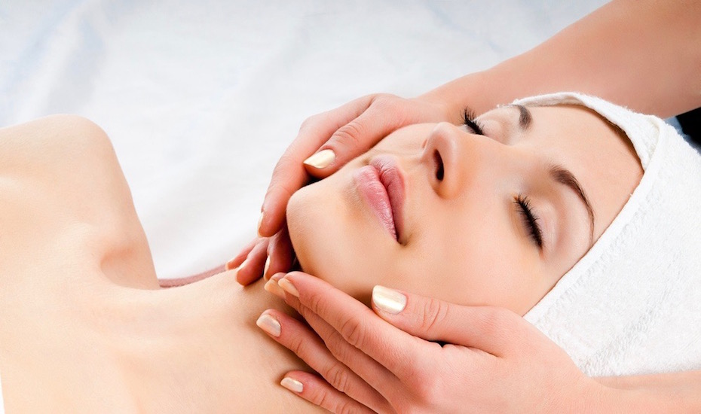
Este7 Benefits
Inner dryness, Bad dryness can be solves with Moisture
Comfortable Total Care without pain
Helps to regenerate skin by penetrating vitamin C deep dermis
* Vitamin C functions in skin: Inhibition of pigmentation, skin cells activation, whitening, regeneration of acne scars etc.

Slide 8
Present 3 ways of TDDS for
the utmost TDDS effect
TDDS (Trans Dermal Drug Delivery system) | Mechanism
Iontophoresis (Available) | Increases the skin absorption rate of ionic drugs by changing the electrical environment of the skin by giving the electric potential difference of the skin
Sonophoresis (Available) | A method of making drugs penetrate the skin through the biological membrane using ultrasound
Electroporation (Available) | Drug Delivery using high voltage
Tape stripping | Removing epidermis using physical method
MTS or AMTS | Micro needling therapy by making a lot of micro hole in the skin

Slide 9
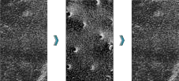



Electroporation MECHANISM
Electroporation
Electric Microscope
Hypothetical Bilayer Poration Model
.
1.Normal
2.Electroporation
3.Recovery
Pore μs-s duration
μs-s duration
Electrical pulses repeatedly create and close pores in the cell membrane in a short time.

Slide 10
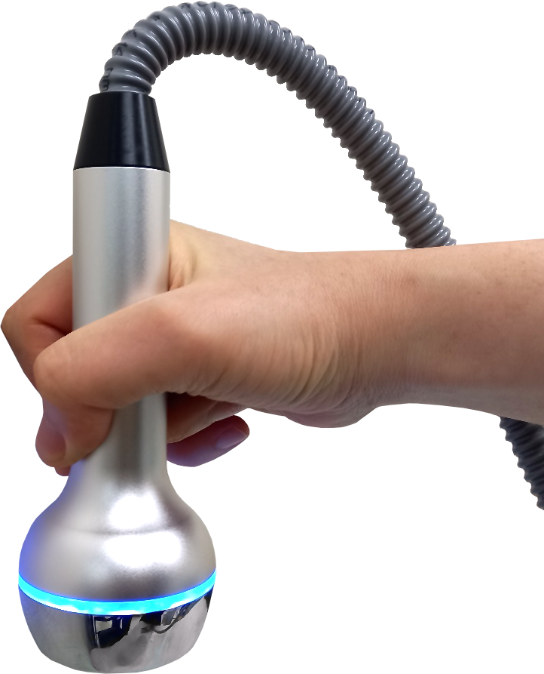
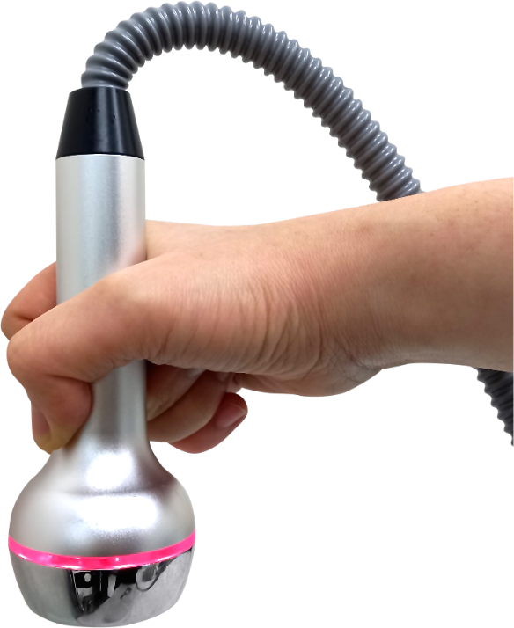
Professional Cryo & Heating care
Max: +45°
Max: -10°
Cryo
Heating
* Relax tighten face muscle – Massage effect
*Open the pores to maximize the TDDS effect in the following steps
* Sedation
* Skin firming effect
* Recommended to use with electroporation to reduce electroporation stimulation feeling and increase time efficiency

Slide 11
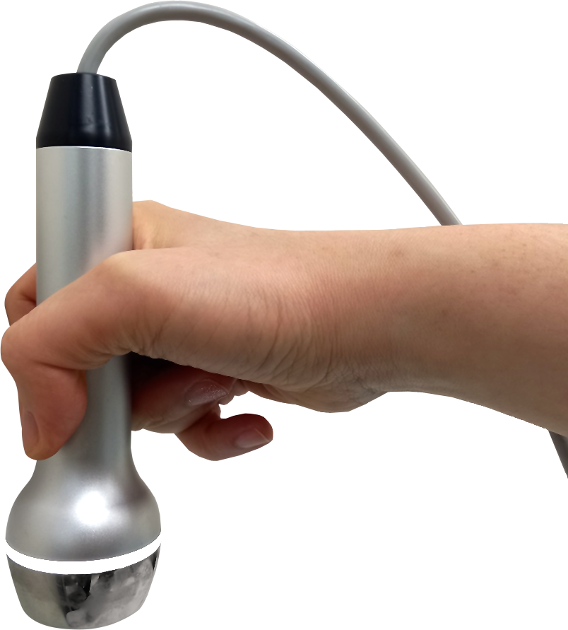
Strong & Professional Ultrasound Care
1MHZ
* Sonophoresis
Accelerate the delivery of nutrients through the skin with micro vibrations generated by ultrasonic waves
* Skin soothing and elasticity improvement with ultrasonic massage

Slide 12
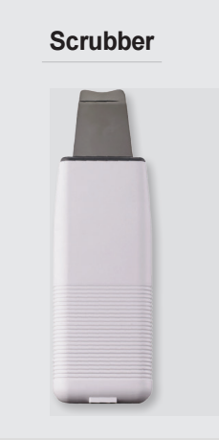
SKIN Scrubber
Accelerate your cellular turnover and keep fresh new skin cells flourishing to the surface
25KHZ – 25,000 times vibration per second
Mode A : Cleansing
Mode B : Sonophoresis
Mode C : Lifting

Slide 13
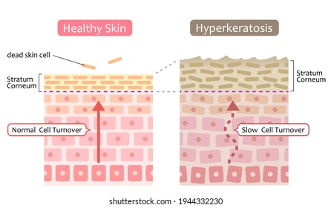
As we grow older, this skin cycle slows
age of 19-21the process can take 14-21 days
20’s and 30’s: 28 -45 days
40’s and 50’s: 45-60 days
50’s and 60’s: 60 – 90 days
Dead cells accumulate on the surface of skin causing sagging and fine lines and wrinkles. Bacteria can become trapped causing blemishes and breakouts. Discoloured and irregular cells can also become trapped causing spots and discolouration
Accelerate your cellular turnover and keep fresh new skin cells flourishing to the surface

