Slide 1

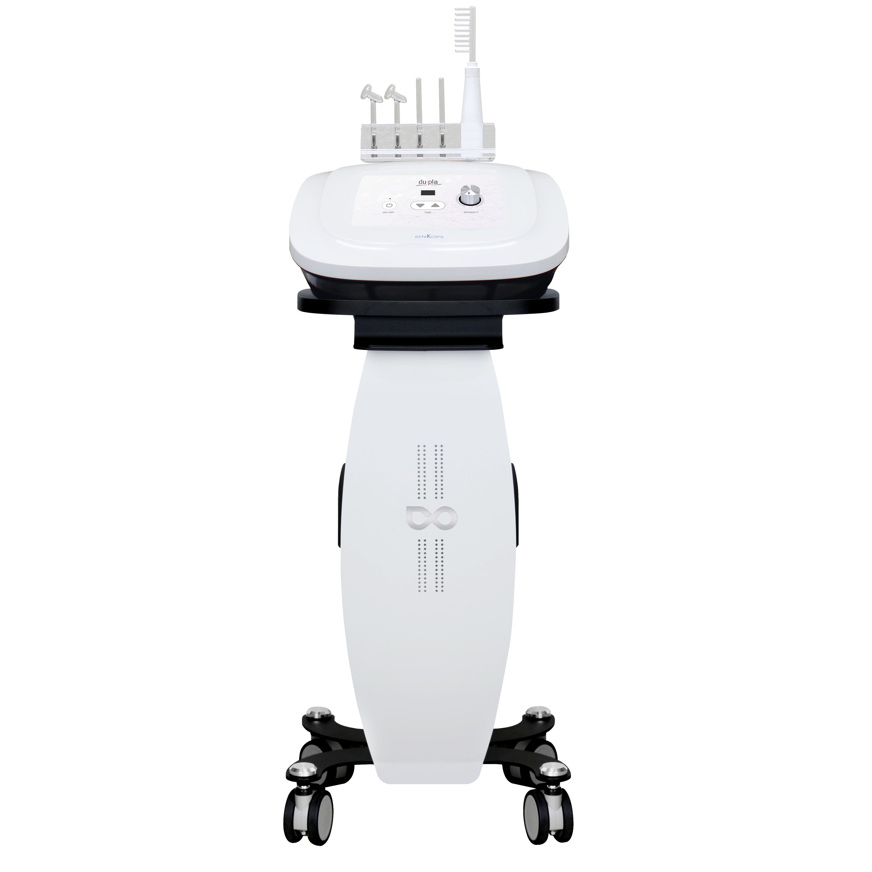


Du:pla [Platoning]

Slide 2

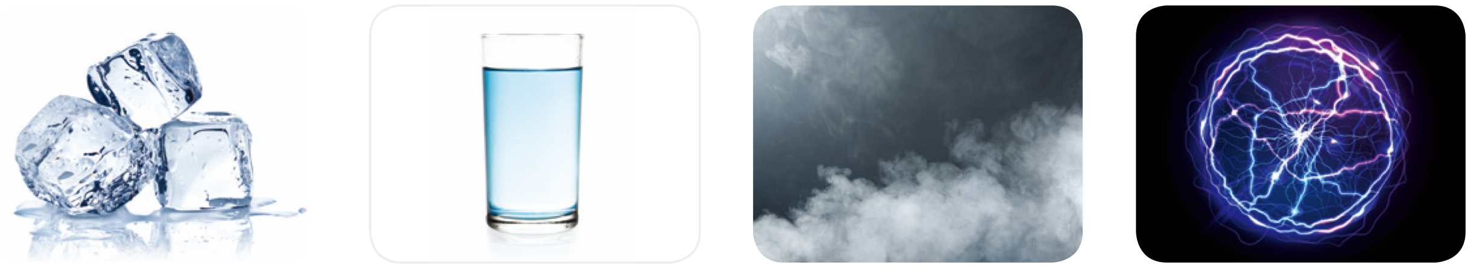
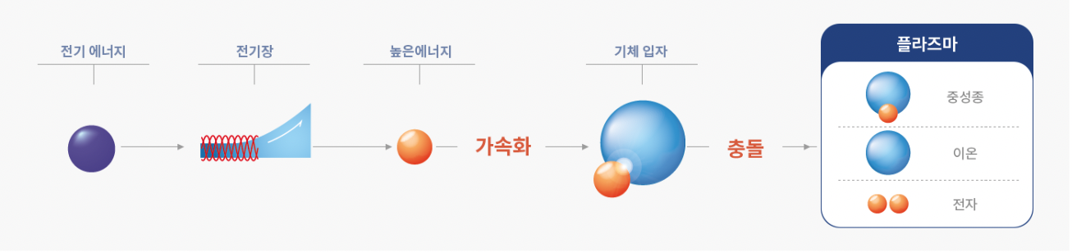
Plasma technology introduction
Plasma is the fourth material after solid, liquid, and gas, and is in a state of being divided into ions and electrons due to strong electric force.
In order to generate plasma, energy of about 100,000°C must be applied to the gas particles.
Electrons accelerated by receiving electrical energy collide with gas particles to create plasma in the form of neutrons, ions, and electrons.
electrical energy
electrical field
high energy
gas particles
Plasma
neuter
Accelerate
crash
ion
former

Slide 3
What is Plasma?
PLASMA IS 4TH STATE OF MATTER
Solid
Liquid
Gas
Plasma

Slide 4
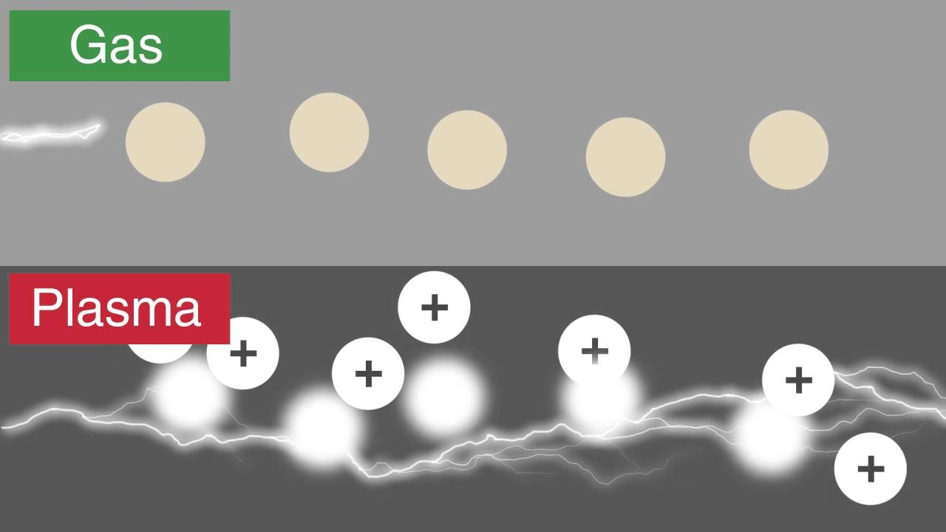
Features of Plasma
High Electric Conductivity
Plasma is conductive gas
Plasma is ionized gas

Slide 5
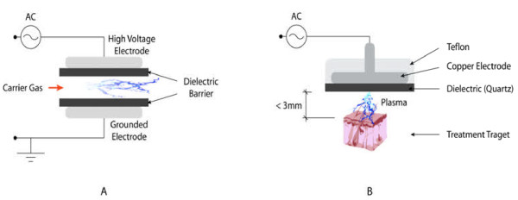
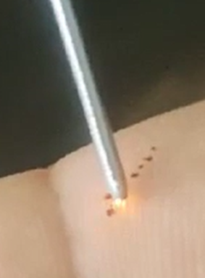
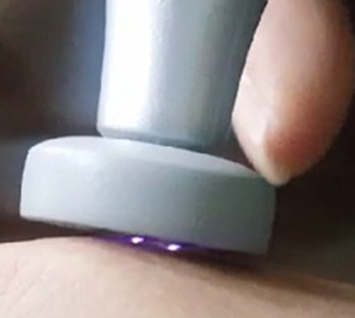
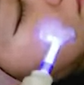
Atmospheric-Pressure Plasma
Dielectric Barrier Discharge
(DBD)
Floating Electrode Dielectric Barrier Discharge
(FE-DBD)

Slide 6
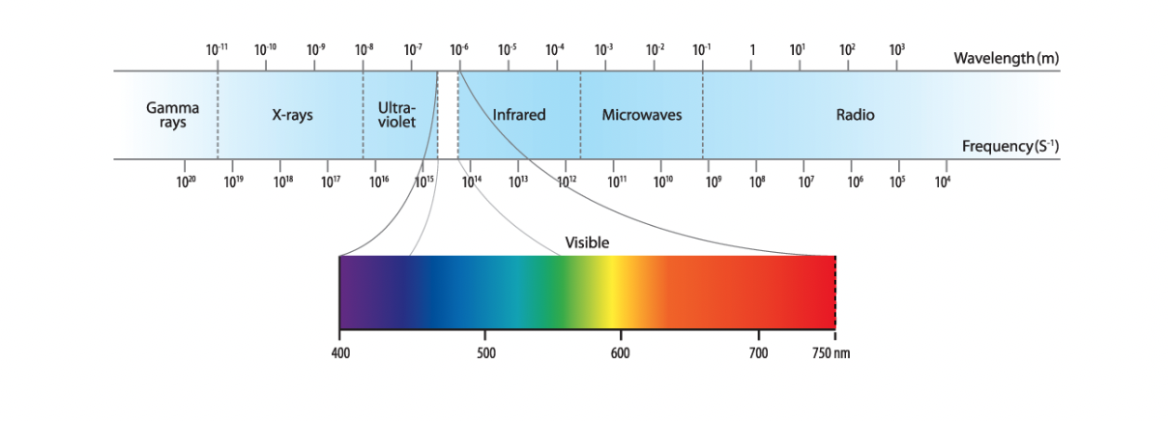
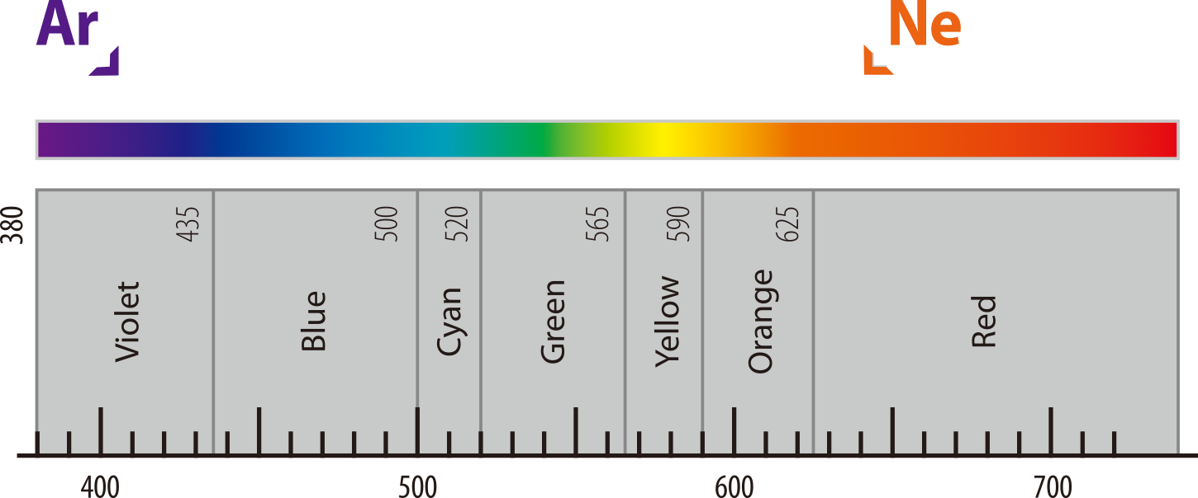
Plasma in the medical field
Wavelengths generated when generating plasma vary from ultraviolet to visible light.
By using this to vary the wavelength band of the discharge tube that generates plasma, effects such as sterilization, anti-inflammatory
action, or promoting blood circulation can be applied depending on the indication.
Ar
Ne
The glass vacuum tube containing Ar has a purple color and sterilizes the skin by activating the sterilization and absorption function of the skin to relieve acne or inflammation.
The vacuum tube containing Ne is orange in color, and it promotes blood circulation and activates the metabolism to regenerate the skin and help the discharge of waste products.
Wavelength in nanometers

Slide 7
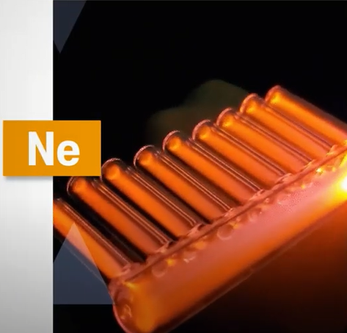
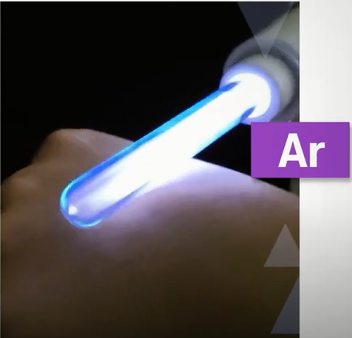

Slide 8
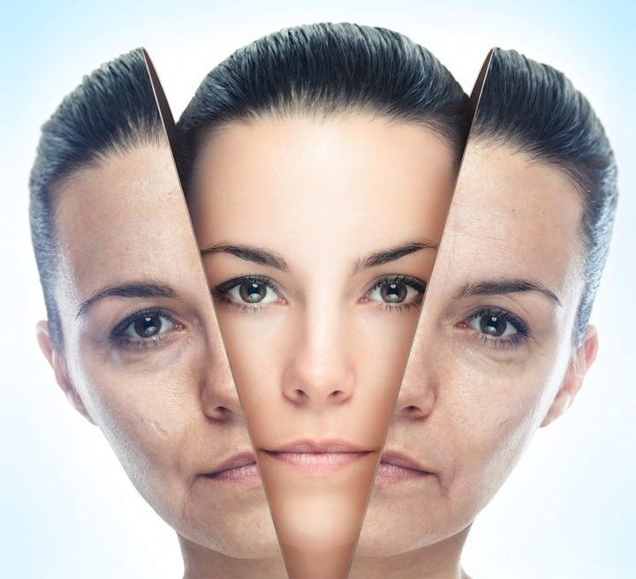
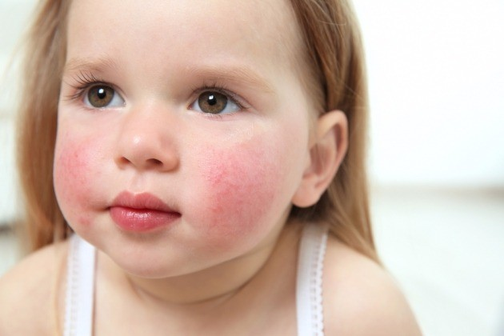
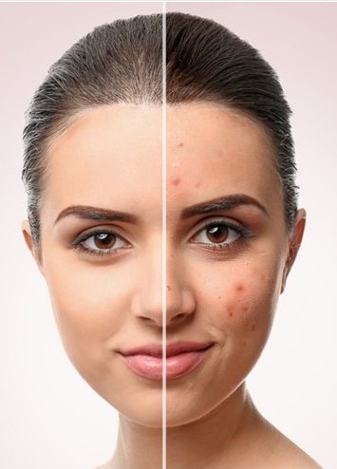
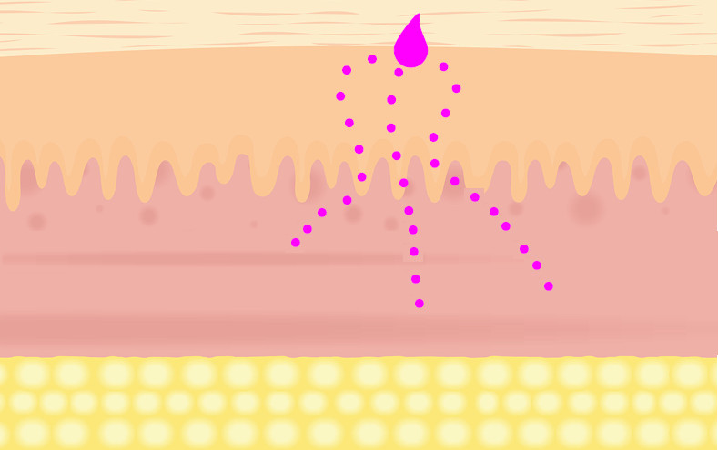
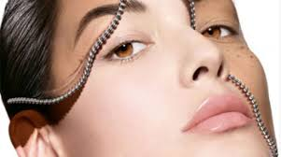

PLASMA FUNCTIONS IN BEAUTY
SKIN REJUVENATION
ATOPIC DERMATITIS
ACNE
TDDS
SKIN WHITENING
Hair Loss

Slide 9
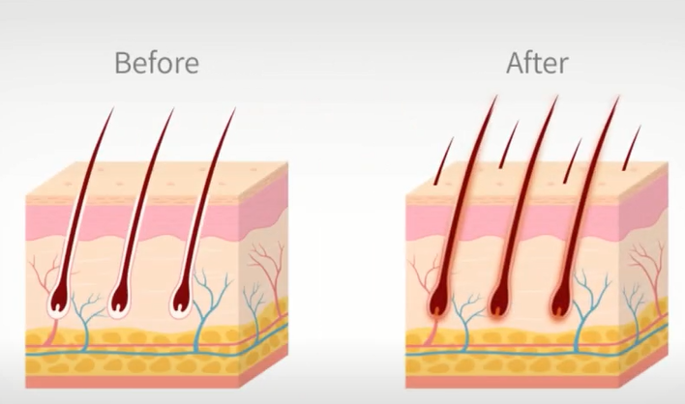

Slide 10
How Plasma works for Hair Loss care
Sterilize hair scalp by killing bacteria to keep scalp as clean condition
Plasma compose new blood vessel and proliferate follicle cell so it activate generating new hair follicle
Hair restoration product and medicine penetration rate is highly increased
Kill mold, super bacteria what causes of trouble
in scalp so it cure seborrheic scalp infection, fungal scalp infection and folliculitis

Slide 11
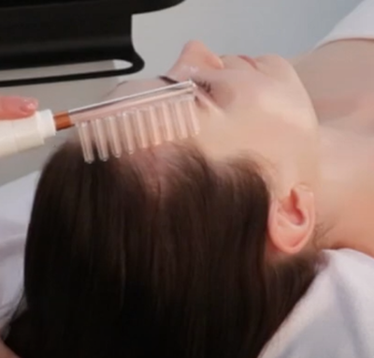

Slide 12
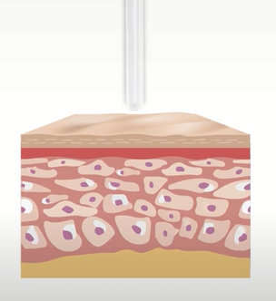
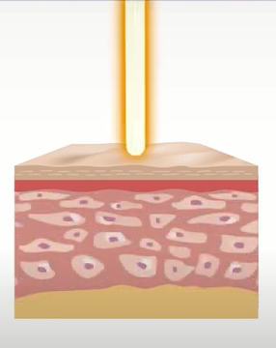
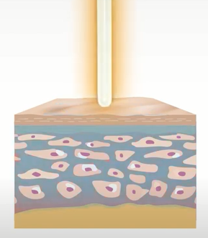
Plasma TDDS(Transdermal Drug Delivery System)

Slide 13
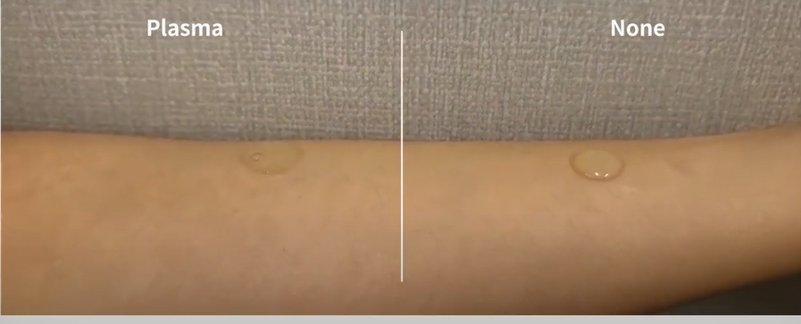

Slide 14
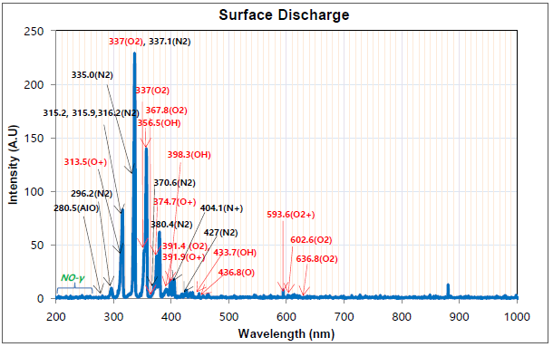
Effects according to the plasma spectrum
In general, the main generation mechanism of OH radical is generated by the action of electrons generated by plasma, excited oxygen atoms, and nitrogen molecules with water vapor in the atmosphere.
OH radical is involved in the sterilization and disinfection of almost all contaminants, and it is a natural substance that is harmless to the human body while producing the strongest effect that can be chemically decomposed and removed. It is more powerful than ozone (O3) and chlorine (CI2), but it is not toxic or harmful to the human body like fluorine (F) and ozone.

Slide 15
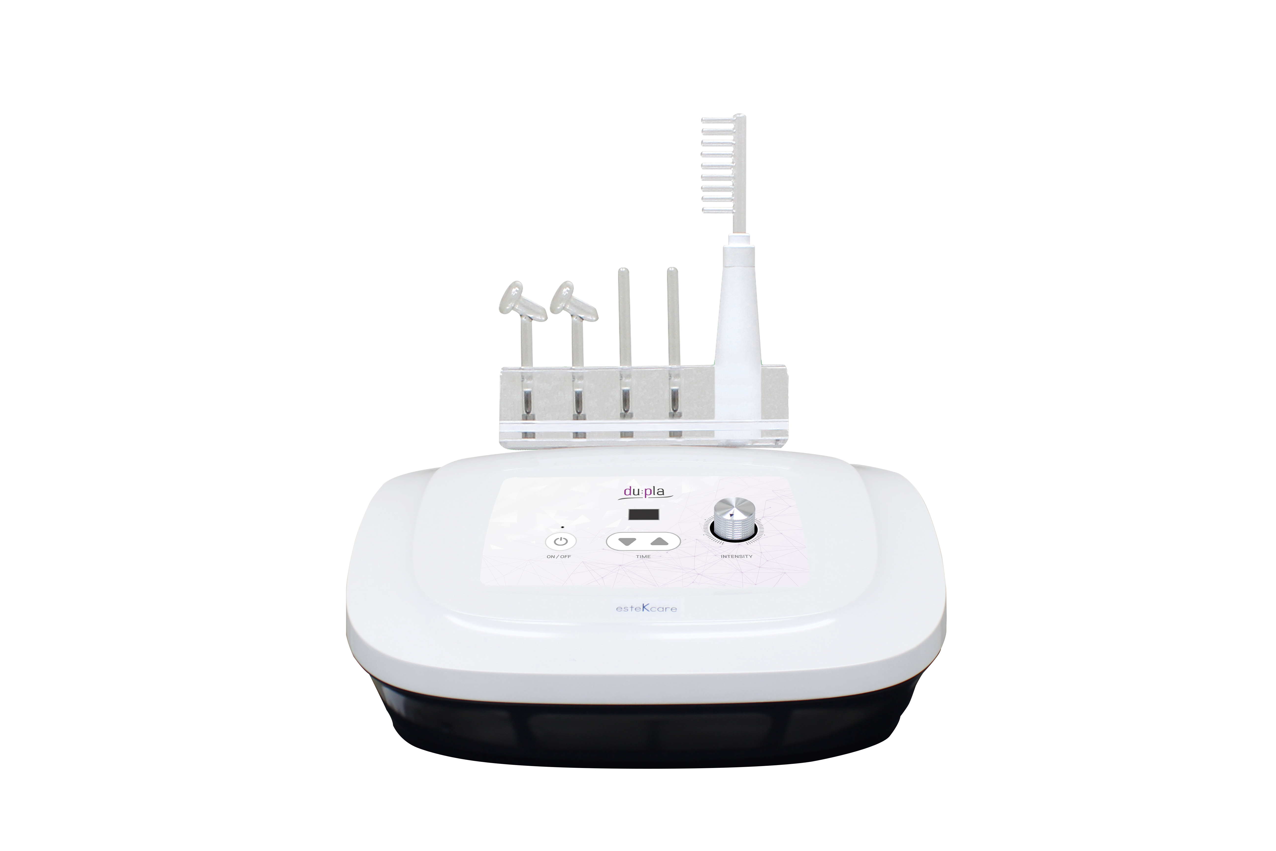
Product Effects
Sterilization, inflammation relief
Skin trouble improvement
whitening, moisturizing
Elasticity and wrinkle improvement
Scalp & Hair Care
Activation of metabolism,
blood vessels and lymph circulation

Slide 16
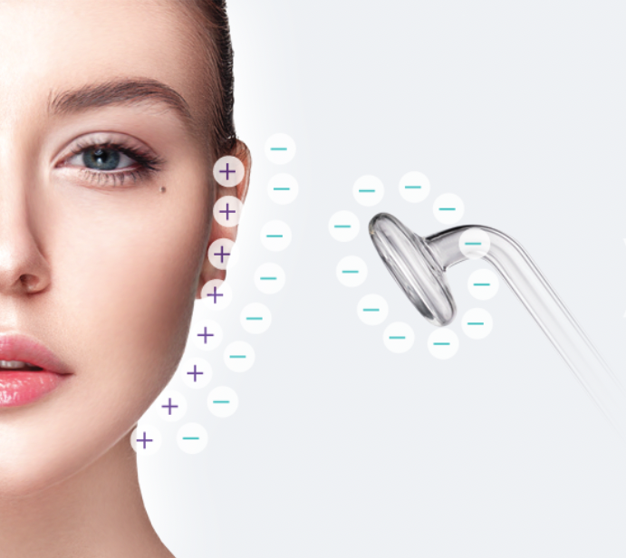
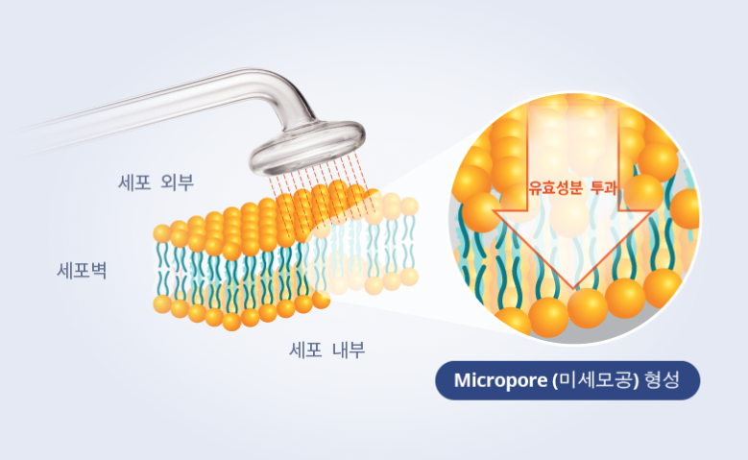
Absorbency Enhancement
outside cell
Active
ingredient
penetration
cell wall
inside cell
Micropore formation
Plasma temporarily creates a passage to the skin surface to increase the material permeability of cell membranes and maximizes the absorption and effectiveness of products applied to the skin without
pain or side effects.

Slide 17
VARIOUS INDICATIONS FOR SKIN REJUEVENATION
Large Pore size reducing
Skin texture smoothening
Acne scar, Striae releasing
Whole face and body tightening
Skin laxity improving

Slide 18
du:pla Advantages
easy maintenance | You can use it conveniently by replacing the electrode only when the plasma weakens after 6 months to 1 year of use without the hassle of periodically replacing the gas cylinder.
non-invasive treatment | It is non-invasive and does not leave marks on the skin surface because the lamp is used by lightly touching the skin surface.
Scalp care | It can be conveniently applied to scalp care by using a comb-shaped NE gas vacuum tube.
acne care | When applied to inflammatory skin care procedures such as acne, it has a quick effect by sterilizing, alleviating inflammation, and promoting skin regeneration.
whitening moisturizing care | Microchannels temporarily created by the plasma principle increase material permeability so that active ingredients such as vitamins can penetrate deep into the skin.

Slide 19
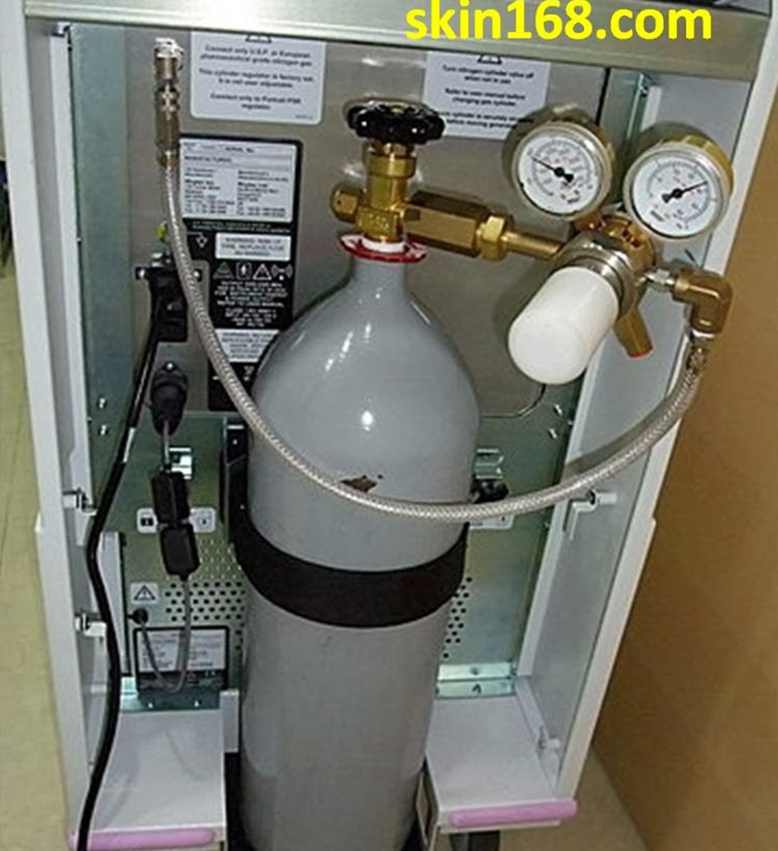
Benefits of Du:Pla
NO NEED GAS TANK
- Economical & Easy Maintenance

Slide 20
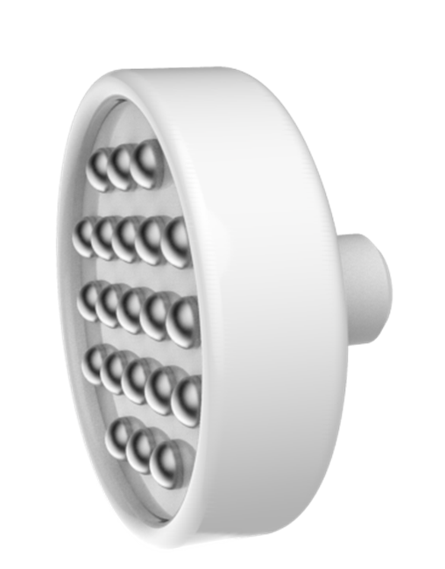
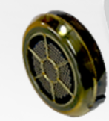
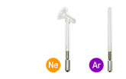
No consumable tips
Others: Until the coating is peeled off.
If it is used continually when the coating is off, energy is concentrated in that part so it will cause of burning.
Du:Pla: Gas is slowly consumed so it can be usable over 2 years depends on operating time.

Slide 21
du:pla treatment
acne sterilization
Extrusion – Dupla Sterilization – Scaling or PDT – Soothing Moisturizing Management
whitening, moisturizing
Cleansing – Vitamin C, ampoule application – Dupla regeneration
scalp care
Cleansing – Dupla sterilization – Scalp treatment application – Dupla regeneration

Slide 22
du:pla and Esthe7 treatment
Step 1) Scrubber
Step 2)여드름 압출
Step 3) Plasma Argon - 티트리 성분 화장품 도포
Step 4) Iontophoresis - 비타민 C 도포
Step 5) Ultrasound - 히알루론산
Step 6) Plasma Neon - PDRN 성분, 재생 앰플 도포
Step 7) Cryo + Electroporation - 재생 앰플 도포

Slide 23
clinical papers
SCI Class Paper : sterilization effect
Cold-air pressure (CAP) plasma has been proven in several studies to be an effective way to kill bacteria, fungi, and viruses, and does not develop
microbial resistance. A two-minute cold-pressure treatment with plasma is effective against a variety of bacteria, including important skin and wound
pathogens such as Escherichia coli, group A streptococci, methicillin-resistant Staphylococcus aureus (MRSA), and Pseudomonas aeruginosa.
It has also been shown in vitro that clinically relevant fungi can be eliminated with cold-pressure plasma.
01
source
Thoralf Bernhardt and 5 others, Plasma Medicine :
Applications of Cold Atmospheric PressurePlasma in Dermatology, Oxidative Medicine and Cellular Longevity, Volume
SCI Class Paper : Wound Healing & Tissue Regeneration
01
Plasma heals wounds and regenerates skin tissue in a safe and effective way without damaging tissues.
The nitric oxide (NO) produced by plasma plays an important role in healing wounds and creating skin tissue.
source
Gregory Fridmanand 5 others, Applied Plasma Medicine, Plasma Processes and Polymers,2008, 5
02
The bactericidal and skin tissue-generating effects of plasma have been shown to heal wounds. Several in vitro studies demonstrate that plasma not only forms blood vessels but also proliferates and migrates cells.
source
Thomas Von Woedtke and 4 others, Plasma Medicine : A Field of Applied Redox Biology, In Vivo 33: 1011-1026 (2019)

Slide 24
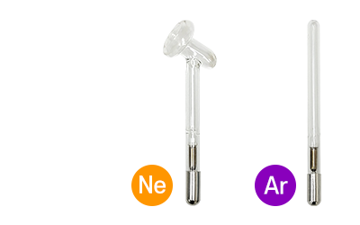
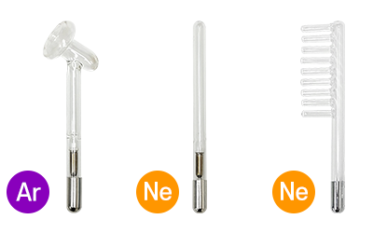
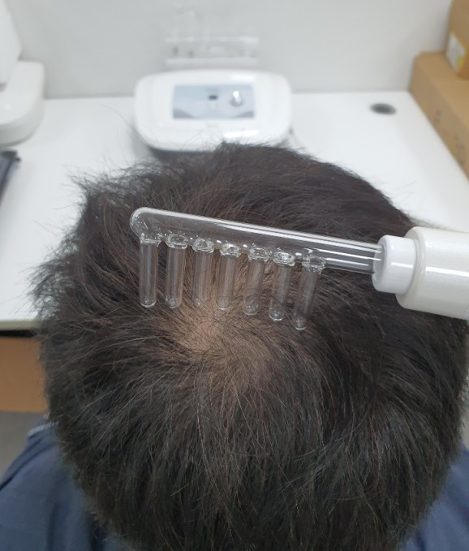
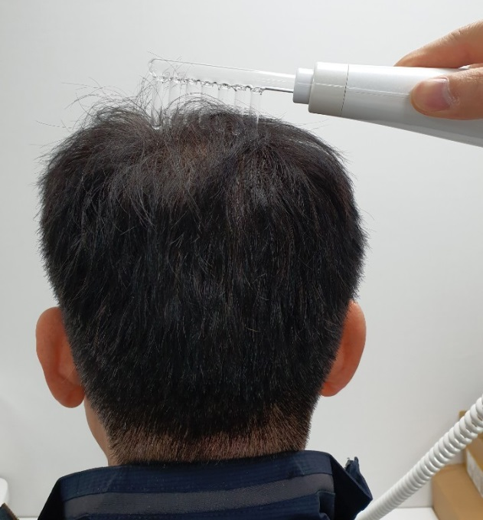
3 types of lamps
Depending on your skin type, you can choose from 3 types to use. Depending on the type of gas added to the lamp, the ionized color and effect are different.
Usage example
When using the scalp
Connect a comb-shaped vacuum tube and gently brush it against your scalp.
meridians, lymph circulation
Stimulate blood points with a vacuum tube of a narrow area, and rub the lymph nodes along the lymph nodes with a vacuum tube of a wide area

Slide 25
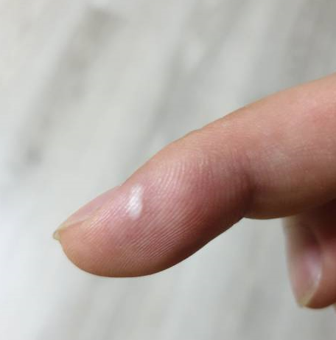
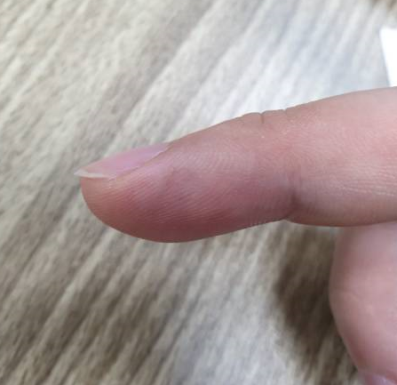
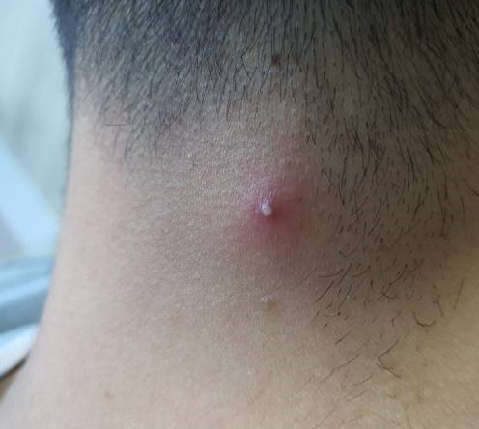
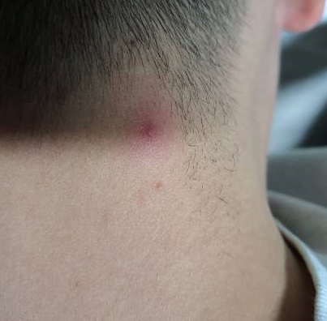
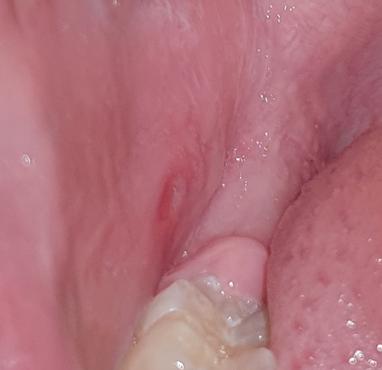
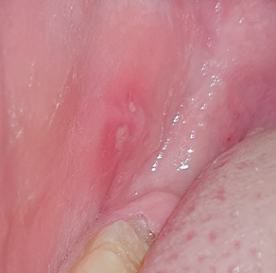
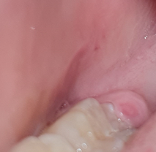
Plasma Expected Effects
Inflammation, acne, stomatitis
inflammation from burns
The next day after 1 treatment
of dupla
purulent acne
30 minutes after dupla 1 treatment
without extrusion
stomatitis
12 hours elapsed after one
treatment of dupla
30 hours elapsed after one
treatment of dupla

