Slide 1


Finebeam
Technical background
REV. 03 AUG. 21, 2023
Issue date: MAY. 29, 2022

Slide 2
Nd: neodymium
YAG: yttrium-aluminm-garnet
Q-switched: quality-switched

Slide 3
Q-switched
= nano second laser

Slide 4
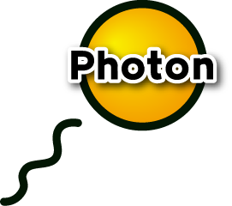
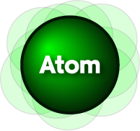

Laser mechanism
Pumping: The atoms or molecules absorb energy and floating.
When the applied energy is high enough, atoms emit photon
Atoms that have absorbed energy through pumping are floating.
Originally, it was related to the orbit of an electron, but for convenience, it was expressed as if an atom were floating.
Then, when the energy is enough to emit a photon (light), it emits all the energy and stops floating

Slide 5
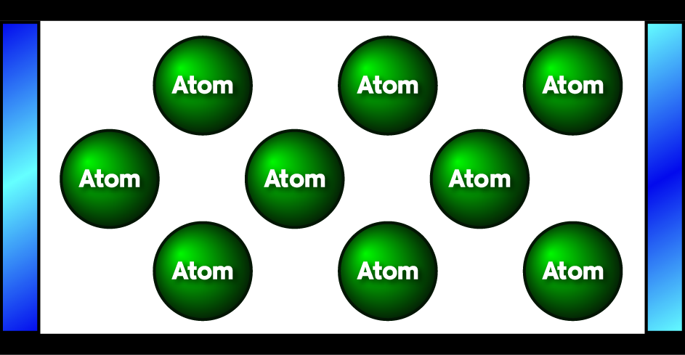
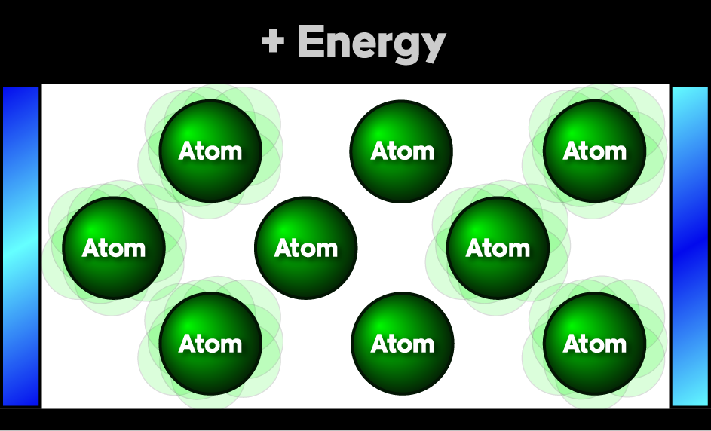
Fully
Reflective
Mirror
Partially
Reflective
Mirror
In the resonator, there are abundant number of atoms.
Pumping
: Not all atoms absorb energy.
Optic Resonator

Slide 6

Stimulated emission
: When the one photon pass the atom, the same photon is emitted from atom. The color, power and direction of photon are all same.

Slide 7
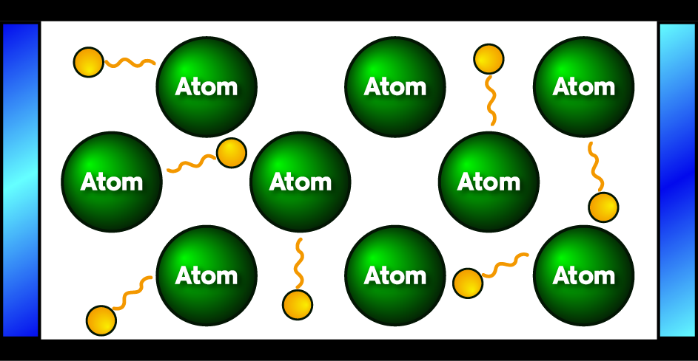
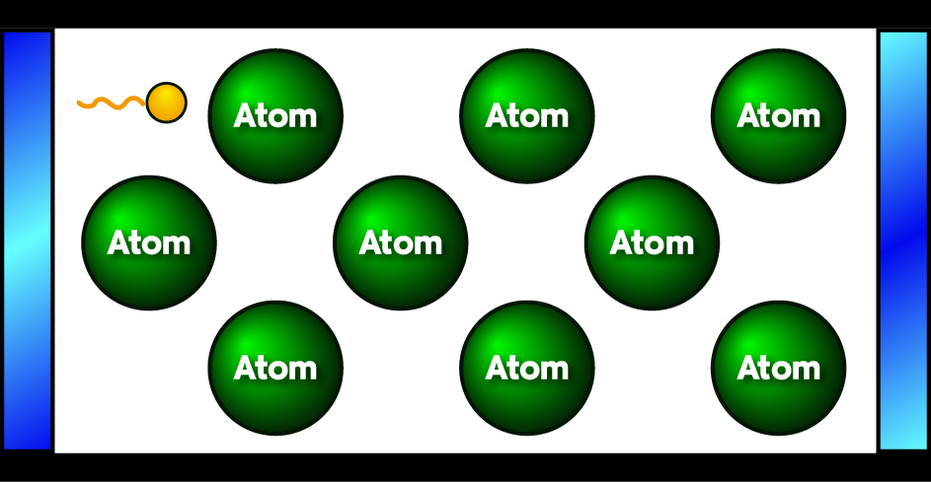
When the energy is rise, atoms emit photons. No one know that the photons moves to which direction. It is just random. As a result, photons go out randomly as beside.
However, over time, when photons collide with the surrounding wall, they are absorbed. That is, most of it is absorbed and disappears.
However, someday there will be photons that are parallel to this wall, that is, perpendicular to the mirror.
These photons are constantly going back and forth between the mirrors.
In the above case, only one photon survived.

Slide 8
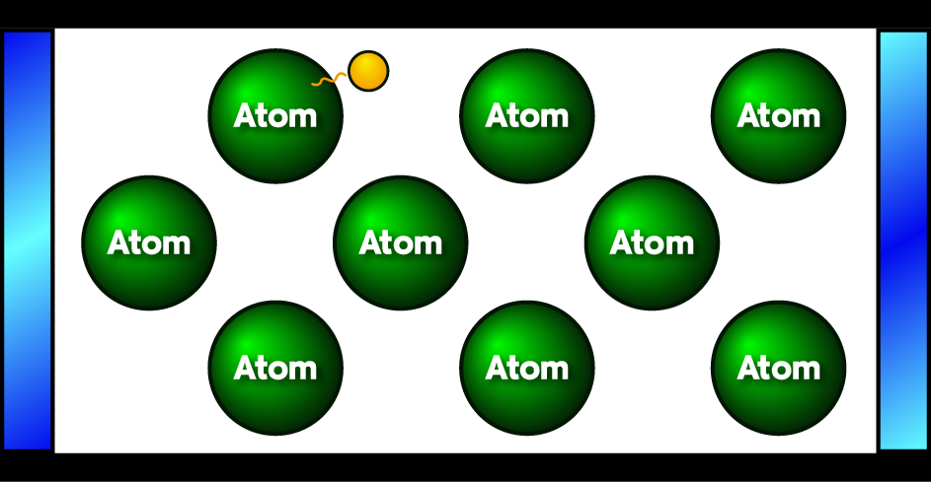
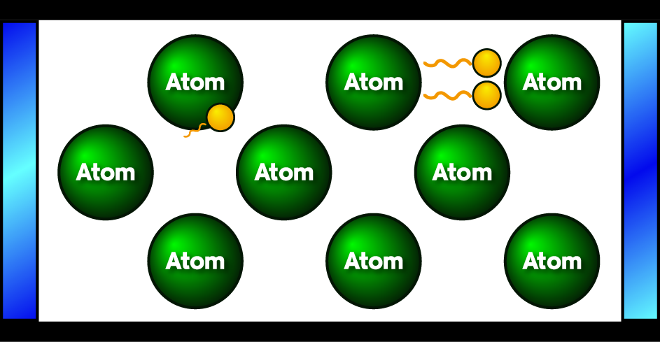
Pumping again
Here comes the stimulated emission.
When the only surviving photon, which had been spinning before, hits an atom with energy, another twin photon is emited. (Stimulated emission)
That is, there are two photons parallel to the wall.

Slide 9
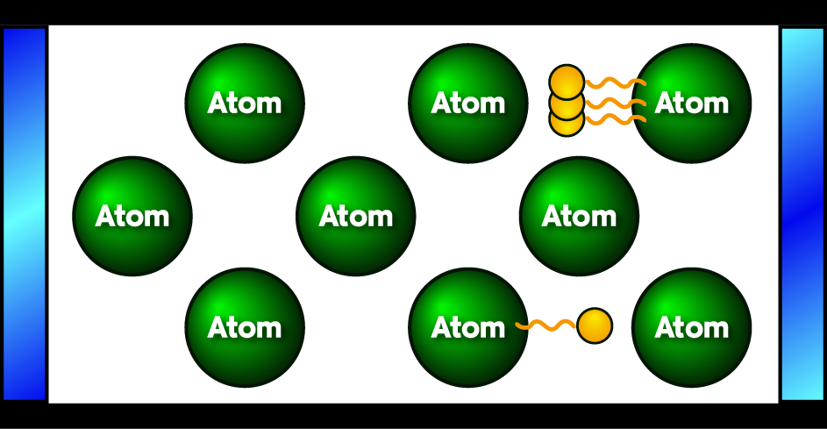
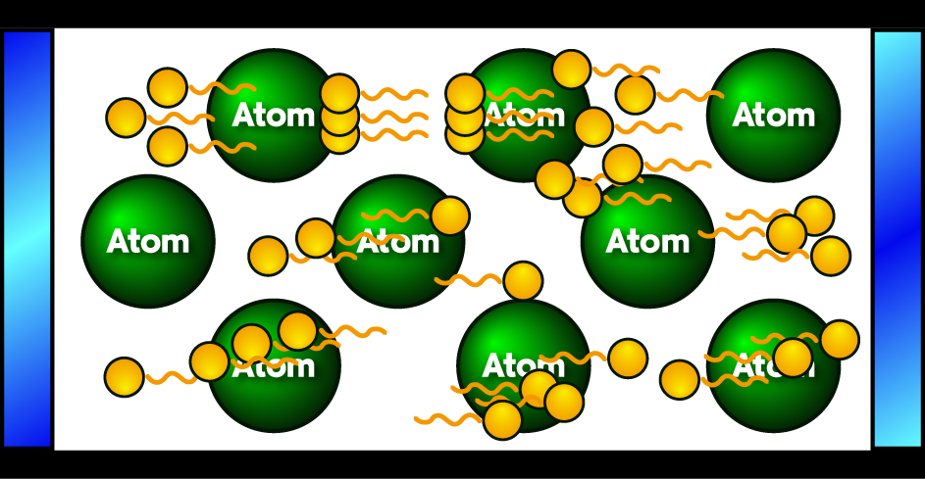
However, if these photons are not parallel to the wall, they will quickly hit the wall and disappear.
If this process is repeated, eventually the light parallel to the wall is amplified.
Things that aren't parallel keep hitting the wall and disappearing.
As a result, photons of the same color, direction, and wave appear.

Slide 10
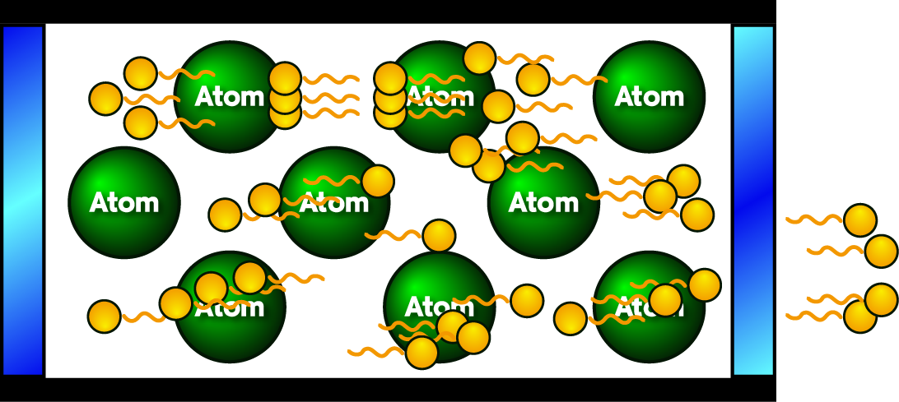
When these photons are stronger than a certain intensity, they break through the partially transparent mirror on the right.
Because they all look the same and travel in the same direction, this light has the same color and continues to travel in a straight line, a laser.
Electricity is used during the pumping process.

Slide 11
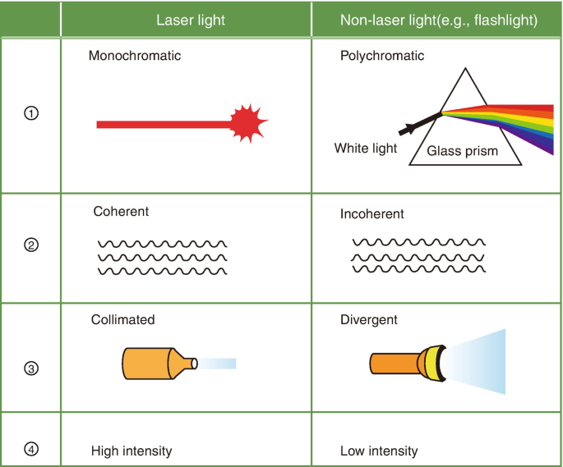
Character of Laser
Monochromacity (the same color)
Coherence (all of the light waves are in phase both spatially and temporally)
Collimation (all rays are parallel to each other and do not diverge significantly even over long distances)
High intensity

Slide 12
Population inversion
When the excited atoms q’ty in the high energy is more than atoms in ground, they drop to the ground and it generate energy.
1064NM
532NM

Slide 13
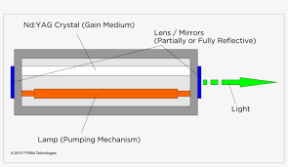
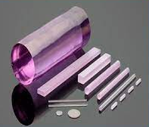
The main parts in the resonator
What is used for pumping?
Flash lamp is a pumping source.
Rod
– it is Nd:Yag(neodymium-doped yttrium aluminum garnet), it is solid laser. The wavelength 1064nm is decided by the medium.
Nd:Yag crystal(Gain medium)
ROD
Lamp(Pumping Mechanism)

Slide 14
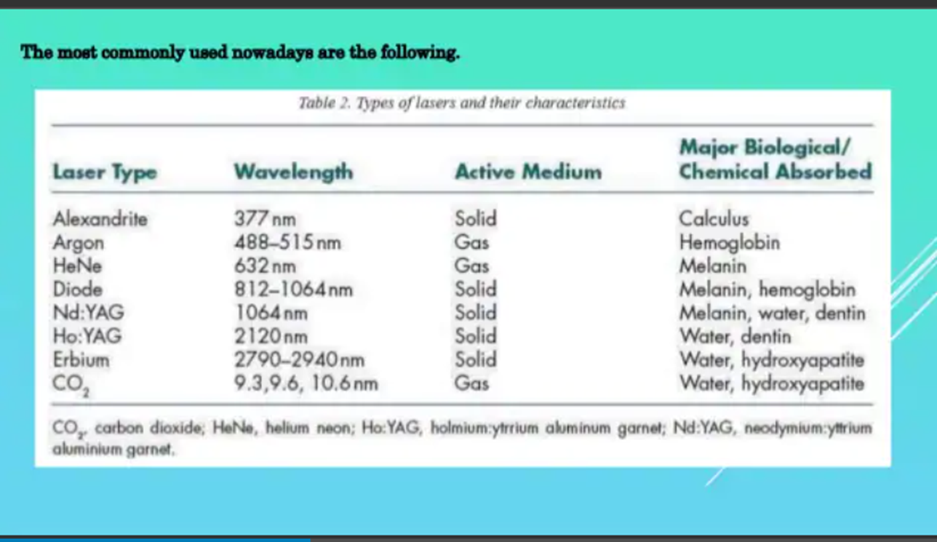

Slide 15
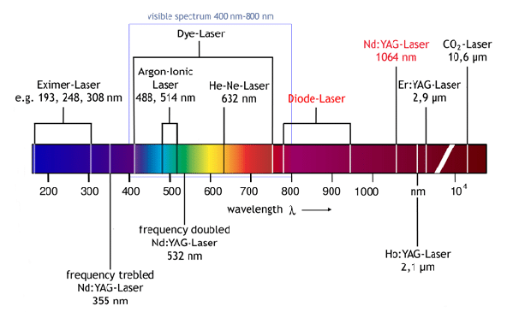
1064nm invisible laser, 532nm visible laser

Slide 16
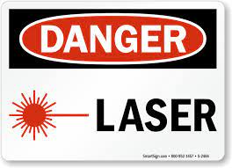
1064nm invisible laser, 532nm visible laser
INVISIABLE LASER RADIATION
Avoid eye or skin exposure to direct or scattered radiation.
LASER SURGERY IN PROGRESS
SAFETY EYEWEAR REQUIRED
DO NOT LOOK DIRECTLY AT LASER LIGHTS

Slide 17
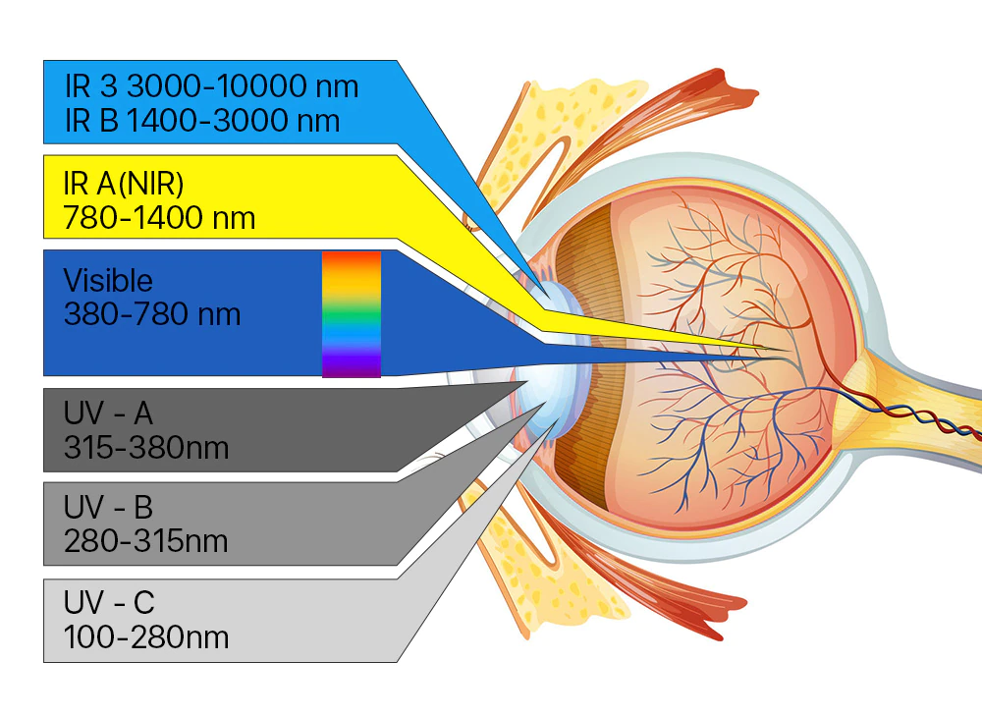
Laser safety goggles

Slide 18
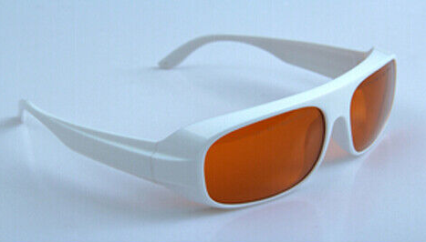
532nm, 1064nm Laser Safety Glasses Protective Laser Light Glasses Goggles
O.D Optical Density: 200 - 540nm O.D 6+
900 - 1100nm O.D5+
Protection Range:200 - 540nm & 900 - 1100nm
Transmittance: 30%
Available for: 532 & 1064 nm etc.
Rating (EU Standard): 315 - 540nm DIRM LB5
900 - 1070nm DIR LB5
Application: ND:YAG, KTP, and Q-Switch
According: CE EN207

Slide 19
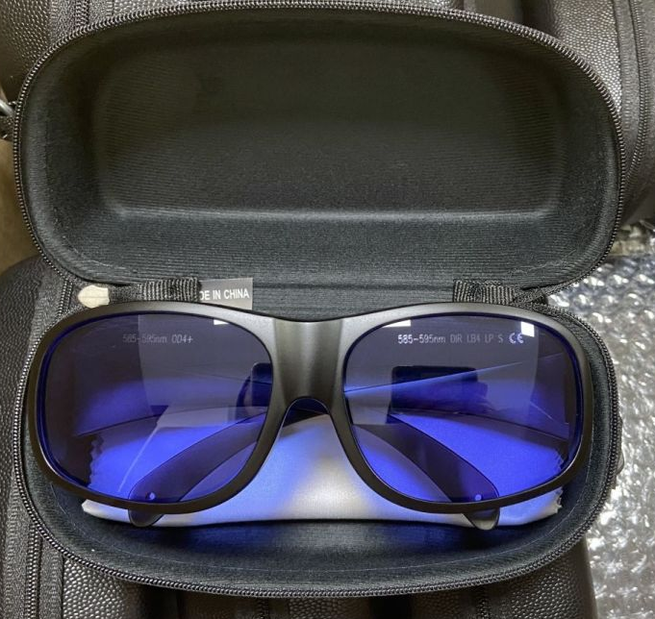
650nm RHP Laser Safety Goggles
RHP Laser Safety Goggles (for 650nm)
Protection wavelength: OD4+ @600-700nm
Transmittance: 50%
Available to use for 635nm, 660nm, 694nm etc.

Slide 20
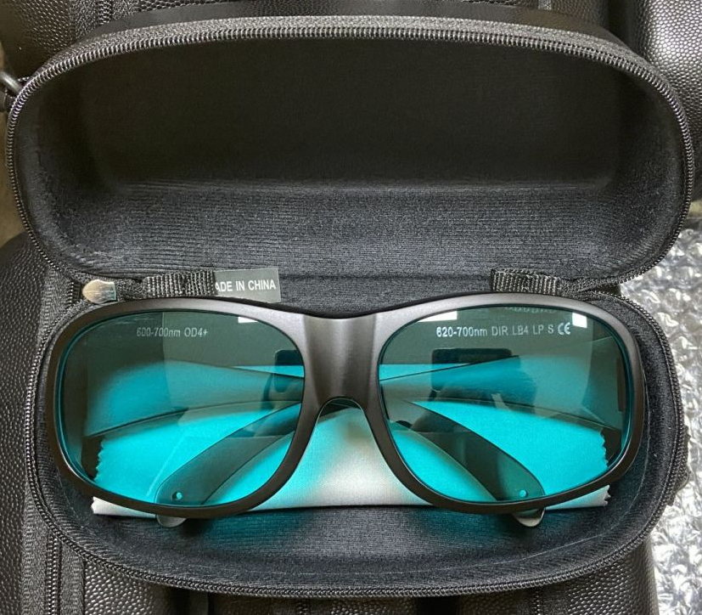
595nm RHP Laser Safety Goggles
RHP Laser Safety Goggles (for 595nm)
Protection wavelength: OD4+ @585-595nm
Available to use for 585nm, 595nm
Transmittance: 30%

Slide 21
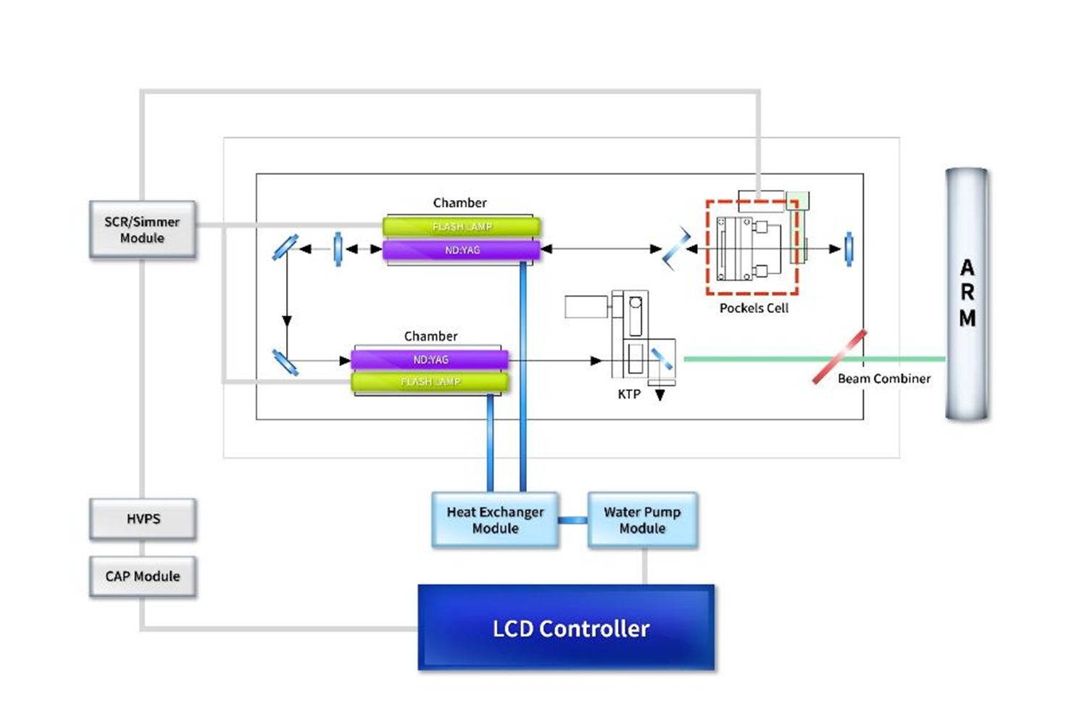
1064nm, 532nm two wavelength
KTP - split the wave length to half
1064nm -> 532nm
Green light

Slide 22
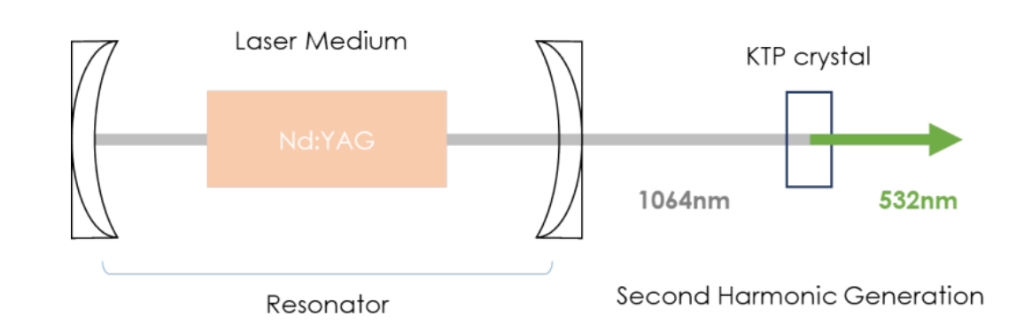

Slide 23
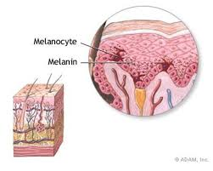
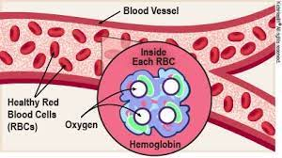
Why we select 1064nm?
1’st: Chromophore
1064nm laser targets two components among three components what determine skin color
Melanin
Hemoglobin
Carotene
Each red blood cell contains several hundred million hemoglobin molecules which transport oxygen
2’nd: 1064nm laser absorption rate

Slide 24
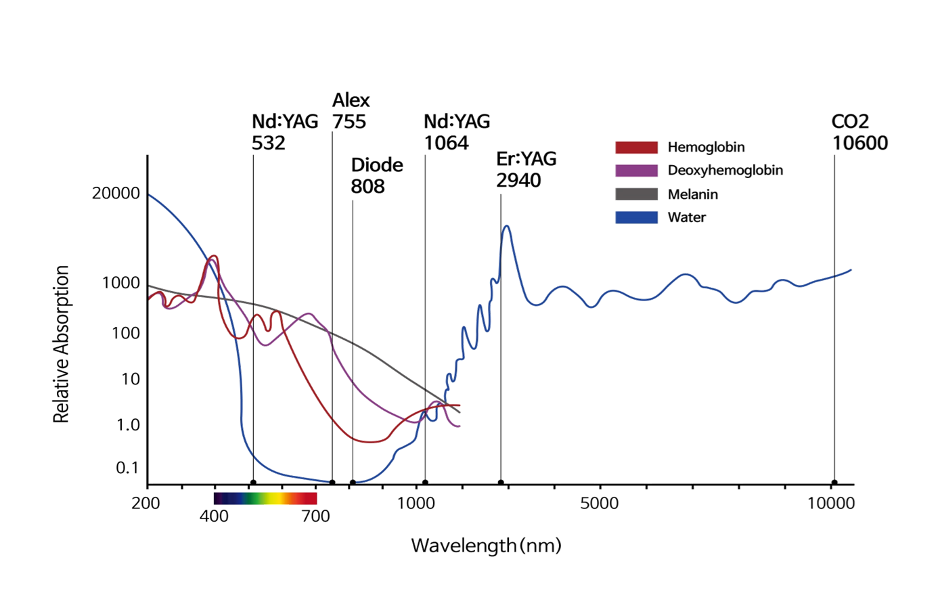
2’nd: 1064nm laser absorption rate

Slide 25
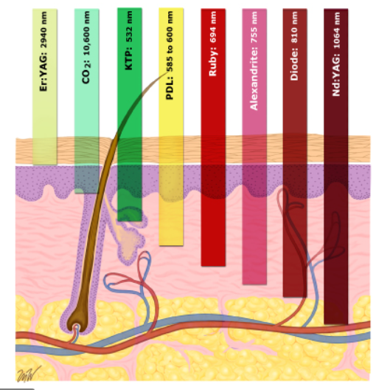
Characteristic of 1064nm
It has appropriate absorption rate.
Its penetration depth is deepest, it is able to reach to the fat layer.
It is good to use for general skin care.

Slide 26
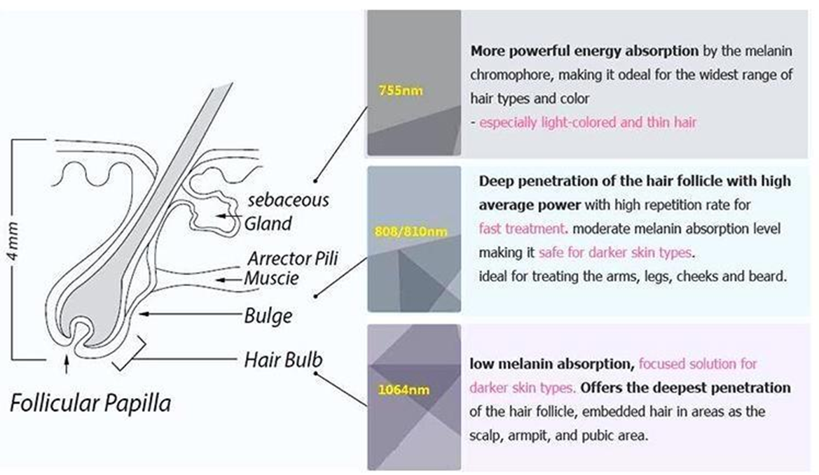

Slide 27
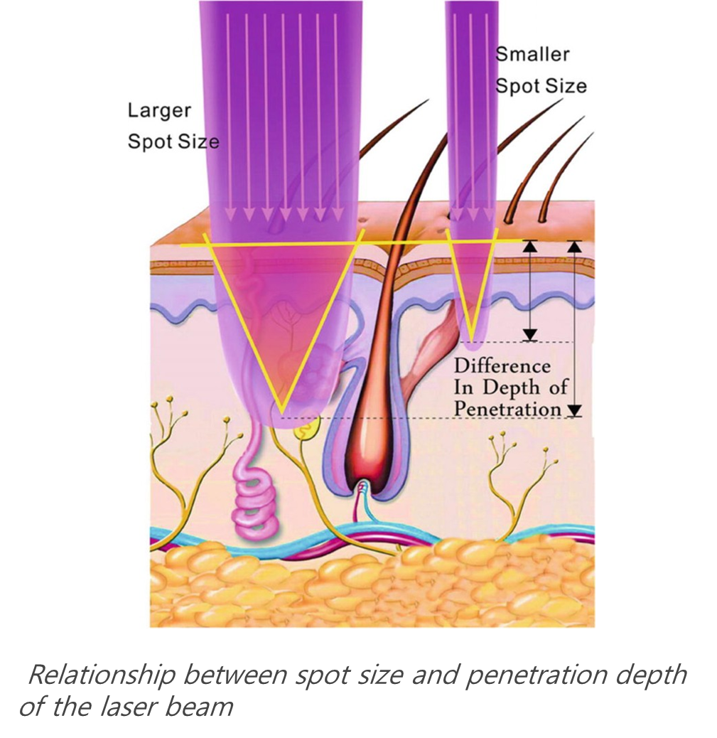

Slide 28
Conversion Formula
Energy -> Fluence
Fluence -> Energy

Slide 29
Conversion Formula
Energy -> Fluence
Fluence -> Energy

Slide 30
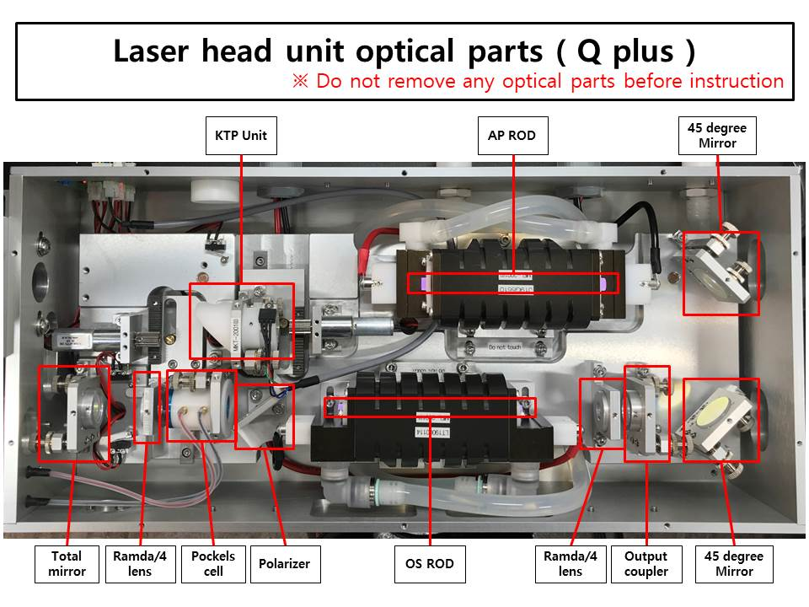

Slide 31
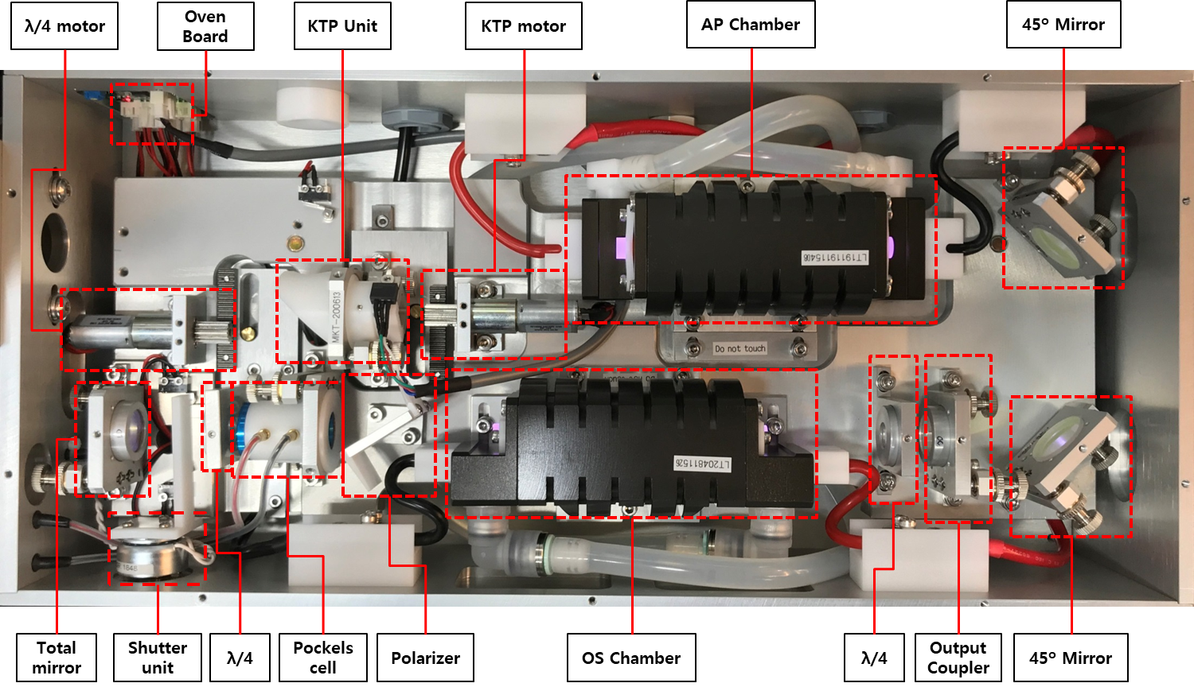
Finebeam Dual

Slide 32
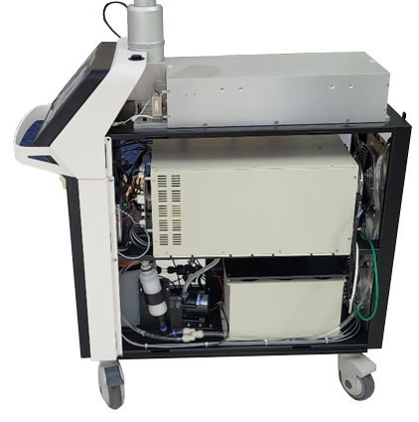
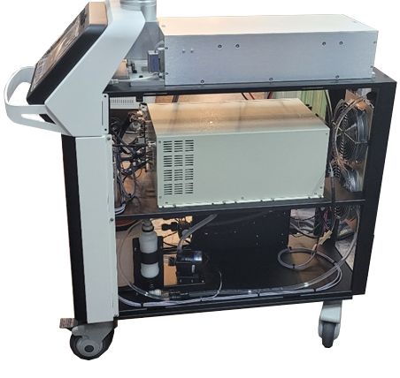
The difference of Finebeam Dual and Qplus
<Inside of Finebeam Dual>
<Inside of Finebeam Qplus>

Slide 33
Difference with Q-plus and Dual
Shutter Unit: Dual – O, Q-Plus – X
It is shutter to control pulse duration.
The specification of Dual optics is higher than Qplus
3. Flash lamp Dual – Series connection
Q-Plus – Parallel connection
The power for Dual is stronger than Qplus
5. Rod coating thickness for Dual is thicker than Qplus
6. Long pulse – Rod and reflector is bigger than Finebeam Qplus
QSW –resonator technique
LPS – Power supply technique
=> control power, capacitor, cooling

Slide 34
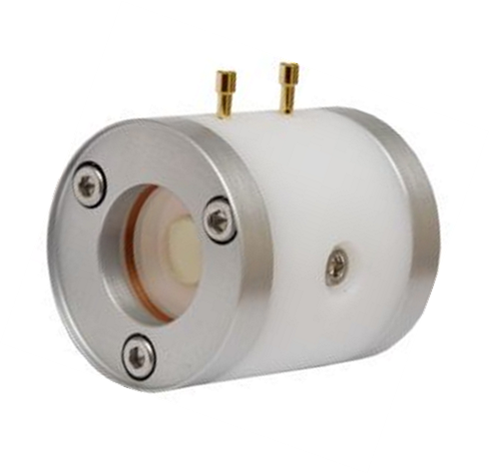
Pockels cell
Core part for Q-Switch
Pulse duration: 5ns to 10ns control
It is called Q-Switching.
Nanosecond
Microsecond
High performance Pockelcell installed
Pulse width is decided by pockelcell. It is electro optics, crystal is in it.

Slide 35
Pulse Duration: Laser type
Picosecond – one trillionth (1/10¹²): Picosecond laser
Nanosecond – one hundred millionth (1/10⁹): Q-Switched laser
Microsecond – one millionth (1/10⁶): Non-Q, Free Running, Quasi, Genesis, Spectra …(differently name it per brand)
Millisecond – one thousandth (1/10³) -> Long Pulsed laser

Slide 36
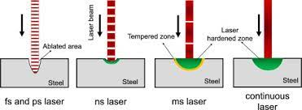
Laser beam

Slide 37


Pulse duration & Peak power
800mj
1200mj
Energy is stronger. -> pulse duration is shorter, peak power rises .
(5ns ~ 10ns)

Slide 38
Pulse duration & Peak power
1200mj
800mj
Energy is weaker. -> Pulse duration is longer, peak power goes down.

Slide 39

Pulse duration & Peak power in PDP mode
Single Pulse
PDP
800mj
1,600mj
Pulse duration is same for single pulse 800mj and PDP mode 1,600mj.
2200mj
Pulse duration and the width between two pulses are different with 1,600mj and 2,200mj under of PDP mode.
1600mj

Slide 40
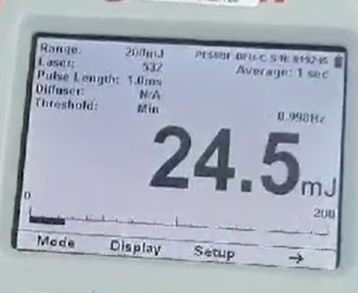
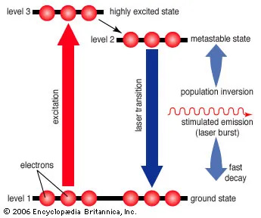

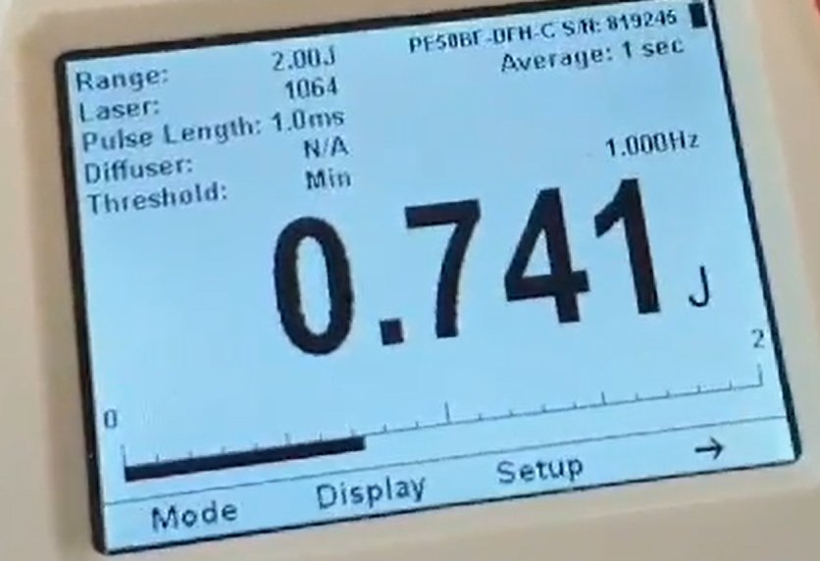
Population Inversion
532nm 20mJ
±5mJ
Difference: 25%
1,000mJ
±10 ~ 20mJ
Difference: 1 ~ 2%
Voltage
is high
Population inversion occurs better
More stable
Energy
Emission
Finebeam stability check

Slide 41
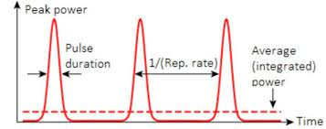
Pulse
The number of pulse/second: Frequency
(Pulse
Width)

Slide 42
Technical difference of Active vs. Passive type Q-switched
Q-Switch type | Active | Passive
Pulse duration Control by | Pockels cell | It is controlled by energy amount
Pulse duration | Only nanosecond laser is out Easy to control | Nanosecond and microsecond is mixed(around 70% microsecond) Hard to control
Thermal effect | Low | High
Energy, pulse duration | can be controlled | can’t be controlled
PDP pulse Multi pulse | Stable | Unstable (Depends on voltage)
Damage threshold | High (high durability) | Low (low durability)

Slide 43
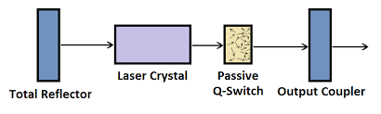
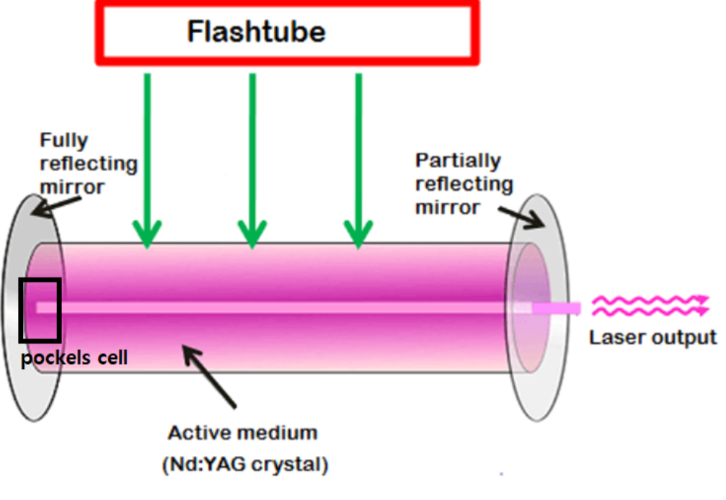
Resonator for Passive method VS. ACTIVE method resonator
SESAM – 1/10 size of rod
Passive
Active

Slide 44
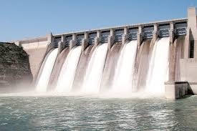
How different Active method VS. Passive method
Sesam is like a bath.
Pockels cell is like a dam.
Passive is like a bath –uncontrollable water from bath
Active laser is like a dam –controlled water by gate

Slide 45
Clinical difference of Active vs. Passive type Q-switched
 | Active | Passive
Major difference | Has power to break pigment in dermis | Doesn’t have power to break pigment in dermis
What makes the difference | Pockels cell (Electro optics) | Sesam: depends on the coating thickness, the amount of laser emission is decided.
Performance | Pulse energy and pulse duration can be controlled. Pulse duration and energy is regular. So doctor can easily expect the treatment result, it is especially so good to treat pigment. | Pulse energy and pulse duration can’t be controlled. Pulse duration is long and irregular. Energy per pulse is irregular and not stable. So it is hard to expect the pigment treatment result.
Pulse width | 5 to 25 ns | 100ns(irregular)
Indication | Good for dermis pigment | epidermis pigment

Slide 46
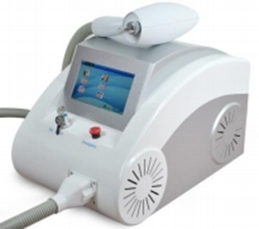

SESAM – 1/10 size of rod
Curas – M mode
Rucas – G 1064, PTPS
Low price China made Nd:Yag mainly for eyebrow tattoo removing purpose because the skin thickness of forehead is thin.

Slide 47
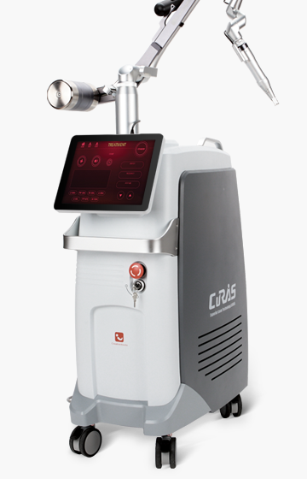
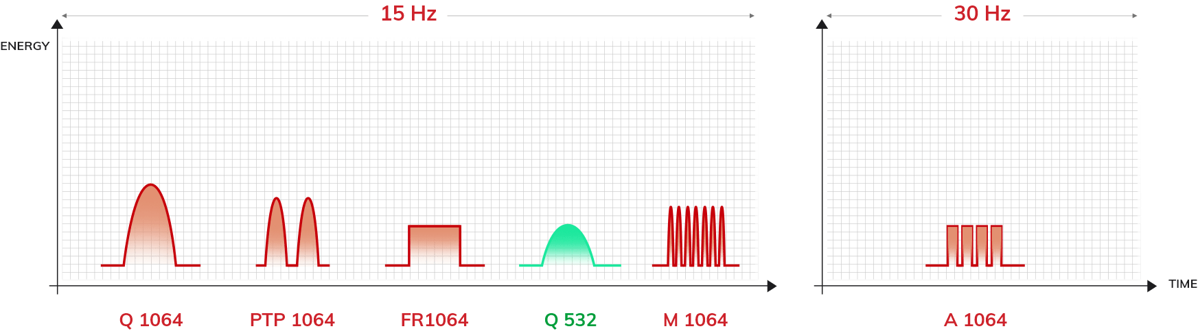
Passive method - 6 pulse
CURAS
M1064
1,300mJ
1,600mJ
3,500mJ
400mJ
2,100mJ
300mJ
5 ~ 20ns
5 ~ 20ns
300µs
5~20ns
100ns
200 ~300 µs

Slide 48
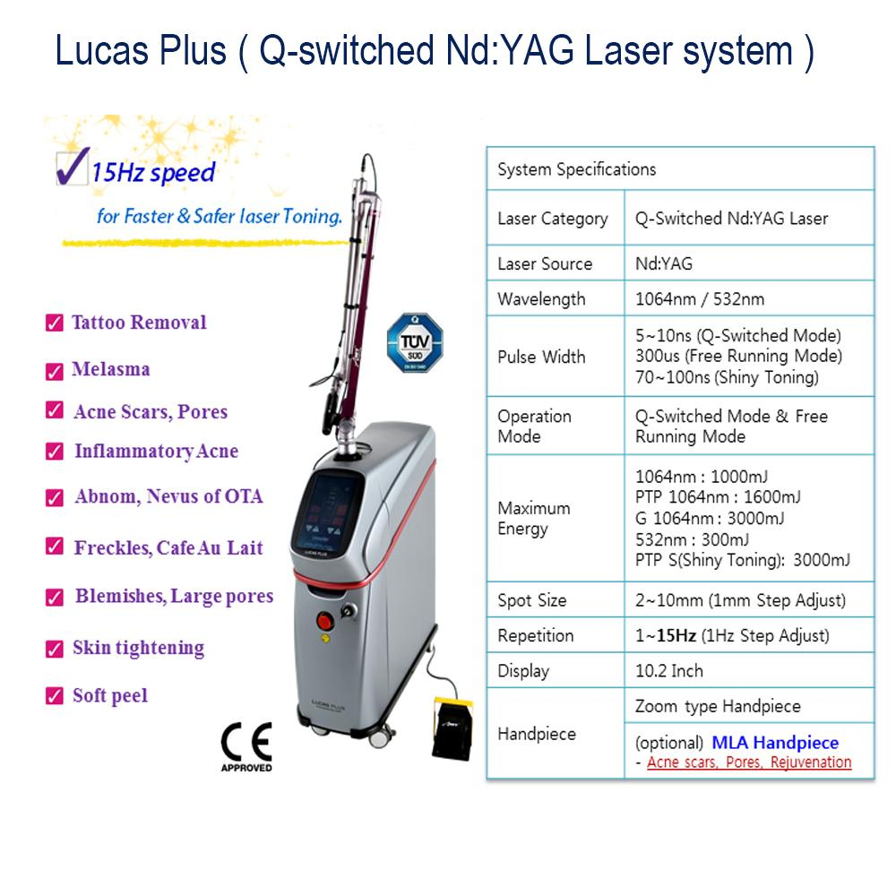
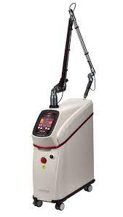
Passive method
LUCAS
G1064nm
PTP S

Slide 49

Difference with Finebeam Dual long pulse and Long pulse alone laser
Finebeam Dual
Long pulse alone laser
2 ~ 3ms
5 ~ 10ms
Pulse duration: 2 ~ 3ms
Pulse train Method
(it is same with Candela Gentle max)
: 2ms + 3ms
Pulse duration: 5 ~ 10ms
10ms + 10ms – 20ms
=> Less burden on the flash lamps
Less painful
Less thermal damage
Beam delivery method: articulated arm
Beam delivery method: fiber
Spot size: 10mm
Spot size: 10 ~ 20mm

Slide 50
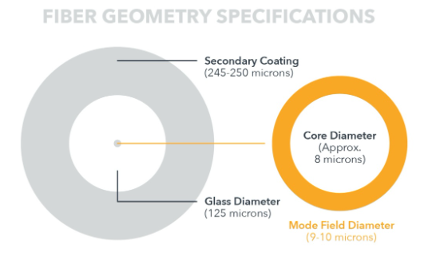
Difference with Finebeam Dual long pulse and Long pulse alone laser
Finebeam Dual long pulse
Long pulse alone laser
Beam delivery method: articulated arm
Beam delivery method: fiber delivery type
=> Higher durability
Articulated arm can resist the energy well.
Lower durability
Core is small like its diameter is smaller than 1mm, the possibility of core damage is very high.
Repair cost is low
: when the glass is broken, change the glass(around USD150 for end user)
It is recommended to clean dust on the mirrors every 6months for more longer time use for it.
Repair cost is high
: over USD1,000

Slide 51
Finebeam Dual Long pulsed laser
ZOOM H/P | Spot size | On time(ms) | Fluence (J/CM²) | Frequency (HZ)
Telangiectasia | 2 ~ 3mm | 5 | 180 ~ 200J | 1HZ
Thin blood vessel | 3 ~ 4mm | 1 ~ 5 | 100 ~ 200J | 1HZ
Flush, Acne | 5mm | 0.5 | 10 ~ 15J | 5 ~ 10HZ
Genesis | 7mm | 0.3 | 7.8J | 10HZ

Slide 52
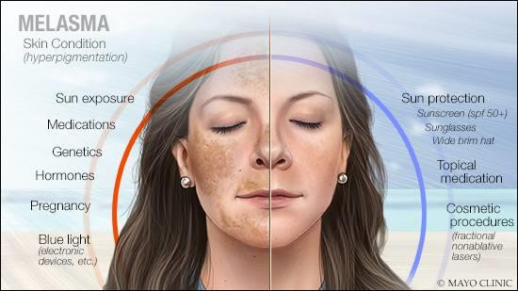
Finebeam Melasma care
Melasma is a facial hyperpigmentation resulting from the stimulation of melanocytes by endogenous or exogenous estrogen.

Slide 53
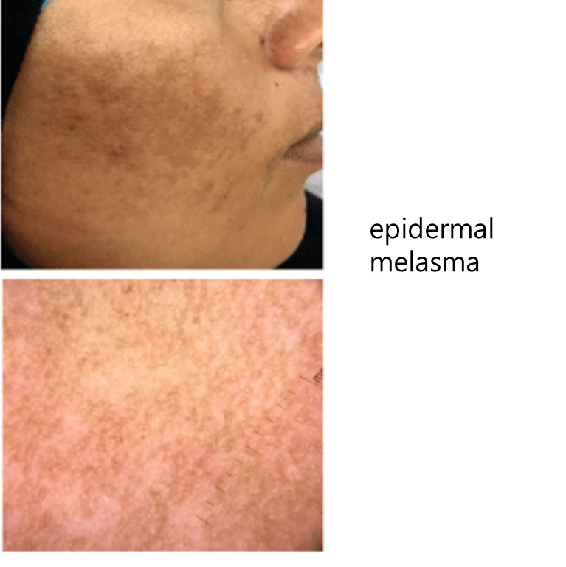

Epidermal melasma - Toning
0.99 ~ 1.04 J/cm²

Slide 54


Dermal melasma
Treating difficult melasma case
Dermal melasma which is still remained after 10 sessions of toning
With the purpose of treat melasma in dermis, if you increase energy, the epidermis react first in the epidermis so it may arise pethecia.
Dermal melasma
Epidermal melasma

Slide 55


Melanin is generated from melanocytes in epidermis

Slide 56

The location of melasma
How deeply 1064nm is able to reach in the skin?

Slide 57


For the dermal melasma care,
If
Increase energy
with single Pluse
Energy mainly acts with melanine and hemoglobin
in epidermis
Epidermal
damage
PIH
HOW DO YOU OVERCOME THE LIMIT OF QSW SINGLE PULSE AND DELIVERY THE LASER UP TO THE DERMIS?
LIMIT OF
QSW Single pulse

Slide 58

PDP Mode
push the limit of QSW single pulse to care dermal melasma
PDP MODE

Slide 59
Finebeam PDP Mode push the limit of QSW single pulse to care dermal melasma
Single Pulse
PDP
2.2J
Enough energy is reached to the dermis
1.1J
1.1J

Slide 60

Finebeam PDP – High lighted marketing points
Safely deliver high energy into the dermis
without damage in the epidermis
PURE Nanosecond laser break the pigmentation in dermis
Benefits: Pigment in dermis(dermal melasma, tattoo in dermis)
Less painful than single pulse
Good to treat pain sensitive person
Sensitive skin

Slide 61
Exceptional High Power in PDP Mode
Exceptional High Power in PDP Mode
2.2J
In PDP mode, when the NON-Q is mixed(it means, µs and ns are mixed), energy can’t be increased.
The high energy 2.2J in Finebeam PTP Mode confirms exceptional good effect on dermal melasma and tattoo removal.
Notes:
Comparing other QSNY, Finebeam has much higher PDP power. It is so meaningful for pigment care in dermis. After several sessions of toning, when you find the pigment in dermis, if you continually increase fluence with the purpose of break pigment in dermis, laser mainly works on skin. To the purpose of breaking deeper lying pigments and ink with reduced risk of unwanted side effect, Finebeam High Power PDP affords deep penetration and strong breaking power what cannot be targeted by lower power PDP.

Slide 62

Finebeam has longer pulse duration in quasi.
Finebeam resonators resonates Very well
Lamp specification is optimized
It lengthen the pulse width long and realize high power.
120µs
~ 150µs
5~10ns
<350µs>
Finebeam & Revlite – pulse duration between two pulses 120 ~ 150µs

Slide 63


Finebeam Dual
MLA and DOE H/P for other representative
Q-Switched Nd:YAG brands
 | Revelite | Spectra XT | Spectra XT Plus | Helios 3 | Curas | Pastell | Finebeam Dual | Remarks
Manufacturer | Cynosure | Lutronic | Lutronic | Laseroptech | Ilooda | Wontech | SNJ
Q-Switch/ Long-Pulse | 1064 / 532 (Q only) | 1064 / 532 / 595 / 660 (Q only) | 1064 / 532 / 595 / 660 (Q only) | 1064 / 532 (Q only) | 1064 / 532 (Q only) | 1064 / 532 (Q only) | 1064 (Q & Long) 532, 585, 650 | Q-Switched & Long-Pulsed
1064Single Max Energy | 1.1 J | 1.2 J | 1.7 J | 1.3 J | 1.3 J | 1.3 J | 1.6 J | Relatively high
PTP Max Energy | 1.55 | 1.7 | 2.1 | 2.0 | 1.6 | 1.6 | 2.2 | High Energy
532 Max Energy | 0.4 | 0.4 | 0.4 | 0.5 | 0.4 | 0.5 | 0.5 | Relatively high
Non-Q Max Energy | - | 4.5 | 4.5 | 3.0 | 2.0 | 3.5 | 3.5 | Relatively high
Fractional H/P | MLA - X DOE – X | MLA - X DOE – X | MLA - O DOE - X | MLA - X DOE – O | MLA - O DOE - X | MLA - X DOE – X | MLA - O DOE - O
Price | USD98,000 | USD35,000 | USD43,000 | USD41,000 | USD39,000 | USD29,000
Finebeam Dual
SNJ
1064 (Q & Long) 532, 585, 650
1.6 J
2.2
0.5
3.5
MLA - O DOE - O

Slide 64
How much the longer width between two pulse is meaningful for effect?
The width between Two pulses in PDP mode(Off time) of Finebeam
Distance between two pulses – Same for Revlite
Rapid healing
Better result
Lowering PIH
Improving the better dermis condition for the better result in the following sessions
Finebeam 120µs ~ 150µs
Thermal effect, temperature increase up to 42 ~ 45°C
※42 ~ 45°C: It is the optimize temperature
for improving dermis environment
Photo thermal effect: whitening, collagen remodeling
The width between Two pulses in PDP mode(Off time) of Others
Others: shorter
less thermal effect, lower temperature increase

Slide 65
PDP(Pulse Double Pulse)
10HZ – 10 pulses a second, 0.1s, 100ms, 100,000µs -> it is so long time
PDP – on: 5ns ~ 10ns -> off: 120 ~ 150µs -> on: 5ns ~ 10ns -> off: 120 ~ 150µs
The meaning of peak power: it is the depth of laser can reach to the skin.
However it doesn’t mean that higher peak pulse can target deeper dermis.
PICO laser has higher peak power than nano second laser but its peak power is too high so it can’t reach to dermis becasue
most of energy act on epidermis.

Slide 66




Revlite SI
One pulse higher peak power
Two pulses lower the peak power and widen the width between two pulses.
Width between two pulses: ~ 140µs

Slide 67

Daesin ENT. – Impac Q 3 pulse(1,500mJ), PTP(1,200mJ)
Lutronic – Hollywood Spectra 4 pulse
Wontech – 3 pulse
1,700mJ

Slide 68

Tattoo removal mechanism
1) tattoo pigment absorbs light, which causes the ink to break down 2) The ink particles are absorbed by our immune system
Laser breakdown tattoo ink

Slide 69
Tattoo removal with Finebeam
Tattoo in epidermis – first with single pulse
With the feeling of skim off the ink on the skin
Tattoo is dark so energy act so well so it should be treated with low fluence.
Start – 1 pass, single pulse: end point is whitening -> petechia
End point isn’t bleeding
Around 2 or 3 sessions later, skin doesn’t show the whitening reaction at all, it should be changed to PDP mode.
When the interval time is longer like 3 months, the dermis area is much more healthier and firmed so tattoo is
more easily took off.
Sessions (1064nm) | Mode | Spot Size (mm) | Fluence (J/cm²) | Pulse Rate (HZ) | Pass | Interval (weeks)
1’st session | QSW S | 4 | 3.34 | 1 ~ 3 | 1 | 4 to 12
2’nd session | QSW S |  | 4.3
3’rd session | QSW S |  | 5.57
4’th session | QSW P |  | 7.07
5’th session | QSW P |  | 8.49
Notice: Set the fluence after checking the skin reaction. The skin reaction is quite different per the characteristic of tattoo, the most important thing is end point is whitening and be so much careful to prevent bleeding. It should be required to fully kept in all different tattoo parameter.

Slide 70
Sessions | Mode | Spot Size (mm) | Fluence (J/cm²) | Pulse Rate (HZ) | Pass | Interval (weeks)
Eyebrow | QSW S | 3mm | 2 ~ 7 | 1 | 1 | 4
Red, Orange, Purple | QSW 532nm | 3mm | 1.1 ~ 2.38 | 1 | 1 | 4
<Combination Tattoo removal with Finexel CO2 and Finebeam>
1)
Fractional Mode | Energy | Density | Scanning size(mm) | Pass
CO2 FRX | 8mJ | 1.2 mm | Depends on tattoo size | 1
Finebeam Tattoo care
2)
Finebeam Sessions | Mode | Spot Size (mm) | Fluence (J/cm²) | On Time (ms) | Pulse Rate (HZ) | Pass | Interval (weeks)
Genesis technique | LPS | 7 mm | 7.8 J | 0.3ms | 10 | 5 | 4 ~ 8
* Treat the Genesis technique after every sessions for improving dermal environment.

Slide 71
After Tattoo removal with Finebeam
Sedate with ice on the day of procedure
Apply skin recovery ointment every 4 or 5 hours interval
Apply enough amount of “Baseline” for keeping moisture
Protect the skin with UV SUN block cream
Don’t take shower around 4 to 5 days before scab comes off

Slide 72


Tattoo removal procedure
Immediate whitening
Petechia
When ink is break out, air is generated. It looks white due to bubble
20 min. later,
Bubble is broken and petechia is occurred
https://youtu.be/cyHqM9DhHcA

Slide 73


In the area with low amount of ink, almost 80% of ink is removed after 1’st session.
Before
After 1 session
After 5 sessions

Slide 74

The representative type of tattoo with big amount of ink in the skin is lettering
It will take long time like 10 to 20 sessions and it will also have chance to arise side effect like scar.

Slide 75
During diagnosis prior for starting Tattoo removal, below information need to be informed to prevent any controversial case
It takes long time, 10 sessions to more, it will take 1 to 2 years. Around 80 ~ 90% of tattoo ink is removed.
2. It can’t be returned to the skin prior for tattoo.
3. It requires high cost.
4. It is more safer and effective whenever keep the longer interval over 1month, when we checked one case 3 months interval, it was more effective. When the epidermis is fully recovered, it is able to treat with higher fluence.
5. After the tattoo, don’t drink alcohol at the same day because it will be bleeding.

Slide 76
Precautions for tattoo care
1. After 90% of tattoo is removed, some patients disappoint that they can’t see the improvement anymore. It is the case that tattoo is already removed but PIH left as side effect. This is commonly arise in the body part with slow recovery rate like arms and legs.
In this case, extend the interval to 3 months to keep a enough recovery time or change the another technique to care.
2. It is required test shot and find the proper energy first immediate whitening and petechia in 20 min.
3. In case the tattoo color is darker, fluence should be lower and then increase energy slowly per every sessions. The too high power can be the cause of side effect like Keloid or hypopigmentation, so you should be so much care about energy setting.
4. Don’t over pass with 532nm.
5. In case you take 1064nm and 532nm together, you should treat with 532nm first.

Slide 77

1’st session
2’nd session
3’rd session

Slide 78

Before
5 session
The rounded area is bulging with ink. It can’t be removed even after 5 sessions. It will be required almost 20 sessions.
Source from Orakkyu TV

Slide 79
Tattoo removal isn’t easy and clinics have their own way to treat
1) Twice a day care “R20”
1’st laser tattoo removal –> 20 ~ 30 min. later -> 2’nd laser tattoo removal
2) Treat Finexel fractional CO2 first, tattoo more easily break down.
1’st Finexel fractional CO2 -> 2’nd Finebeam QSW -> 3’rd Finebeam LPS Genesis technique

Slide 80

Eyebrow Tattoo removal
Advice to patient before tattoo removal, in case removing eyebrow tattoo as the purpose to completely remove it, it will also remove hair in there. So considering the eyebrow, control the sessions.

Slide 81
Several factors to effect tattoo removal
Amount of ink
The ink color
Skin condition
Depth of tattoo
Permanent or Semi permanent
Interval
Tattoo operator
The location of tattoo
(the tattoo near of heart is more easily removed)

Slide 82

Around 50% of tattoo ink particle is removed at the first session, when the tattoo have 100 pcs of ink particle and 50% of tattoo ink is remained. And 50% of tattoo for 10 is removed. So patient disappointed about the result by sessions goes by.
1’st session: among 100 pcs tattoo ink/
50 pcs of ink particle are broken.
Next sessions: among remained tattoo ink/ half or even lower than half of them are broken

Slide 83

The removed tattoo amount
The amount of tattoo
Reverse compound
The amount of tattoo is reduced by increasing treatment sessions
Treatment sessions

Slide 84
One session tattoo removal cost for one tattoo removal specialized clinic in Korea
It is so different per size, color, color thickness, clinics.
9cm
2.6cm
5cm
Color tattoo additional cost depends on the size
: 2.6cm diameter round size: +USD50
USD50
X1 – USD100
X2 - USD200
X3 – USD300
X4 – USD400
A4 SIZE – USD700

Slide 85

epidermis
blood vessel
fat layer
muscle layer
Rank of Absorption Rate by Wavelength
Tattoo Removal
Wavelength | Melanin | Oxyhemoglobin | Deoxyhemoglobin
1064nm | 4 | 3 | 4
694nm | 3 | 4 | 3
585nm | 2 | 1 | 2
532nm | 1 | 2 | 1
1064nm 694nm 585nm 532nm
Ruby Toning(694nm): Lentigines, Freckles
Gold Toning(585nm) : Acne vulgaris
Notes:
complementary colors

Slide 86




Energy efficiency of Dye laser
650nm RUBY QSW 1064 : 3mm
DYE
595nm GOLD QSW 1064 : 5mm
Dye 650nm, 595nm : the beam quality is not good, the beam shape is like oval not the round. And the energy efficiency is so low as around 30 to 40%, so it isn’t enough to penetrate up to dermis.
Ex) Apply 100mJ emit 30 ~ 40mJ
595nm: vascular melasma,
purple, sky blue tattoo
650nm: rosacea, fine blood vessel,
green tattoo
rosacea
Vascular melasma

Slide 87


Finebeam - 2 chamber laser
1 ROD and 1 Lamp in the each chambers – 2 chamber laser(Finebeam)
2 flash lamps -> economical
The new version for the maximize the beam performance having high cost effective
2 ROD and 2 Lamps in the one chamber – 1 chamber laser (AMT - Lucas, Ilooda - Curas, Jeysis - Tribeam, Wontech - Pastelle)
1ROD and 2 Lamps in the each chambers – 2chamber laser(Lutronic – Spectra)
4 flash lamps -> high maintenance cost
The first generation of two chamber type, less cost effective

Slide 88
Lutronic Spectra – 2chamber
chamber
chamber
Lutronic Spectra
1 ROD
2 LAMP
1 ROD
2 LAMP
Weak point – high maintenance cost
Upgrade
SNJ
Finebeam
1 ROD
1 LAMP
1 ROD
1 LAMP
It has high cost effectiveness.

Slide 89

Finebeam - 2 chamber laser head
Finebeam Advanced Optic technology based two Chamber system
Max. Energy: 2.2J(Double pulse)
High durability(Flash lamp): 10 Million shot(Q-switched)
KTP: Stable
Less technical problem
One Chamber type lasers
Max. Energy: 1.8J(Double pulse)
Low durability(Flash lamp): 7 Million shot(Q-switched)
KTP: unstable
More technical problem
vs.

Slide 90


Two chambers assure long term high durability,
stable power supply
i
Others with one Chamber
Finebeam with Two Chambers
800V ~ 900V input
Margin – over 400V
1,100V ~ 1,200V input
Margin – only lower than 200V
Laser Power supply
Specification:
Max. 1,400V
Actual Performance:
1,250 ~ 1,300V
1.2J
1.2J
* High power efficiency
* Stable laser emission
* High Durability
Lower power efficiency
Less stable laser emission
Lower Durability
* Outstanding performance
It so stably emit laser and have a longer duration in quasi.
Its laser emission can be less stable and it has shorter duration in quasi than two chamber.

Slide 91




Two chambers assure long term high durability, stable power supply and superior beam quality
Finebeam: Two Chambers of laser head
Others: One Chamber of laser head
(C, L, T, P etc.)

Slide 92

HIGH POWER SETTING
High power efficiency
Stable laser emission
High Durability

Slide 93



Fractional DOE(Diffractive Optical Element)
DOE recollects light after splitting light by using diffractive element. It has top hat energy output which is the energy is same for center and around of it. DOE can evenly delivery energy. However there is energy loss in the process of splitting light and recollecting it. And it disregard the energy around of main beam.
Stable Beam Quality
Flat top beam

Slide 94

Diffraction of Light wave
When light passes through an opening it is observed to spread out. This is known as diffraction and becomes more pronounced with narrower opening.
Diffraction of light through wide and narrow openings

Slide 95

* This is the main reason of low power efficiency of DOE.
Inside the region contain ~80% of incident light (disregarding surface losses)
outside the region contain around 20 ~ 25% of incident light, it is not used.
(disregarding surface losses)

Slide 96

FINEBEAM DOE UNIFORM BEAM QUALITY
7mm X 7mm – 49 SPOTS
DOE is quite important role to supply stable energy without energy fluctuation, it is good for pigmentation care. It isn’t effective if apply same parameter for zoom h/p. It requires higher fluence or overlapping.
Its quite big benefit is that the individual beams are so stable.

Slide 97




MLA
MLA: It collects the laser beam through lens, character of laser beam is maintained, it makes Gaussian distribution curve like the energy in center is high and around of it is low. MLA deliver high energy in the center.
** Finebeam MLA H/P is same with PICO laser H/P.

Slide 98

Micro lens inside of MLA Hand piece

Slide 99

How can we induce PICO laser holders or the doctors under consideration of Pico laser or Nano second laser?
The peak power for Pico single pulse is too high and especially when its fluence is too strong, the energy mainly used in
an epidermis, it may cause the epidermal damage. (Melanin -> PIH, Blood vessel -> petechia)
It is same mechanism that 1064nm single pulse can’t go in to the dermis. So it is required double pulse

Slide 100
Finebeam MLA
Finebeam MLA – pore, scar
Stacking – 3 ~ 5 pass
Spot 10mm, Energy 700 ~ 800mj – stacking
Around 1 min. 30 seconds later – petechia
Scar care
1’st) MLA 2’nd) CO2

Slide 101

How come QSW Nd:YAG non-ablative laser can give ablative effect?
Plasma induced ablation
The mechanism of ablation is not by the water absorption.
1064nm reacts mainly with melanin and hemoglobin, MLA generate ablation due to high output power not by the water absorption
like CO2 or Er:yag.

Slide 102

Finebeam으로 촬영
Energy: 1.3J ~ 1.4J -> ABLATION

Slide 103

LIOB Mechanism
High power short pulse laser effect only in dermis without damage in surface
Multiphoton in dermis generate plasma effect and cavitation effect. So explosive vaporization and mechanical expansion is occurred in dermis so several vacuoles are made but completely protecting epidermis.
They works like subcision and they are filled with neo-collagen thanks to natural body recovery mechanism.
And also pigment can be defected by them.

Slide 104

Q
What is LIOB,
Laser Induced Optical Breakdown?
When high power short pulse laser is emitted,
Plasma is generated with cavitation sensation
by multiphoton in dermis. At that moment,
shock wave is generated and it break tissue
down in dermis and neo-collagen is generated
as the natural skin recovery mechanism.

Slide 105



Finebeam Clinically proven LIOB(laser-induced optical breakdown) effect for Skin Rejuvenation
Histology picture tested by Finebeam MLA
100x
200x
400x
How Finebeam can realize high quality LIOB sensation?
1. High power thanks to high quality resonator: With our advanced resonator technology and a specially designed arm, there is almost no energy loss passing the laser arm from a resonator to the end of the arm.
The display power is the real output power from the end of arm.
LIOB requires high power however as the reason of energy loss in the pass of resonator to end of laser arm so
many of other QSW lasers can’t make good LIOB effect.
2. PICO laser MLA Hand piece: We supply high performance good quality MLA Handpiece which is the PICO Laser MLA Hand piece.

Slide 106

PORE TREATMENT
Conventional Fractional: Crusts are kept at least 1 week and painful
Needle RF: so much painful
Finebeam MLA Care
is the answer to treat pore without above complications

Slide 107

Scar: 10mm spot size
With 4 weeks interval, increase energy to 800 ~ 1000mj(spot: 10mm), treat 2 to 3 pass
For Scar removing and pore reduction purpose:
It is so helpful to increase laser power until pethechiae is appeared and a little blood.
It is disappeared in a day or it takes 1 to 3 days.

Slide 108

Recommended Indication for
MLA vs DOE
Scar Subcision
Scar, Dermal Pigmentation, Pore - MLA
To improve scar, it is required to disrupt the tissue first, so as the way for subcision is normally conducted to disrupt the tissue what pull it to down. A subcision is very helpful to make scar is move upward but requires local anesthesia, very much painful even under anesthesia, around 2 weeks recovery time is required and also patients scared of procedure with the needle. MLA can be the excellent substitute can remove this concerns of subcision. M.L.A with the strong energy focusing on scar and disrupt the tissue in dermis with cavitation and plasma effect, we call it as LIOB.
vs
Epidermal Pigmentation - DOE
To improve pore, elasticity and epidermal pigment, it is required even damage and recover in dermis not tissue disrupting.

Slide 109

Advantage of MLA
1
NO or short down-time.
Less painful, Less pigmentation comparing
conventional fractional laser.
Safe procedure for skin rejuvenation safely
protecting epidermis.
2
3

Slide 110


PLASMA SHAPE
a) PICO
b) NANO
Nano can be
More effective than PICO laser
For tightening and elasticity care.

Slide 111


1064 Single
1064 PDP
1064 Quasi
532nm
Finebeam supply strong and stable energy
동영상 연결 작업
1064 Single
1064 PDP
1064 Quasi
532nm
Click!

Slide 112

Return to the main page

Slide 113

Return to the main page

Slide 114

Return to the main page

Slide 115

Return to the main page

Slide 116

SKIN COOLING
Three basic types of skin cooling
Pre-cooling
- Pulsed dye and all Q-Switched lasers(pulse durations shorter than ~ 5 millionseconds)
-Blue Ice
2. Parallel cooling
For pulses longer than ~ 5milliseconds
Blue Ice
3. Post-cooling
- Bulk skin cooling before and after laser treatment(e.g. with ice or cold air cooling or cryo H/P with este7) is useful for minimizing pain, erythema and edema

Slide 117


Slide 118


From Cutera

