Slide 1
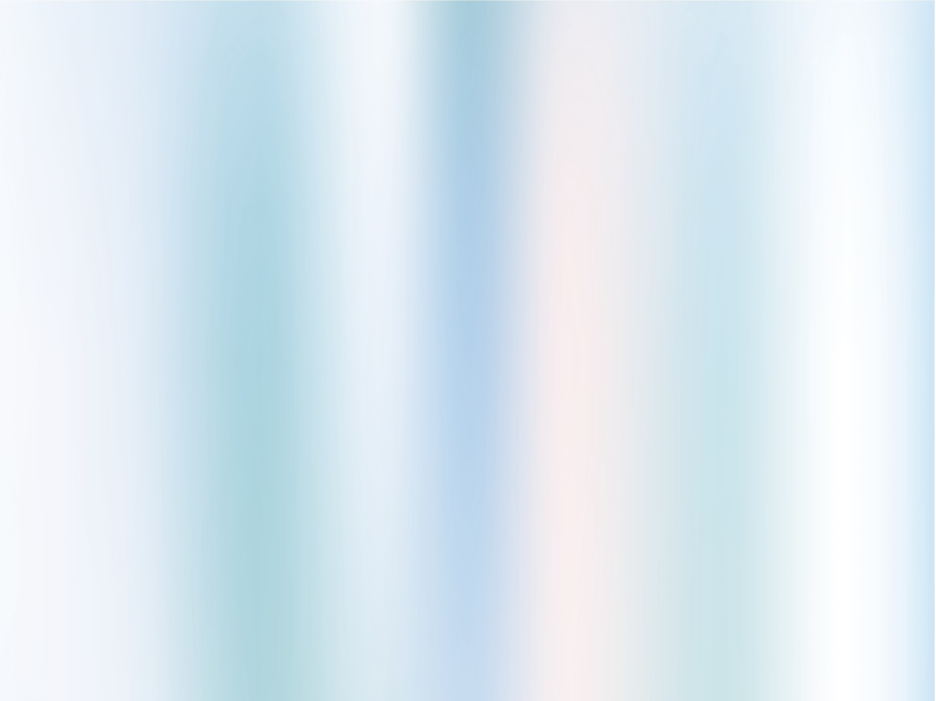
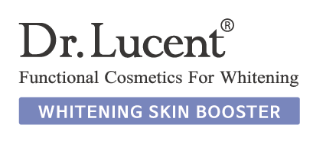
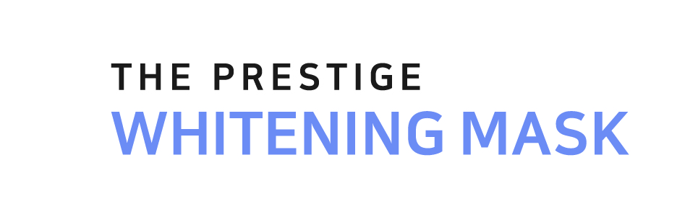


Slide 2
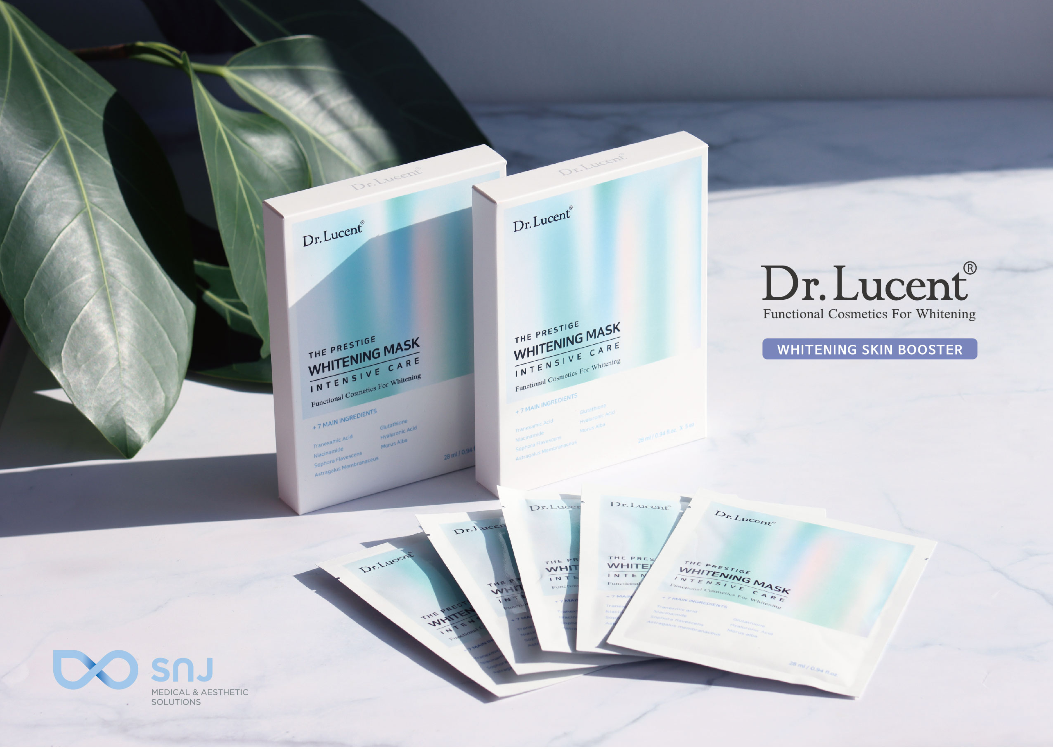

Slide 3
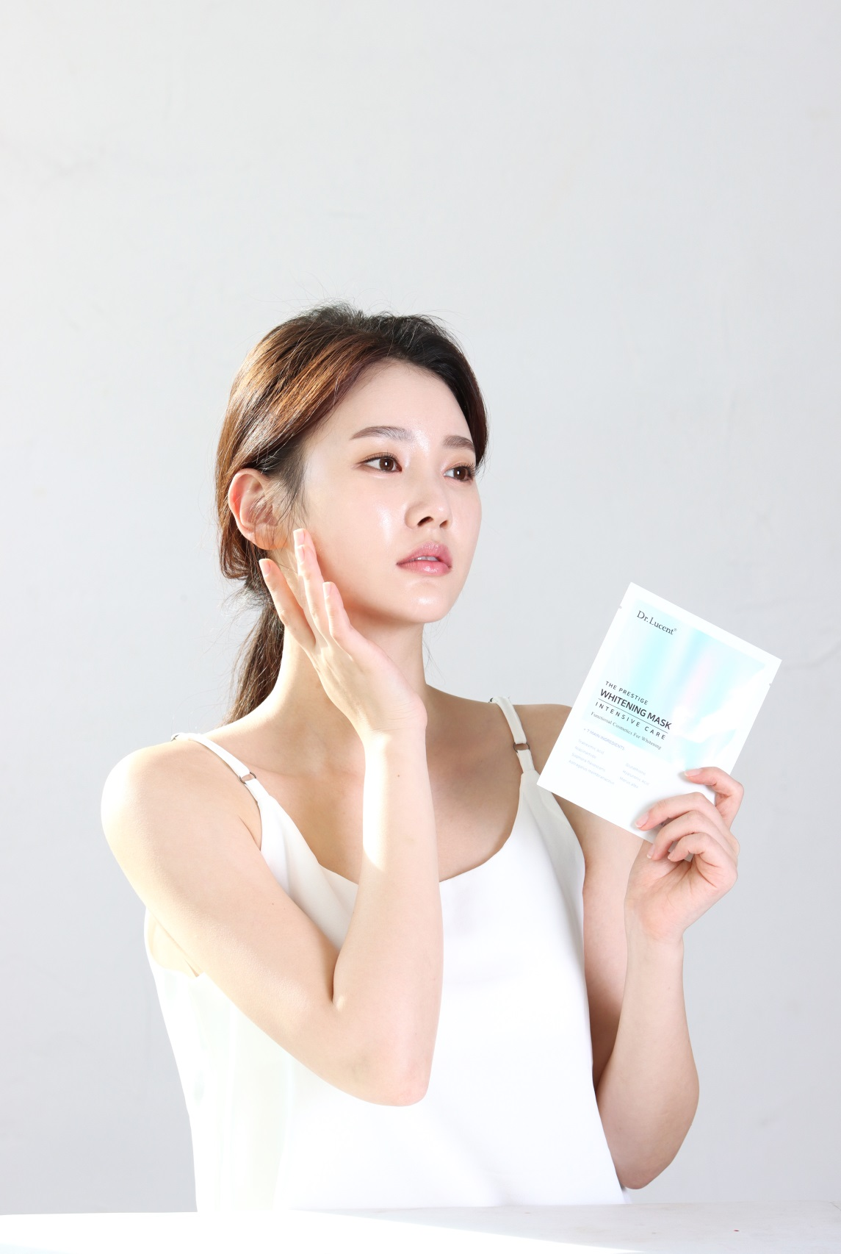

Slide 4
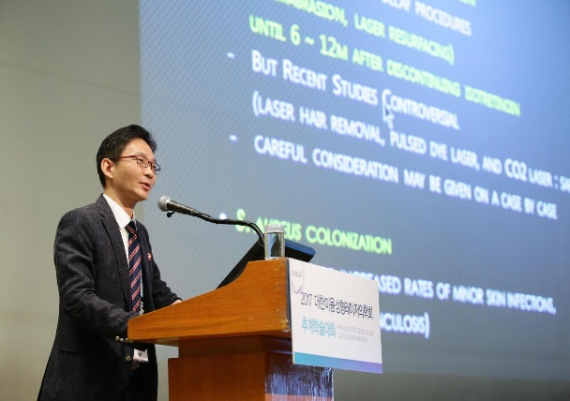
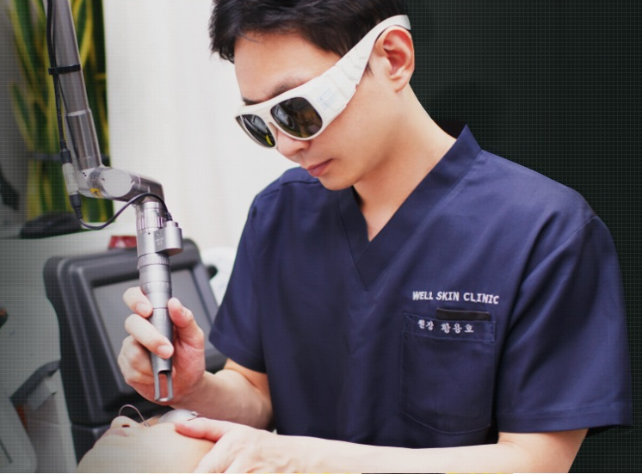
Whitening Mask Pack l Dr. Hwang
Developed By
Dr. Hwang Yong Ho
MD, OMD
- Director of Korean Double
Licence Medical Doctor &
Oriental Medical Doctor Association
- Chief academic director of Korean
Aesthetic Surgery & Laser Society
(DEMIRE)

Slide 5

Whitening Mask Pack l Dr. Hwang
The Story of
Dr. Lucent
4 years
to develop
When using a number of existing cosmetic products, our satisfaction was below expectation.
Many clinical doctors can not treat melasma and pigment of skin effectively with many cosmetics because many products contains improper and so few active ingredients.
None of the products showed the specific effect that doctors desired even some of the people who manufacture and develop cosmetics without knowing what effect certain ingredients have to make up for
the unsatisfactory disadvantages.
Tried to find effective whitening ingredients that have been published in existing and validated ingredients and in the medical papers.

Slide 6
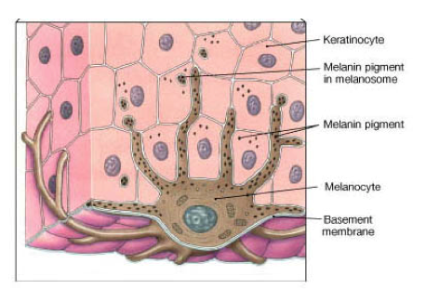
Whitening Mask Pack l Dr. Hwang
The Story of
Dr. Lucent
With Laser
Treatment
It works better with other Whitening and Ablative Fractional Laser treatments.
Lucent Mask has the effect of whitening the skin by control melanocytes that produce skin spots and pigment.
In addition, We thought that our products should be the safest ingredient in human body.

Slide 7
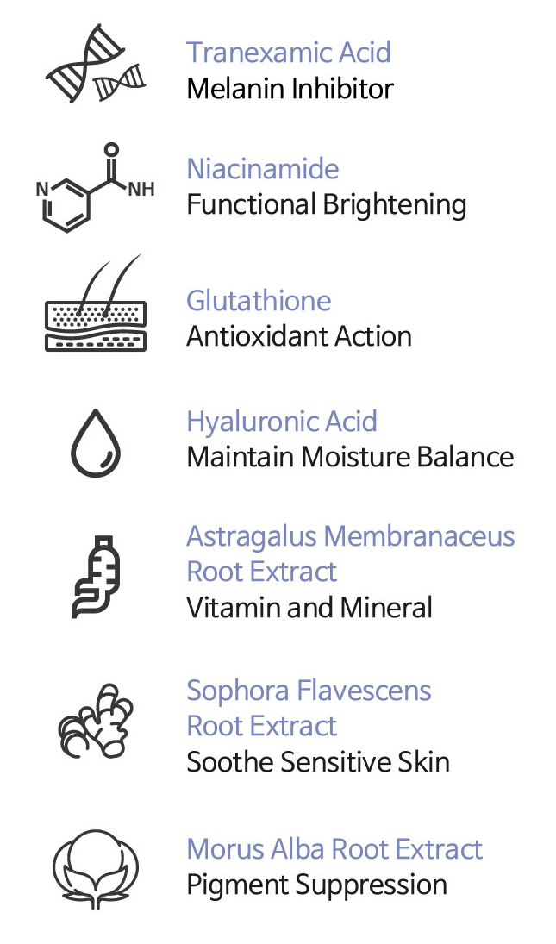
Whitening Mask Pack l Dr. Hwang
Ingredient of
Dr. Lucent
7 Main
Ingredients

Slide 8
Whitening Mask Pack l Dr. Hwang
Ingredient of
Dr. Lucent
Tranexamic Acid
Main Ingredient
+
Functional whitening components
Provide a stable brightening effect
Niacinamide

Slide 9
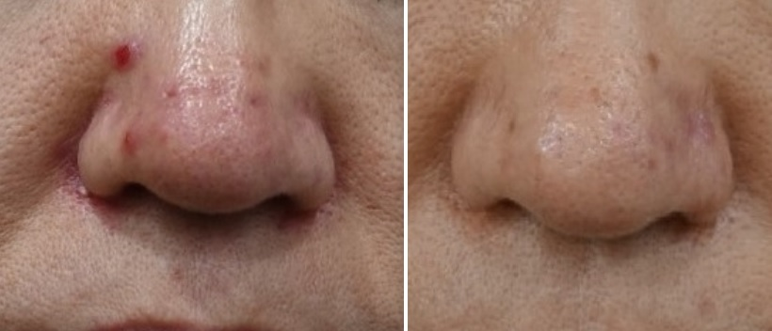
Whitening Mask Pack l Dr. Hwang
Clinc Use of Dr. Lucent with Tranexamic Acid
MTS + Tranexamic Acid + Lucent Mask for Rosacea
Korean Male / 40-Year
Before
After
Relieve Rosacea's erythema, Papules and Pustulosis

Slide 10
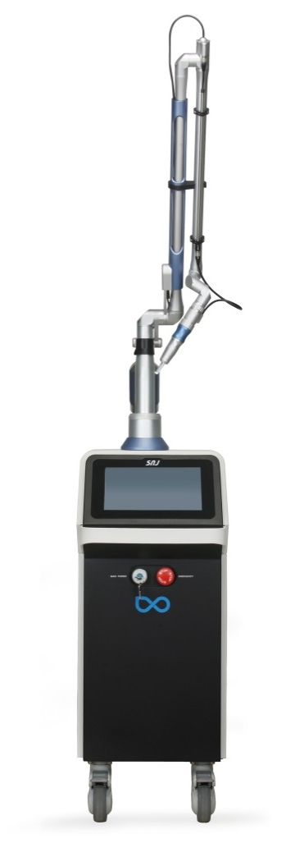
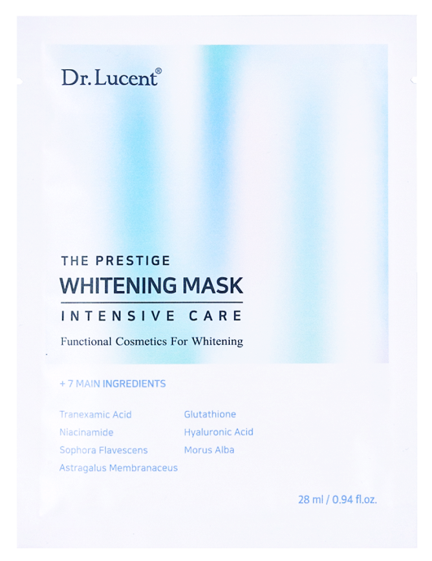
Whitening Mask Pack l Dr. Hwang
Clinical Use of
Dr. Lucent
After
Q-Switched
Laser
Treatment,
+
Finebeam Qplus
Q-Switched
Nd:YAG Laser
Dr. Lucent
Whitening Mask Pack
Dr. Hwang

Slide 11
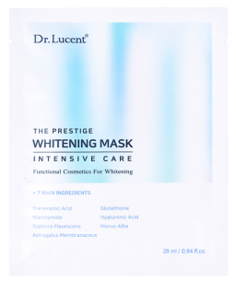
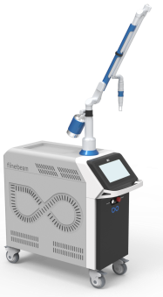
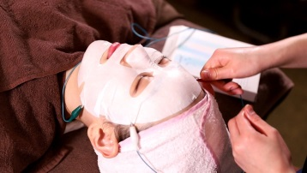
Whitening Mask Pack l Dr. Hwang
Brightening Treatment Program
Only Ample using with Ultrasound,
High Frequency
Device
(15minute )
Q-Switched
Nd:YAG
(10mm,1.0J )
Mask Sheet using with Iontophoresis (20minute )
Parameter for Asian
Cold sheets help to calm down

Slide 12
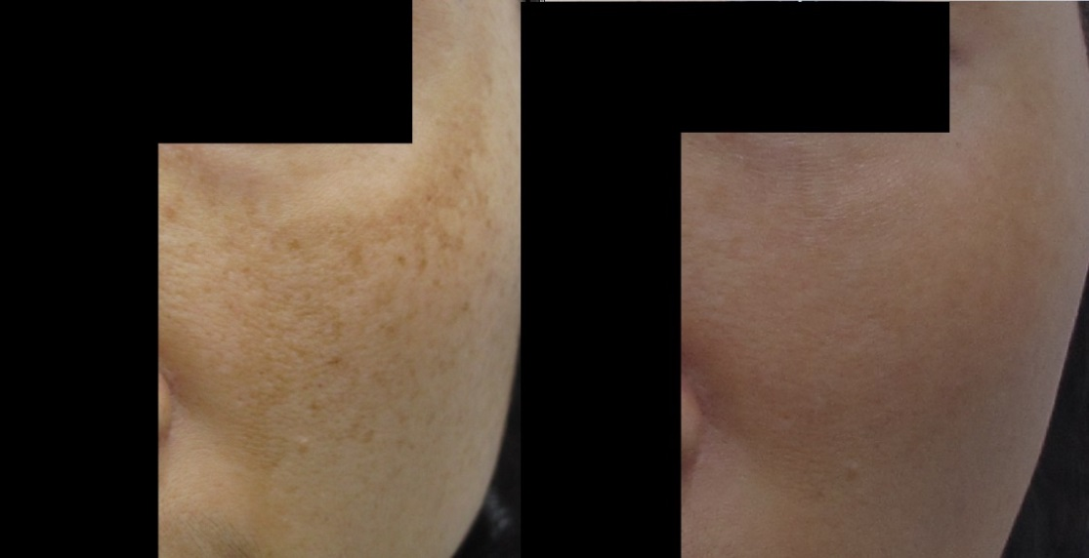
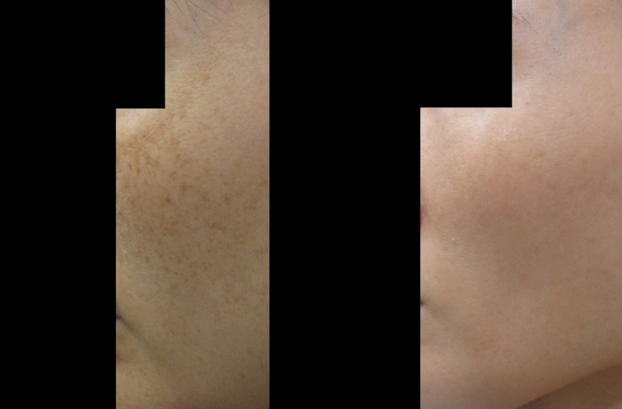
Whitening Mask Pack l Dr. Hwang
Use of Nd:YAG Laser Treatment for Melasma
1064 Q-Switched 10mm,1.0J + Lucent Mask 20min with Ionto phoresis (10 times)
Korean Female / 40-Year
Korean Female / 30-Year
Before
After
Before
After

Slide 13
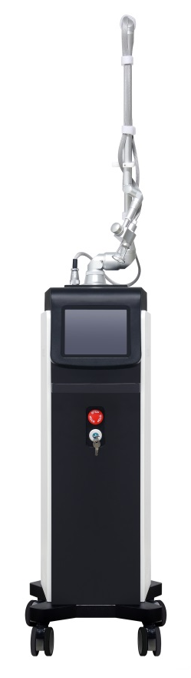
Whitening Mask Pack l Dr. Hwang
Clinical Use of
Dr. Lucent
After
Fractional
CO2 Laser
Treatment,
+
Finexel
All in One
Fractional CO2 Laser
Dr. Lucent
Whitening Mask Pack
Dr. Hwang

Slide 14
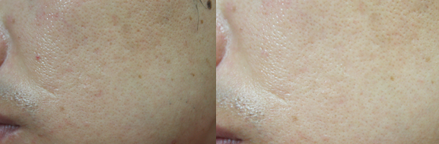
Whitening Mask Pack l Dr. Hwang
PIH Prevent after CO2 Fractional Laser Treatment
Dr. Lucent contains a high concentration of Hyaluronic Acid for scar treatment or improvement of elasticity after CO2 Fractional Laser procedure. Recommended to use it for several days, even if there is concern about PIH
Korean Male / 34-Year
Before
After

Slide 15

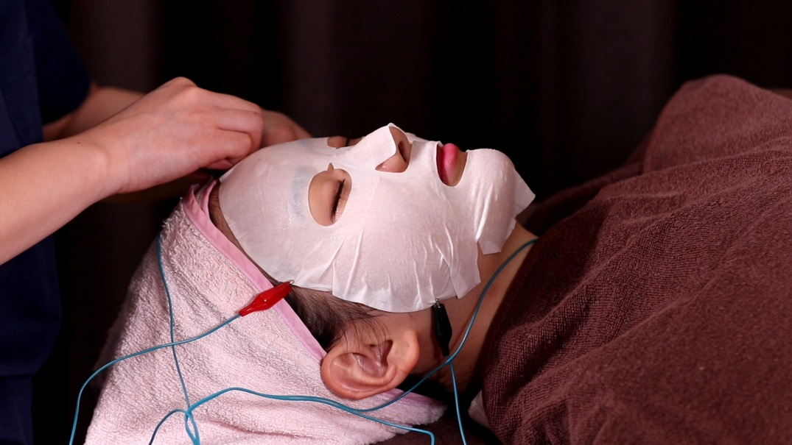
Whitening Mask Pack l Dr. Hwang
Clinical Use of
Dr. Lucent
With Ionzyme,
to infiltrate the patient's skin for about 10-30 minutes for after aggressive facial laser treatment.

Slide 16

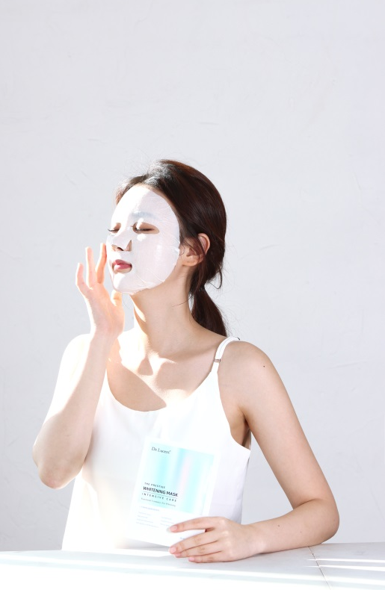
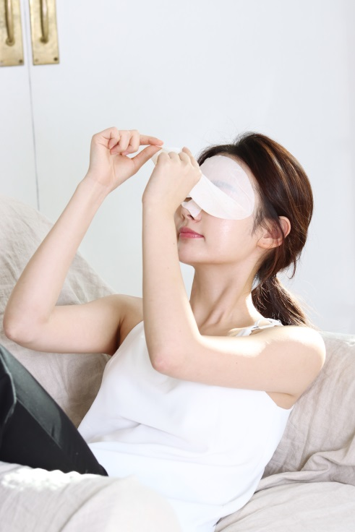

Whitening Mask Pack l Dr. Hwang
Homecare Use of
Dr. Lucent
After cleansing, Spread the mask sheet carefully and cover the face. Then take the mask sheet off after about 10~20 minutes. Dab essence
on the face and body lightly and massaging until completely absorbed for better efficacy.

Slide 17
