Slide 1
Finebeam Dye Handpiece
Issue date: February 21, 2023

Slide 2
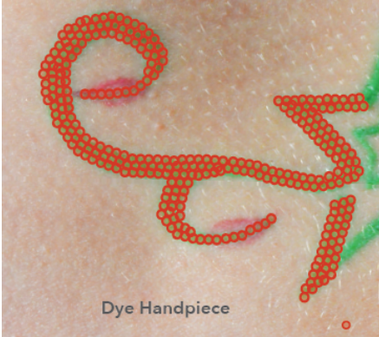
650nm Hand piece
Rod Limit: 20,000 ~ 30,000 shot
Epidermal Pigment
Freckle
Age spot
Café-Au-Lait etc.
Lentigines
Green tattoo
Spot: 3mm

Slide 3
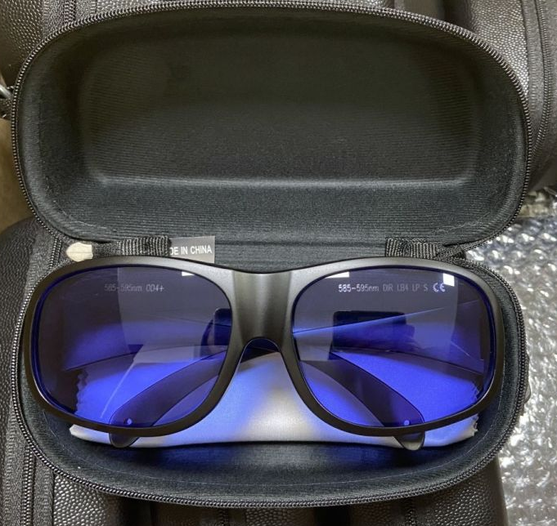
650nm RHP Laser Safety Goggles
RHP Laser Safety Goggles (for 650nm)
Protection wavelength: OD4+ @600-700nm
Transmittance: 50%
Available to use for 635nm, 660nm, 694nm etc.
Notes:
OD optical density

Slide 4
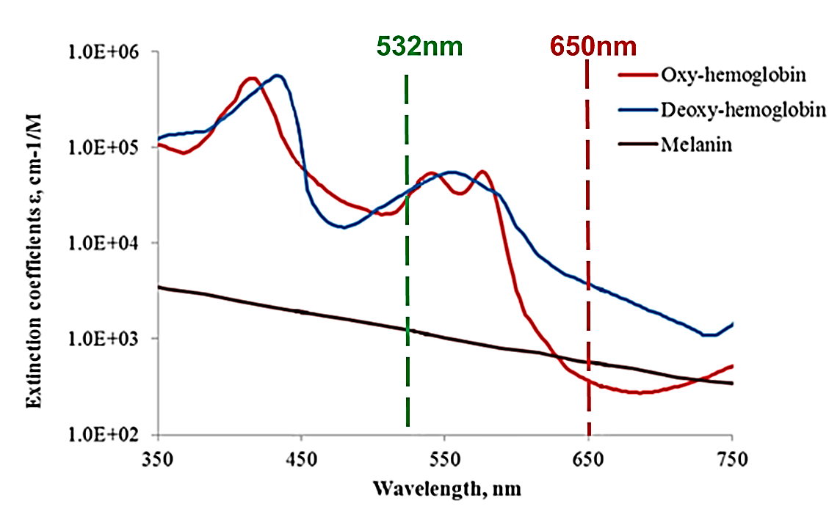
Absorption characteristics of 650nm
650nm wavelength is safer than 532nm, especially for epidermal lesions treatments.
That is because 650nm has lower absorption on blood, which leads to keep vessels undamaged.
In addition, 650nm has less absorption of melanin leading to less damage on the epidermis, and decrease inflammatory reactions such as PIH.
 | Absorption
Melanin | 532 nm > 650 nm
Oxy- and Deoxy-Hemoglobin | 532 nm > 650 nm
Notes:
Photo source
https://www.mdpi.com/2076-3417/10/21/7472

Slide 5
595nm Hand piece
ROD Life time: 120,000 ~ 180,000 shot
Vascular lesions
Acne
Post Acne Redness
Facial Flushing
Rosacea
Melasma, PIH
Sky blue tattoo
Spot: 5mm

Slide 6
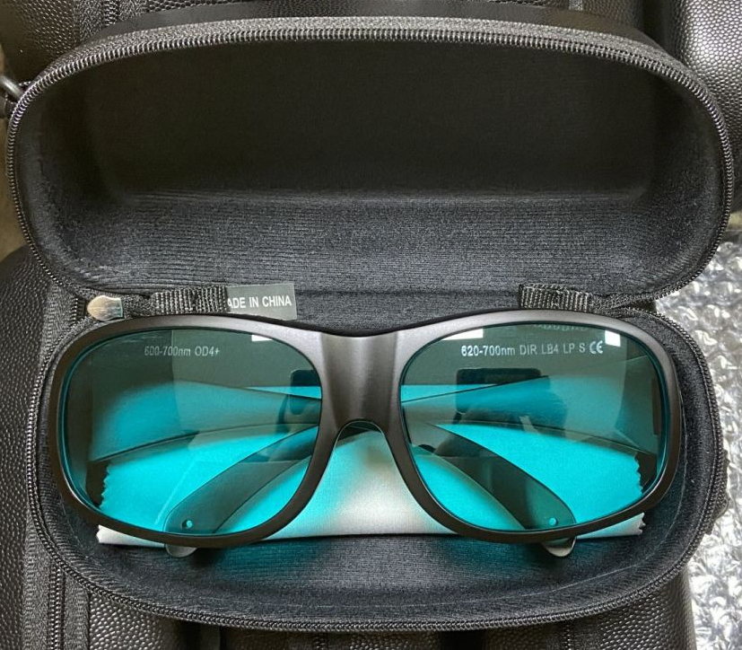
595nm RHP Laser Safety Goggles
RHP Laser Safety Goggles (for 595nm)
Protection wavelength: OD4+ @585-595nm
Available to use for 585nm, 595nm
Transmittance: 30%

Slide 7
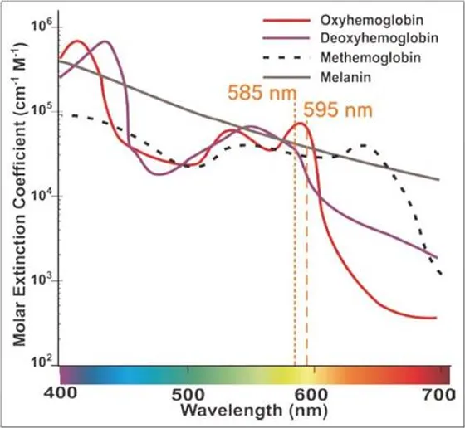
Absorption characteristics of 595nm
Absorption rate for melanin and hemoglobin is high.
It is effective for flushing, post-acne redness, melasma or PIH.
Notes:
Postinflammatory hyperpigmentation PIH(SE) Side Effect
Photo source
https://www.emedicinehealth.com/image-gallery/henoch-schonlein_purpura_picture/images.htm

Slide 8
Finebeam Dye Handpiece Parameter
595nm H/P
Indication | Wavelength (nm) | Mode | Spot Size (mm) | Fluence (J/cm²) | Pulse Rate (Hz) | Pass | Session | Interval (weeks)
Acne Post Acne Redness Facial Flushing Rosacea | 595 | 532 QSW | 5 | 0.15 ~ 0.25 | 5 | 2 ~ 3 | 5 ~ 10 | 1~2
 | End Point: Mild erythema Post care: Apply hydrocortisone (~1%)
Sky Blue Tattoo | 595 | 532 QSW | 5 | 2.29 ~ | 1 ~ 2 | 1 | 3 ~ | 6 ~ 8
 | End Point: Mild erythema Post care: Apply hydrocortisone (~1%)
650nm H/P
Indication | Wavelength (nm) | Mode | Spot Size (mm) | Fluence (J/cm²) | Pulse Rate (Hz) | Pass | Session | Interval (weeks)
Epidermal Pigment | 650 | 532 QSW | 3 | 1.55 ~ | 1 | 1 | 1 ~ 2 | 4
 | End Point: Mild Frosting Post care: Apply antibiotic ointment or hydrocortisone (~1%)
Green Tattoo | 650 | 532 QSW | 3 | 3.18 ~ | 1 ~ 2 | 1 | 3 ~ | 6 ~ 8
 | End Point: Frosting, Pinpoint bleeding is acceptable Post care: Apply a cold compress and antibiotic ointment then, cover the treated area

