Slide 1

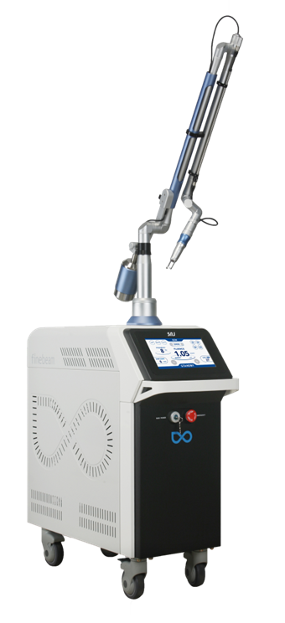

Finebeam
Tattoo removal

Slide 2
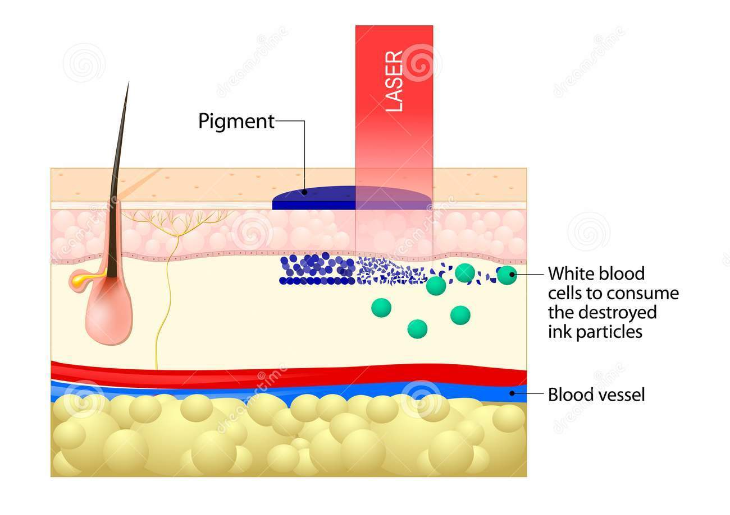
Tattoo removal mechanism
1) tattoo pigment absorbs light, which causes the ink to break down 2) The ink particles are absorbed by our immune system
Laser breakdown tattoo ink

Slide 3
Tattoo removal with Finebeam
Tattoo in epidermis – first with single pulse
With the feeling of skin off the ink on the skin
Tattoo is dark so energy act so well so it should be treated with low fluence.
Start – 1 pass, single pulse: end point is whitening -> petechia
End point isn’t bleeding
Around 2 or 3 sessions later, skin doesn’t show the whitening reaction at all, it should be changed to PDP mode.
When the interval time is longer like 3 months, the dermis area is much more healthier and firmed so tattoo is
more easily took off.
Spot size: 3mm
Sessions (1064nm) | Mode | Spot Size (mm) | Fluence (J/cm²) | Energy (mJ) | Pulse Rate (HZ) | Pass | Interval (weeks)
1’st session | QSW S | 3 | 4.35 | 285 | 1 | 1 | 4 to 8
2’nd session | QSW S |  | 4.81 | 340
3’rd session | QSW S |  | 5.94 | 420
4’th session | QSW P |  | 7.07 | 500
5’th session | QSW P |  | 8.49 | 600
Notice: Set the fluence after checking the skin reaction. The skin reaction is quite different per the characteristic of tattoo, the most important thing is end point is whitening and be so much careful to prevent bleeding. It should be required to fully kept in all different tattoo parameter.

Slide 4
Spot size: 4mm
Sessions (1064nm) | Mode | Spot Size (mm) | Fluence (J/cm²) | Pulse Rate (HZ) | Pass | Interval (weeks)
1’st session | QSW S | 4 | 3.34 | 3 | 1 | 4 to 8
2’nd session | QSW S |  | 4.3
3’rd session | QSW S |  | 5.57
4’th session | QSW S |  | 6.52
5’th session | QSW P |  | 8.49

Slide 5
Sessions | Mode | Spot Size (mm) | Fluence (J/cm²) | Pulse Rate (HZ) | Pass | Interval (weeks)
Eyebrow | QSW S | 3mm | 2 ~ 7 | 1 | 1 | 4
Red, Orange, Purple | QSW 532nm | 3mm | 1.1 ~ 2.38 | 1 | 1 | 4
<Combination Tattoo removal with Finexel CO2 and Finebeam>
1)
Fractional Mode | Energy | Density | Scanning size(mm) | Pass
CO2 FRX | 8mJ | 1.2 mm | Depends on tattoo size | 1
2)
Finebeam Tattoo care
3)
Finebeam Sessions | Mode | Spot Size (mm) | Fluence (J/cm²) | On Time (ms) | Pulse Rate (HZ) | Pass | Interval (weeks)
Genesis technique | LPS | 7 mm | 7.8 J | 0.3ms | 10 | 5 | 4 ~ 8
* Treat the Genesis technique after every sessions for improving dermal environment.
Return to PAGE 77.

Slide 6
After Tattoo removal with Finebeam
Sedate with ice on the day of procedure
Apply skin recovery ointment every 4 or 5 hours interval
Apply enough amount of “Baseline” for keeping moisture
Protect the skin with UV SUN block cream
Don’t take shower around 4 to 5 days before scab comes off

Slide 7
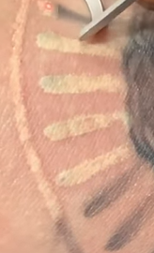
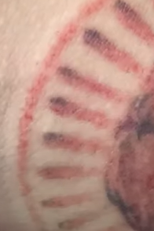
Tattoo removal procedure
Immediate whitening
Petechia
When ink is break out, air is generated. It looks white due to bubble
20 min. later,
Bubble is broken and petechia is occurred
https://youtu.be/cyHqM9DhHcA

Slide 8
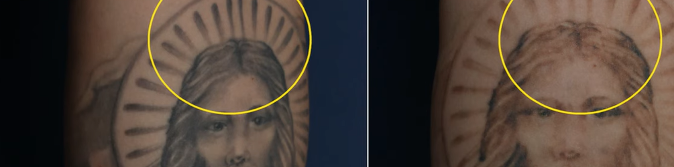
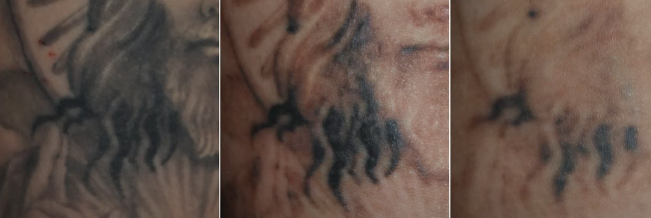
In the area with low amount of ink, almost 80% of ink is removed after 1’st session.
Before
After 1 session
After 5 sessions

Slide 9
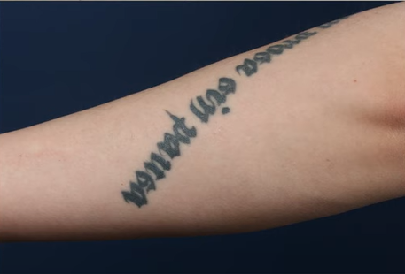
The representative type of tattoo with big amount of ink in the skin is lettering
It will take long time like 10 to 20 sessions and it will also have chance to arise side effect like scar.

Slide 10
During diagnosis prior for starting Tattoo removal, below information need to be informed to prevent any controversial case
It takes long time, 10 sessions to more, it will take 1 to 2 years. Around 80 ~ 90% of tattoo ink is removed.
2. It can’t be returned to the skin prior for tattoo.
3. It requires high cost.
4. It is more safer and effective whenever keep the longer interval over 1month, when we checked one case 3 months interval, it was more effective. When the epidermis is fully recovered, it is able to treat with higher fluence.
5. After the tattoo, don’t drink alcohol at the same day because it will be bleeding.

Slide 11
Precautions for tattoo care
1. After 90% of tattoo is removed, some patients disappoint that they can’t see the improvement anymore. It is the case that tattoo is already removed but PIH left as side effect. This is commonly arise in the body part with slow recovery rate like arms and legs.
In this case, extend the interval to 3 months to keep a enough recovery time or change the another technique to care.
2. It is required test shot and find the proper energy first immediate whitening and petechia in 20 min.
3. In case the tattoo color is darker, fluence should be lower and then increase energy slowly per every sessions. The too high power can be the cause of side effect like Keloid or hypopigmentation, so you should be so much care about energy setting.
4. Don’t over pass with 532nm.
5. In case you take 1064nm and 532nm together, you should treat with 532nm first.

Slide 12
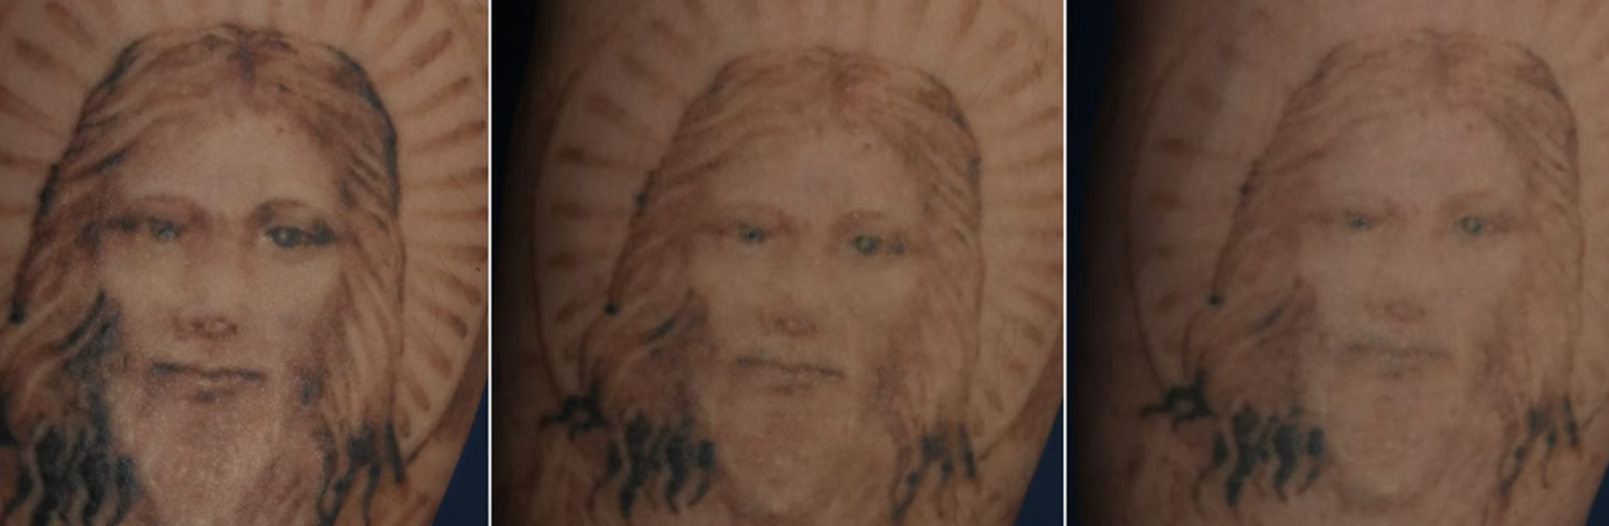
1’st session
2’nd session
3’rd session

Slide 13
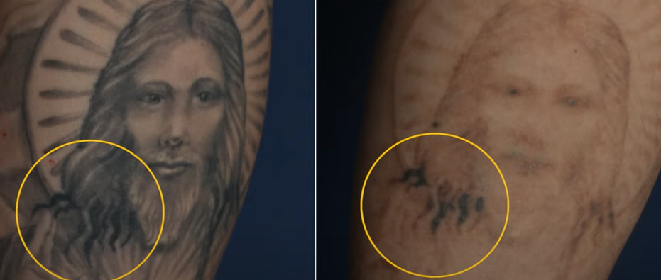
Before
5 session
The rounded area is bulging with ink. It can’t be removed even after 5 sessions. It will be required almost 20 sessions.
Source from Oracle clinic

Slide 14
Tattoo removal isn’t easy and clinics have their own way to treat
1) Twice a day care “R20”
1’st laser tattoo removal –> 20 ~ 30 min. later -> 2’nd laser tattoo removal
2) Treat Finexel fractional CO2 first, tattoo more easily break down.
1’st Finexel fractional CO2 -> 2’nd Finebeam QSW -> 3’rd Finebeam LPS Genesis technique

Slide 15
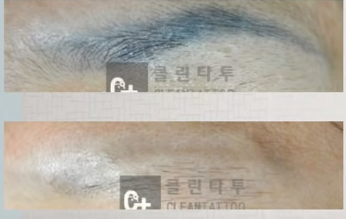
Eyebrow Tattoo removal
Advice to patient before tattoo removal, in case removing eyebrow tattoo as the purpose to completely remove it, it will also remove hair in there. So considering the eyebrow, control the sessions.

Slide 16
Several factors to effect tattoo removal
Amount of ink
The ink color
Skin condition
Depth of tattoo
Permanent or Semi permanent
Interval
Tattoo operator
The location of tattoo
(the tattoo near of heart is more easily removed)

Slide 17
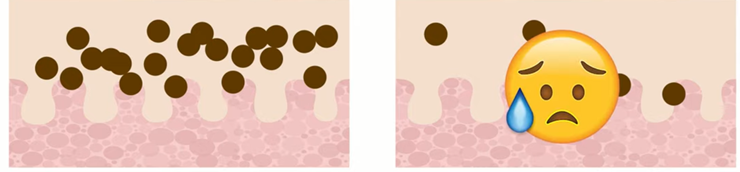
Around 50% of tattoo ink particle is removed at the first session, when the tattoo have 100 pcs of ink particle and 50% of tattoo ink is remained. And 50% of tattoo for 10 is removed. So patient disappointed about the result by sessions goes by.
1’st session: among 100 pcs tattoo ink/
50 pcs of ink particle are broken.
Next sessions: among remained tattoo ink/ half or even lower than half of them are broken

Slide 18
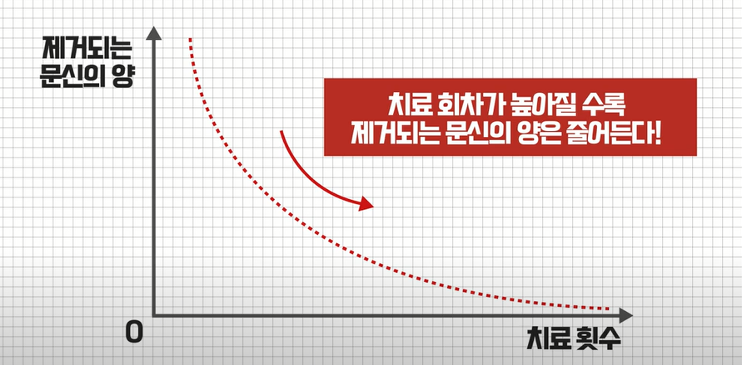
The removed tattoo amount
The amount of tattoo
Reverse compound
The amount of tattoo is reduced by increasing treatment sessions
Treatment sessions

Slide 19
One session tattoo removal cost for one tattoo removal specialized clinic in Korea
It is so different per size, color, color thickness, clinics.
9cm
2.6cm
5cm
Color tattoo additional cost depends on the size
: 2.6cm diameter round size: +USD50
USD50
X1 – USD100
X2 - USD200
X3 – USD300
X4 – USD400
A4 SIZE – USD700

Slide 20
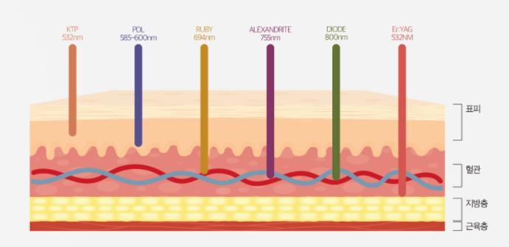
epidermis
blood vessel
fat layer
muscle layer
Rank of Absorption Rate by Wavelength
Tattoo Removal
Wavelength | Melanin | Oxyhemoglobin | Deoxyhemoglobin
1064nm | 4 | 3 | 4
694nm | 3 | 4 | 3
585nm | 2 | 1 | 2
532nm | 1 | 2 | 1
1064nm 694nm 585nm 532nm
Ruby Toning(694nm): Lentigines, Freckles
Gold Toning(585nm) : Acne vulgaris
Notes:
complementary colors

