Slide 1
Finebeam Main indications parameter side effects care
Issue date: SEP. 19, 2022
Revision: AUG. 19, 2023
OCT. 17, 2023
Notes:
https://youtu.be/zujTUoE4bbA

Slide 2
Fine peel – Carbon peel
1. Long pulsed mode(300 µs) – Real Long pulse Genuine Genesis
: It contract pores and improve skin texture.
Spot size: 10mm, On time: 0.3ms, Fluence: 3.1J/cm², 10HZ
2. Apply Finebeam carbon cream
: Lightly apply Finebeam carbon cream and 3 to 5 min. So cream can be well seeped in to the pores.
3. Q-switched mode(5ns)
: Explode carbon particles to peel off dead cell.
Spot size: 10mm, Fluence: 1.04J/cm², 10HZ

Slide 3
Hair bleaching
Wavelength | Mode | Spot Size (mm) | Fluence (J/cm²) | Pulse Rate (HZ) | Pass | Interval (weeks)
1064nm | QSW | 8 | 1.0 ~ 1.5 | 5 – 10 | 1 -2 | 2
End point: immediate bleaching

Slide 4
Scar & Rejuvenation combination care
 | Wavelength (nm) | Mode | Spot Size (mm) | Fluence (J/cm²) | Pulse Rate (HZ) | Pass | Interval(weeks) | Session
Initial overall tightening
Basic (treat with this parameter first before focused care) | 1064 | PDP | 10 |  | 10 | 2 ~ 3 | 1 | 10 ~
Focused care
Overall skin rejuvenation | 1064 | QSW | MLA 10mm | 0.53 ~ 0.63 | 10 | 2 ~ 3 | 2 | 5 ~
Acne scar | 1064 | QSW | MLA 4mm | 4.61 ~5.25 | 2 ~ 4 | 3 | 2 | 5 ~
Wide Pore | 1064 | QSW | MLA 7mm | 2.13 ~ 2.65 | 5 ~ 10 | 2 ~ 3 | 2 | 5 ~
Final RE-FIRM
Dermis Firming Genuine Genesis | 1064 | LPS | 10mm | 7.8J On time (0.3ms) | 10HZ | 3 | 1 | 10 ~

Slide 5
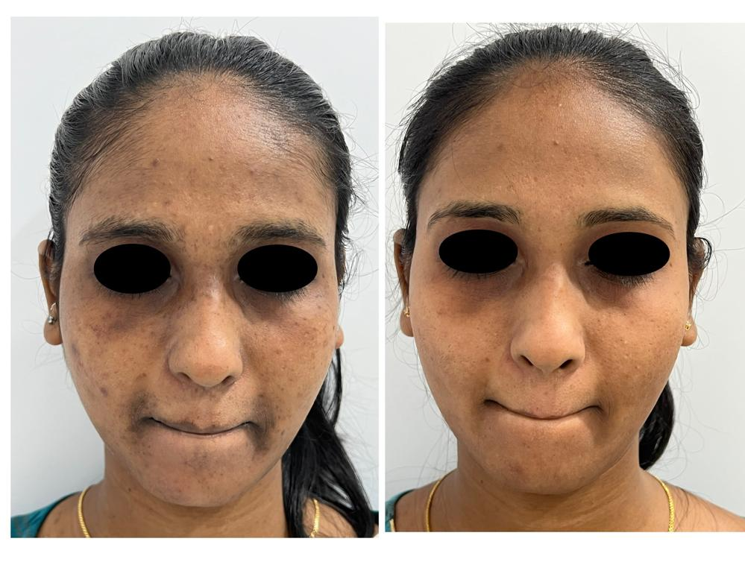
Pigmentation care
Courtesy of DR.JYOTI V.
from India
Wavelength | Mode | Spot size (mm) | Fluence (J/cm²) | Pulse Rate (HZ) | Pass | Remark
1064nm zoom | QSW Single | 7mm | 1 ~ 1.2 | 5 – 10 | 1
 | QSW PDP | 7mm | 1.3 ~ 1.4 | 5 – 10 | 1
1064nm ZOOM | Genesis Quasi | 8mm | 4.42 ~ 4.68 | 10 | 1
*Clean the DOE handpiece’s tip and window before and after treatment

Slide 6
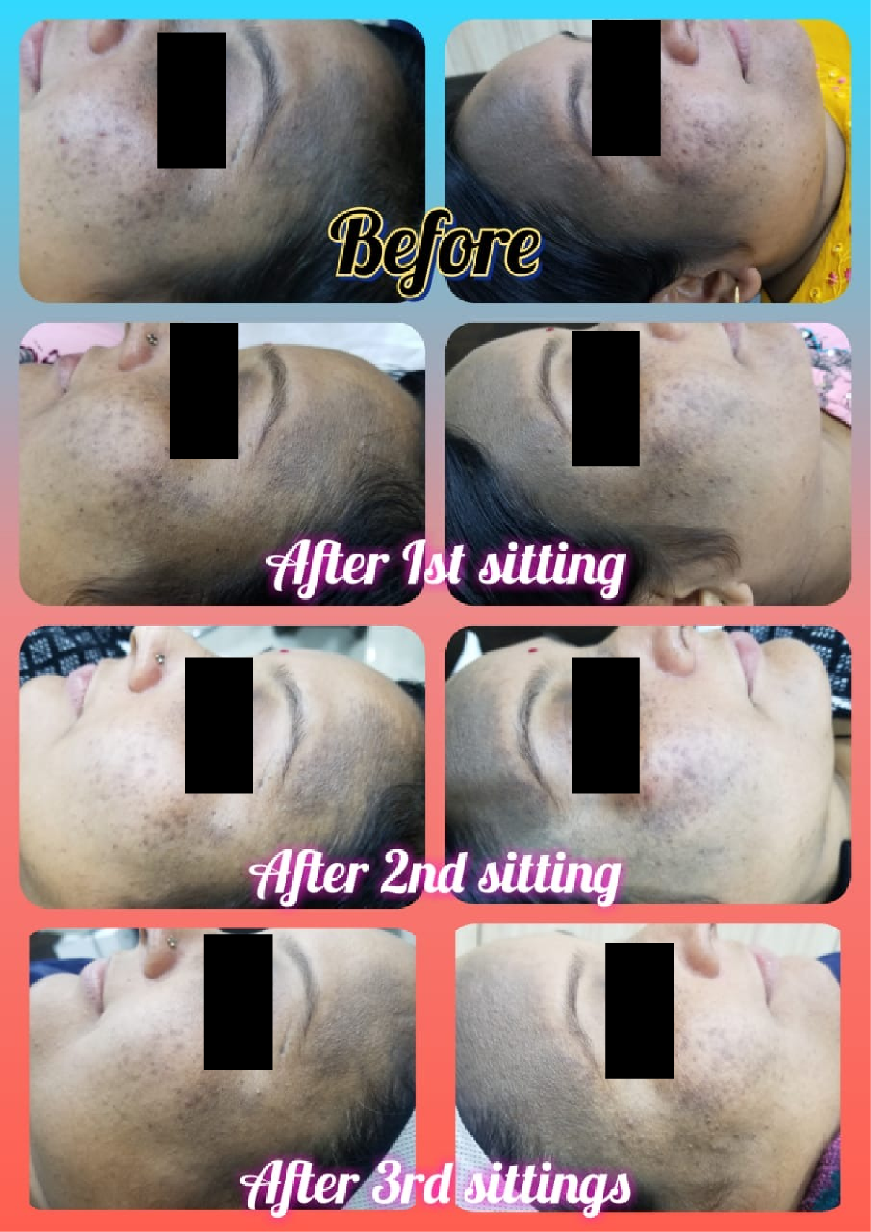
DOE H/P Ota Nevus
Courtesy of Vibhor Kaushal M.D
from India
Wavelength | Mode | Spot size (mm) | Fluence (J/cm²) | Pulse Rate (HZ) | Pass | Remark
1064nm DOE | QSW Single | 7mm | 0.8 | 5 – 10 | 1
 | QSW PDP | 7mm | 1 | 5 – 10 | 1
1064nm ZOOM | Genesis Quasi | 8mm | 4.2 | 10 | 2~4

Slide 7
Finebeam Dual Trifull Toning
Wavelength | Mode | Spot Size (mm) | Fluence (J/cm²) | Pulse Rate (HZ) | No. of shot | Interval (weeks)
1064nm ZOOM | QSW S | 10 | 0.99 ~ 1.04 | 10 | 2,000 | 2
 | Wavelength (nm) | Mode | Spot Size (mm) | Fluence (J/cm²) | Pulse Rate (HZ) | On time | No. Of shot | Interval (weeks)
Genuine Genesis | 1064 | LPS | 7mm | 7.8J | 10HZ | 0.3ms | 2000 | 2
Wavelength | Mode | Spot Size (mm) | Fluence (J/cm²) | Pulse Rate (HZ) | No. of shot | Interval (weeks)
1064nm MLA | QSW S | 10 | 0.53 | 10 | 2,000 | 2

Slide 8
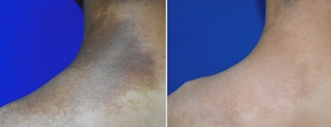
Becker’s Nevus
Toning parameter
1 or 2 weeks interval, toning parameter, 30 to 40 sessions care
End point: petechia, frosting
Becker's nevus is quite difficult to remove indication. It was treated with high power before but many cases, it left hyper pigmentation or hypopigmentaton and even though its relapse case is so high. Now, one dermatologist recommend that 1 or 2 weeks interval, toning parameter, 30 to 40 sessions care. It doesn't left side effect.
Mechanism: Repeatedly treat it with low energy so it break melanosome in the cell and so they loose their functions. And finally abnormal melanocytes will be dead.
It has low pain so it is able to do without anesthesia. And also it doesn’t arise any skin change like scab so it doesn’t hurt normal life. The adolescent child also can be took the care without problem so it is able to treatable from young age.
Source from Gwang-Chul Hong M.D Blog

Slide 9
Becker’s Nevus
 | Strong laser care | Low power laser care
Laser type | Ruby laser Nd:Yag laser Alexandrite laser IPL, Erbium, CO2 Fractional | 1064nm Q-Switched Nd:Yag laser Toning parameter
Interval | 1 ~ 2 months | 1 ~ 2 weeks
Anesthesia | Topical anesthesia cream is required | No need
Pain | Painful | Almost no pain
Post care | Scab is remained for several days | No discomfort feeling
Required sessions | 5 to 10 sessions | Minimum 30 sessions
Treatment result | Can’t be expected | Generally good result
Side effect | Hyper pigmentation Mottled hypo pigmentation Scar, recurrence rate is common | No side effect
Source from Gwang-Chul Hong M.D Blog

Slide 10
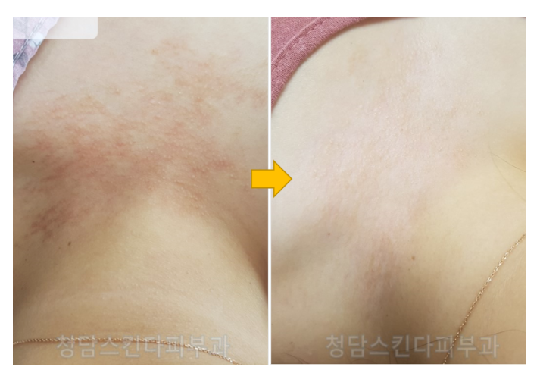
Becker’s Nevus
Treatment with laser with low power, it is able to effectively treat becker’s nevus with less pain and without side effect
Source from Gwang-Chul Hong M.D Blog

Slide 11
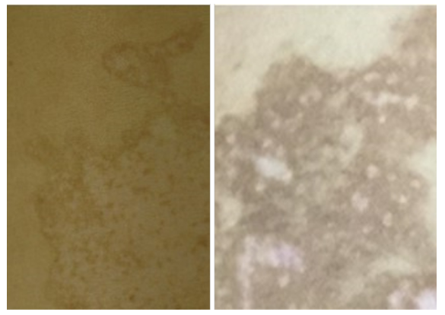
Side effect after Becker’s Nevus care with strong treatment
Side effect after strong power laser care
It can make mottles hypopigmentation(left) or hyperpigmentation(right)
There is chance to frequent rebound problem and it is easily rebounded.

Slide 12
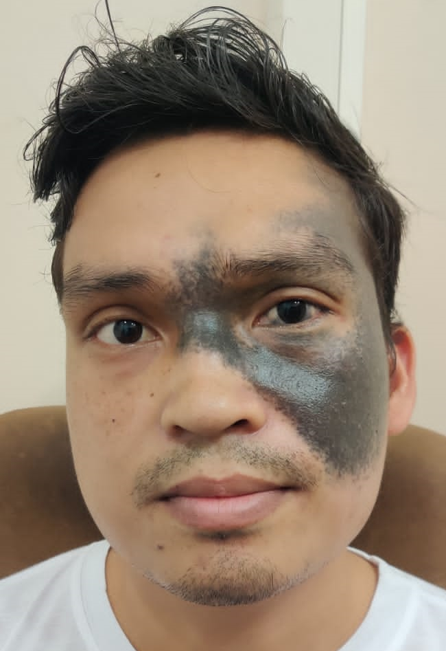
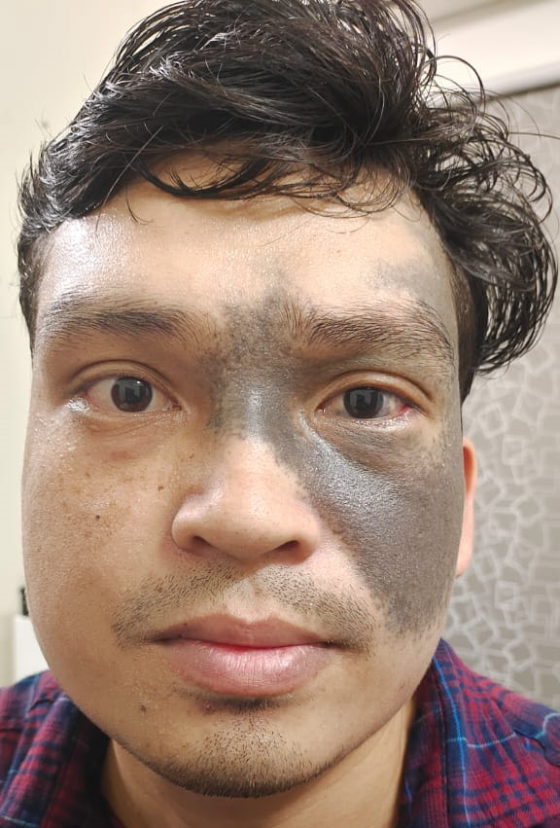
Interval: 15 days
1’st session for Finebeam
Fluence: 4.93 J/cm²
Spot size: 4mm
mild whitening
Finexel CO2 resurfacing energy: 10~12mJ, density 12mm
2’nd session for Finebeam
Fluence: 7 J/cm² PDP mode
Spot size: 6mm
3’rd sessions for Finebeam
1’st pass: Fluence: 4.93 J/cm² spot size: 4mm PDP
2’nd pass: 7 J/cm² PDP mode
Spot size: 6mm

Slide 13
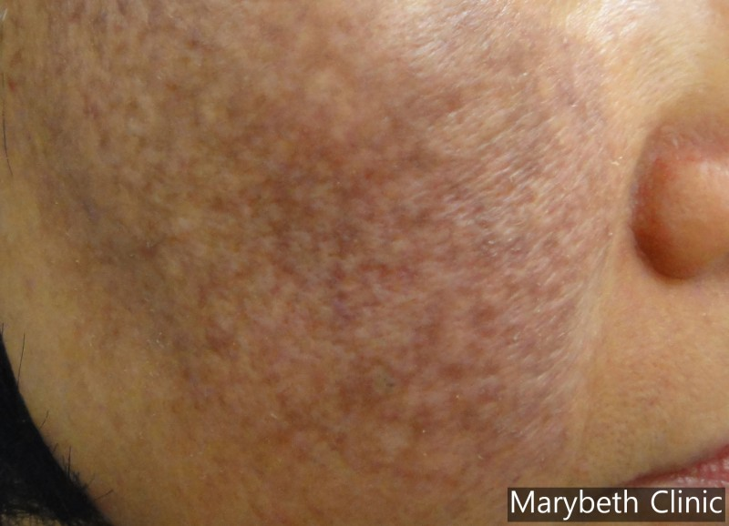
Melanosis
A retrospective review was conducted on patients repetitively treated with mid-fluence (3.5–5 J/cm2 with a spot size of 5 mm and a pulse rate of 10 Hz) QSNY 1064-nm laser. The endpoint is petechial hemorrhages partially in the dark portion of the pigmentation.

Slide 14
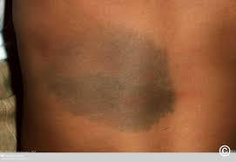
Dermal melanocyte
It is recommended to higher the energy over than it 5J. And it required to do periodical hair removal. It is very easy to generate side effect like PIH and it takes so long time to treat.
For the becker melanosis, it is recommended to use with
It is difficult to say about parameter setting because it should be changed per skin type. You should set the fluence checking the skin response. Remove hair periodically with long pulse and treat melanocyte up to the petechia. If you have QSW Ruby or QSW Alex, it will be better to treat. With QSW Nd:Yag, 4mm spot and increase the fluence up to the petechia. If there is no improvement after 2 or 4 weeks later, apply Q532 and set the grayish color change as end point and without improvement with that setting, set the whitening as end point at the next session. Same with Q1064 treatment, you also explain about the possibility of PIH with Q532 care. Due to the limit of optical penetration depth, it is quite difficult indication with Q532.

Slide 15
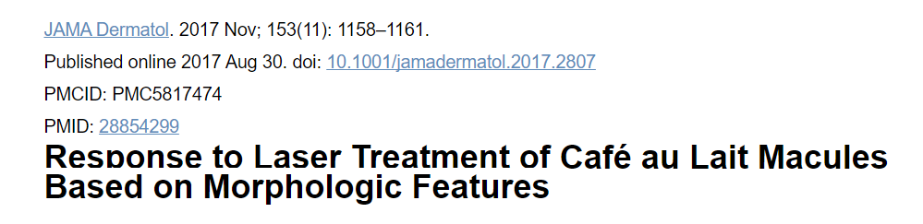
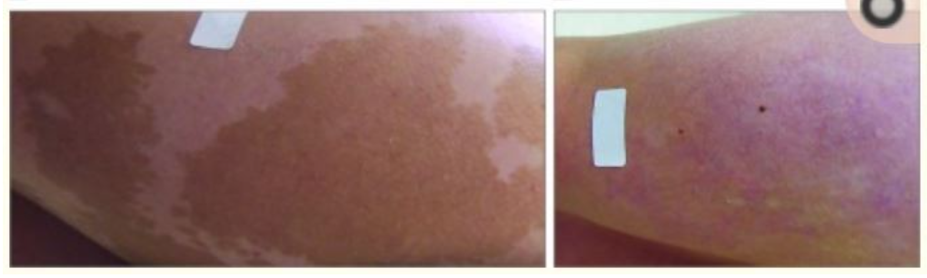
Café au lait spot
Response to laser treatment for café au lait macules(CALMs) is inconsistent and difficult to predict.
Some of them like the line isn’t smooth and color is irregular with variety colors mixed lesion.
Above one has line is irregular and it is cured a little bit.
The case like that line is smooth and evenly distributed one has no response from laser.

Slide 16
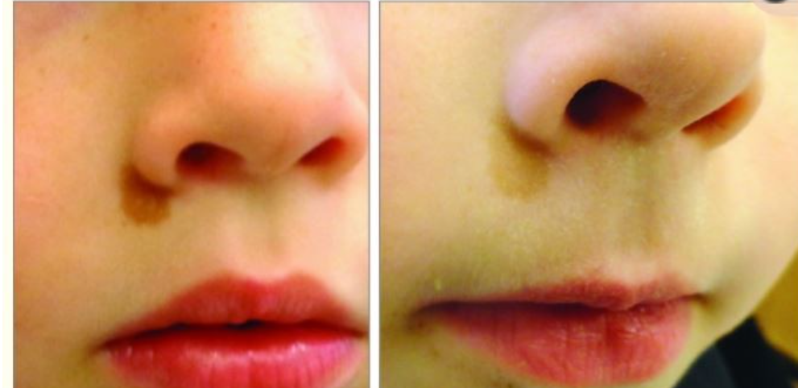
Some of them like the line isn’t clear, the response rate against laser is tend to low.
Comparing size and located area, Café au Lait macules smaller in face having irregular boundary and mixing several colors have higher chance to be removed.
But P-Value isn’t significant.
Source from “Response to Laser Treatment of Café au Lait Macules Based on Morphologic Features”

Slide 17
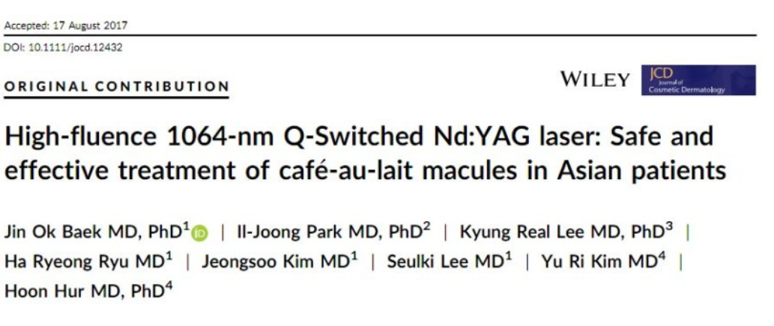
Testee group: 35 Koreans
With 1064nm laser, Café-au lait spot can be cured without side effect or recurrence.
However it requires several sessions, according to the clinical report, it was treated average 30 sessions for almost 1 year.

Slide 18
Abstract
Objectives: Café-au-lait macules (CALMs) are benign cutaneous hyperpigmentary disorders. Usually, laser therapies for cosmetic concerns result in more severe side effects in the people of Asian descent than that of Caucasians. Unfortunately, there is no gold standard for the laser treatment of CALMs in skin of people of Asian descent. To investigate the efficacy and safety of a high-fluence 1064-nm Q-switched neodymium-doped yttrium aluminum garnet (Nd:YAG) laser treatment of CALMs in Asian patients.
Study design: The medical records of 35 Korean patients (age range: 1 to 40 years old, mean age: 18.5 years) diagnosed with isolated CALMs were reviewed retrospectively.
Methods: The patients were treated with a 1064-nm Q-switched Nd:YAG laser. The parameters were a spot size of 7 mm, a fluence of 2.2-2.4 J/cm2 with a slow single sliding-stacking pass, and a pulse rate of 10 Hz with a 1-week interval for 20-50 sessions.
Results: At the week of the final treatment, all treated Café-au-lait macules (CALMs) showed considerable pigmentation removal without any permanent side effects, such as scaring, mottled hypopigmentation and post inflammatory hyperpigmentation (PIH). All treated CALMs showed more than 50% clinical improvement. No recurrence was observed in any of the patients after 12 months of follow-up.
Conclusion: A high-fluence 1064-nm Q-switched Nd:YAG laser treatment of CALMs in Asian patients is a safe and effective method without side effects and recurrence.
Keywords: 1064-nm Nd: YAG; Café-au-lait macules; Q-switched; laser; treatment.

Slide 19
Parameter for Café-au lait macule
Wavelength | Mode | Spot Size (mm) | Fluence (J/cm²) | Pulse Rate (HZ) | Pass | Interval (weeks) | Sessions
1064nm | QSW | 7 | 2.2 ~ 2.4 J/cm² | 10 | 1 -2 | 1 | 20 ~ 50
* Source from: High-fluence 1064-nm Q-Switched Nd:Yag laser: Safe and effective treatment of café-au-lait macules in Asian patients
Wavelength | Mode | Spot Size (mm) | Fluence (J/cm²) | Pulse Rate (HZ) | Pass | Interval (weeks) | Sessions
532nm | QSW | 2 ~ 3 | 0.5 ~ 0.7 | 1 | 1 -2 | 1 | 20 ~ 50

Slide 20
Telangiectasia
Wavelength | Mode | Spot Size (mm) | On Time (ms) | Fluence (J/cm²) | Pulse Rate (HZ) | Pass | Interval (weeks) | Sessions
1064nm | LPS | 2 ~ 3 mm | 5ms | 180J ~ 200J | 1 | No overlapping | 4~6 weeks
The biggest problem for blood vessel treatment is blood vessel itself is sink as big as vessel size. It is the big problem of vessel removing by all long pulsed lasers.
It is caused by blood vessel is coagulated and it is skin sink as big as blood vessel size.
When doctor want to remove vessel with once, it makes this problem.
It is so important to treat with several sessions like 3
And cooling is quite important. Air cooling by Blue Ice, it is quite important to pre cooling, on-time cooling and post cooling. DCD cooling is only cool the surface but air cooling can cool in dermis so it protect this kind of trouble.

Slide 21
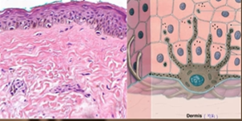
Age spot, Lengtigo
: they can be easily removed
Melasma
: it is appeared by increasing melanin on the epidermis
Cause: Aging – Photo aging and sun beam
1. Excessively produce the melanocyte q’ty, so it makes the skin looks mottled.
2. Dermis is aged.
Photo aging

Slide 22
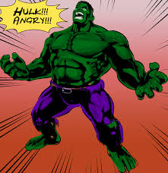


Only toning: break melanin pigment -> temporal effect -> the activated melanocytes continually generate pigments
UV
genetic
friction
Female hormone

Slide 23

Activated melanocyte
Normal melanocyte
Improving dermal condition
Hulk
Bruce Banner

Slide 24
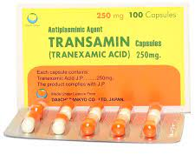
Improving dermal condition
Toning
Improve dermal condition
Lowering cytokine
Skin texture improvement effect
MLA, Genesis, RF Needle
It doesn’t guaranty melasma 100% removal but the rebound rate is extremely lowered
Melasma is very tough indication to be cured. So it requires additional method and effort to maintain good condition.
It is recommended to periodically visit clinic every 1 or 2 months.
Taking Transamin
Patient effort
Lowering friction on the face: it generate micro inflammation ->
activate melanocyte
UV – Sunblock
Taking Vitamin C
Receive treatment regularly once a month

Slide 25
Melasma
 | Wavelength (nm) | Mode | Spot Size (mm) | Fluence (J/cm²) | Pulse Rate (HZ) | On time | Pass | Interval (weeks) | Session
Genesis | 1064 | LPS | 10mm | 3.1J | 10HZ | 0.3ms | 3 | 1 | 10 ~
Treat Genesis technique before melasma care for dermal environment improvement.
Wavelength | Mode | Spot Size (mm) | Fluence (J/cm²) | Pulse Rate (HZ) | Pass | Interval (weeks) | Sessions
1064nm | QSW S | 6 | 0.8J | 10 | 2~3 | 2
1064nm | QSW S | 5 | 0.99J | 10 | 2~3 | 2
1064nm | QSW S | 5 | 1.04J | 10 | 2~3 | 2
1064nm | QSW P | 5 | 2.2J | 10 | 2~3 | 2
1064nm | QSW P | 5 | 2.4J | 10 | 2~3 | 2
1064nm DOE | QSW P | 7 | 3.2J ~ | 10 | 2~3 | 2
End point: Observing the delayed perilesional erythema and increase the fluence little by little.

Slide 26
* For the patients who had several laser toning and the melasma becomes worsen.
 | Wavelength (nm) | Mode | Spot Size (mm) | Fluence (J/cm²) | Pulse Rate (HZ) | On time | Pass | Interval (weeks) | Session
Genuine Genesis | 1064 | LPS | 10mm | 3.1J | 10HZ | 0.3ms | 3 | 1 | 10 ~
* Treat Genesis technique before melasma care for dermal environment improvement.
Wavelength | Mode | Spot Size (mm) | Fluence (J/cm²) | Pulse Rate (HZ) | Pass | Interval (weeks) | Sessions
1064nm | QSW P | 6 | 2.1 ~ 2.5J | 10 | 2~3 | 2
End point: Slight erythema

Slide 27
One shot toning
Indication | Wavelength | Mode | Spot Size (mm) | Fluence (J/cm²) | Pulse Rate (HZ) | Pass | Interval (weeks) | Sessions
Melasma | 1064nm | QSW S | 4 | 3 ~ 3.5 | 1HZ | 1 | 2
Lengtigo, ABNOM |  |  |  | 4.5 ~ 5
Nevus of Ota |  |  |  | ≥6
PIH with erythema(inflammation) |  |  |  | 3 – 3.5
PIH without erythema(inflammation) |  |  |  | 4.5 - 5
This is the parameter to break out melanosome without cell damage, it is lower than 4J ~ 6J/cm².
In case of tattoo or nevus which is required high power, we use over 6J/cm².

Slide 28
ABNOM(Acquired Bilateral Nevus of Otal-like Macules)
Wavelength | Mode | Spot Size (mm) | Fluence (J/cm²) | Pulse Rate (HZ) | Pass | Interval (weeks) | Sessions
1064nm | QSW | 4 | 5.12 ~ 5.96 | S | 1 | 3 | 3
*End point: immediate whitening

Slide 29
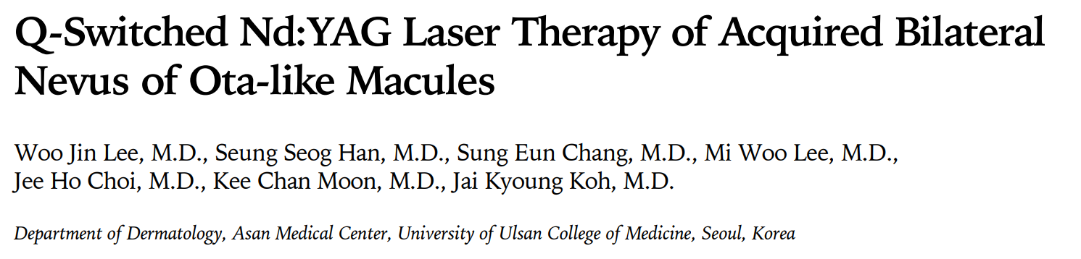
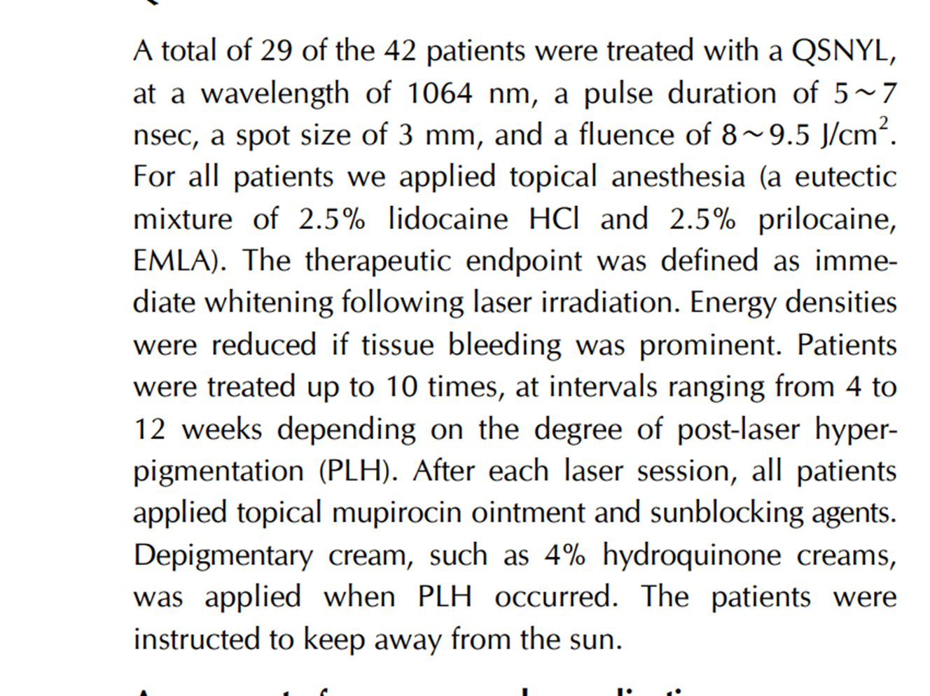
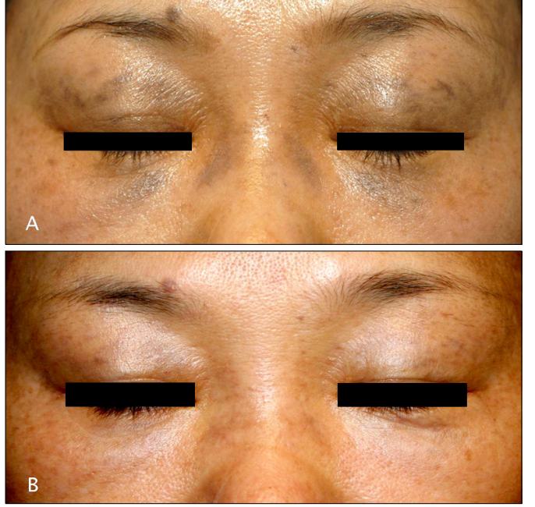

Slide 30
Parameter of Acquired Bilateral Nevus of Ota-like Macules
Wavelength | Mode | Spot Size (mm) | Fluence (J/cm²) | Pulse Rate (HZ) | Pass | Interval (weeks) | Sessions
1064nm | QSW | 3 | 8 ~ 9.5 | S | 1 | 4 ~ 12 | 10
Anesthesia: eutectic mixture of 2.5% lidocaine HCI, 2.5% prilocaine, Emla
Endpoint: immediate whitening
Energy should reduced if tissue bleeding was prominent
Interval: 4 ~ 12 weeks depending on the degree of post-laser hyperpigmentation(PIH).
Post care: Topical mupirocin ointment
Sunblocking agents
PIH occurred: Depigmentary cream, such as 4% hydroquinone creams
Instruction: The patients were instructed to keep away from the sun.
Source from “Q-Switched Nd:YAG Laser Therapy of Acquired Bilateral Nevus of Ota-like Macules

Slide 31
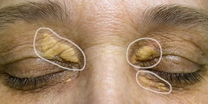

Xantelasma
Cholesterol is chronically leaked from the blood vessel
Accumulated in the dermis
Appeared in the skin surface
Exact cause for Xantelasma is unknown.

Slide 32
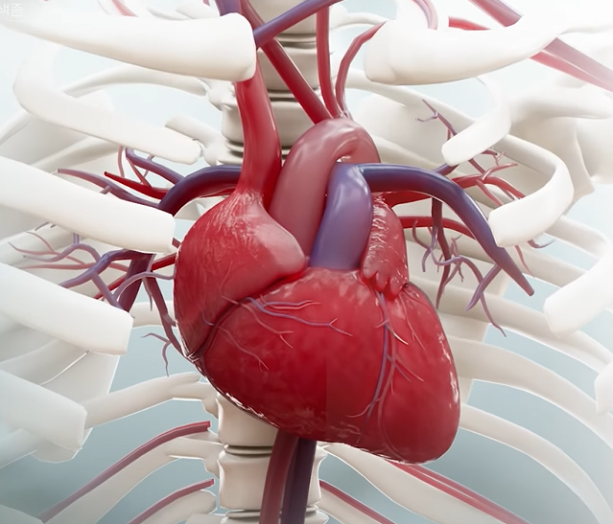
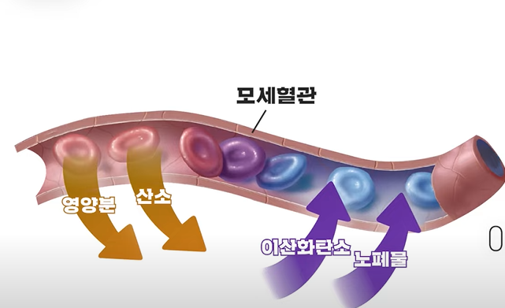
capillaries
nutrient
oxygen
CO2
residue
Blood vessel from heart works like a pipe
Capillaries has high vascular permeability

Slide 33
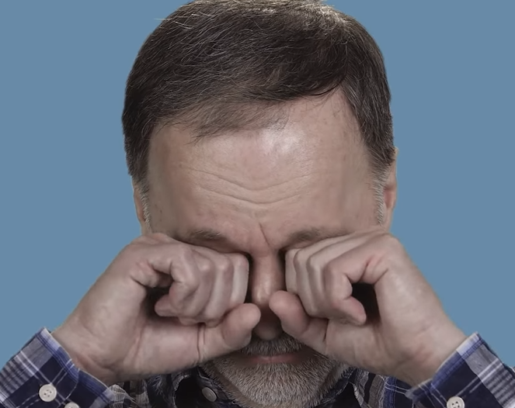
Cause
1. When the cholesterol rate is higher than normal in the blood it can be easily leaked out
2. Habit: When the people continually rub the eyes.
generate inflammation -> vascular permeability is higher -> chronically oils leaked out from the vessel
3. Genetic reason

Slide 34
3 different approaches
Surgery
CO2 Laser: vaporization
3. Nd:Yag laser 1064nm

Slide 35
4 factors should be considered for decision of treatment way
Benign
Malignant
Recurrence rate
is high
Recurrence rate
is low

Slide 36

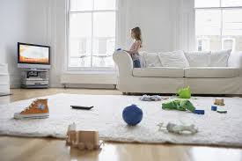
Recurrence rate of Xantelasma is very high

Slide 37
Medical treatment
It can’t guaranty Permanent result
Due to cholesterol,
It has a high recurrence rate.

Slide 38
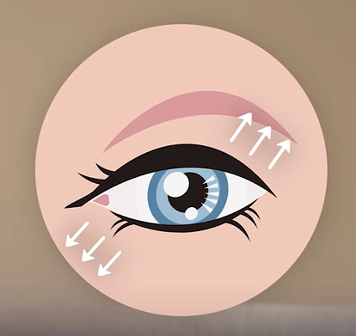
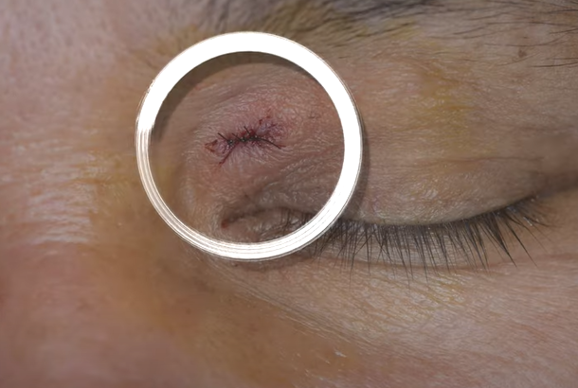
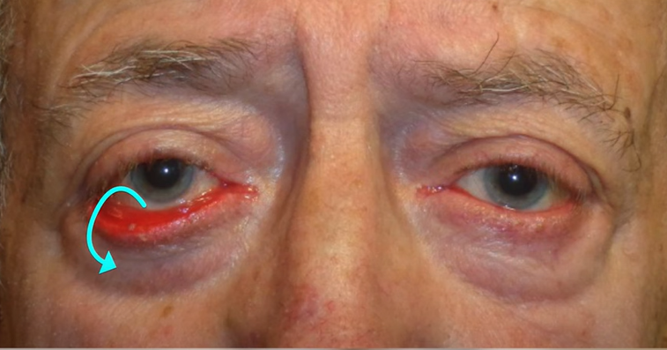
Side effect of Surgery
only one time is available.
If the incision and suture is repeated, it change the eye shape.
ectropion
Leave suture scar

Slide 39
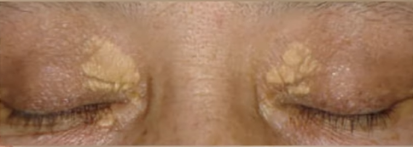
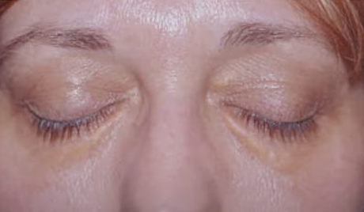
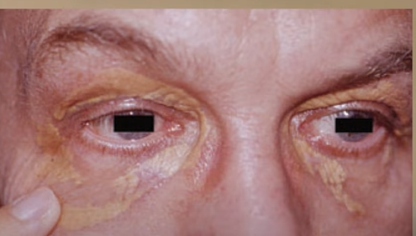
Limit of surgery due to the shape of xantelasma
Fan shape: the normal tissue should be injected.
The boundary is not clear.
It is located widely around of eyes.

Slide 40
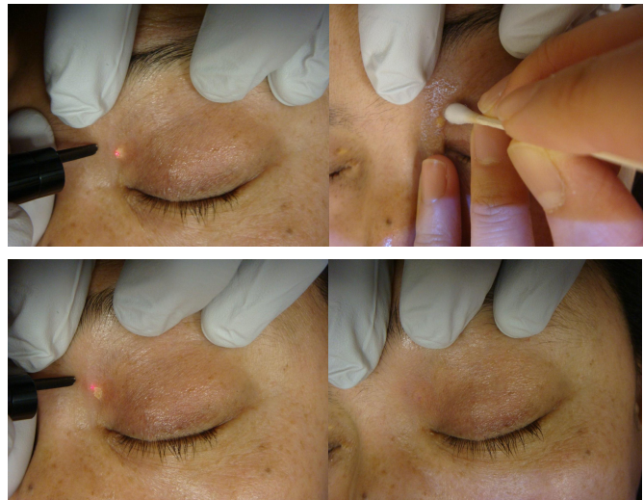
CO2 Laser
Advantage:
No suture scar left.
It can be treated several sessions if it is reoccurred.
Disadvantage:
Requires special care to prevent PIH, scar
Focusing: Vaporize fast, 50HZ, 200 ~ 300µS
Repeat the cooling and clean with cold saline layer by layer
Vaporize up to see the normal tissue is appeared
To prevent thermal damage, it should be so delicately treated.
It is recommended to treat at once under 5mm diameter lesion and treat over 3 sessions for bigger than it with 1 or 3 months interval checking the re-epithelialization.
Post care is so important: apply duoderm until skin is filled.
Apply fusidine in the scar
Source from SNJ CO2 laser by Dr.Jung jong young

Slide 41
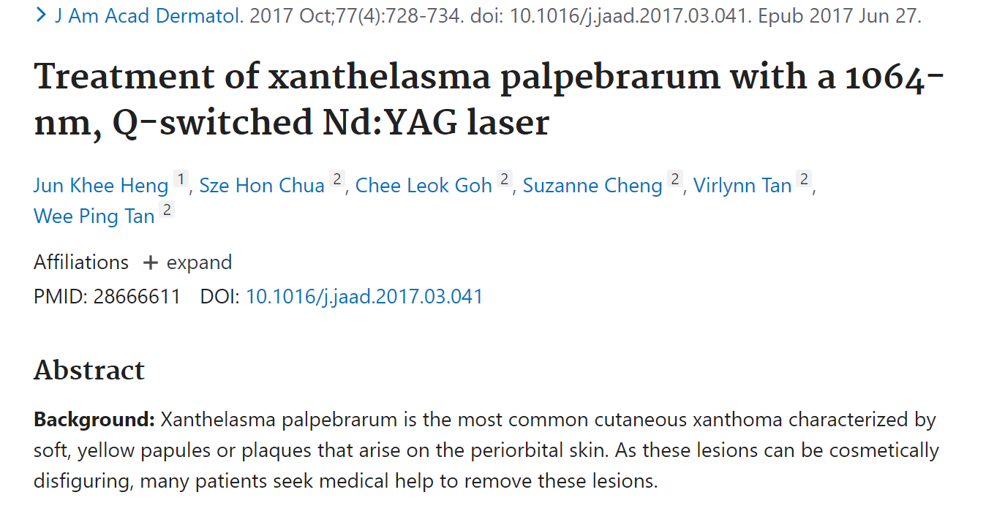
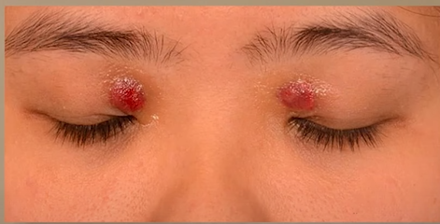
Q-Switched Laser
Right after treatment, its color is changed to red and diminish 1 or 2 weeks later.
It isn’t removed right after treatment, the cell is gradually reduced after thermal damage

Slide 42
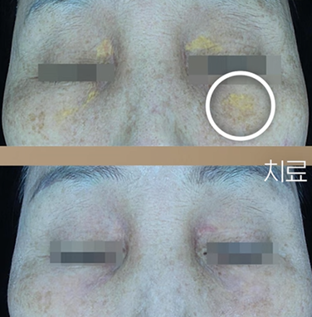
1064nm, Zoom 4mm, 6J/CM2, 1HZ
Check the response and adjust power
2 weeks interval, after redness is removed.
Average – 4 sessions
Severe case – 5 sessions
Apply fusidin after treatment
Source from Dr.Phelps

Slide 43
Side effect handling

Slide 44
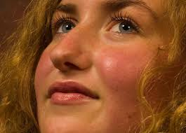
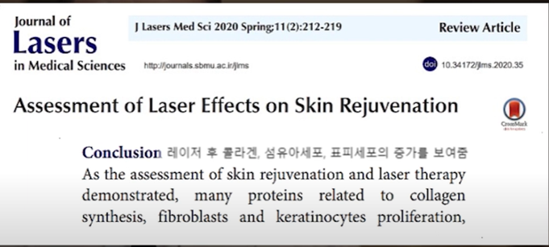
Skin will be thinner when you be treated with laser several times?
Right after treatment – patient feels that their skin is red, hot. And also patient can feel the dryness for 1 day.
So patient think that their skin thickness is thinner after laser treatment
Fibroblast is activated after continuous laser care.
Epidermis is thicker.
Dull skin become clear and elasticity.
Skin isn’t thinner, it is ended to be healthy.

Slide 45
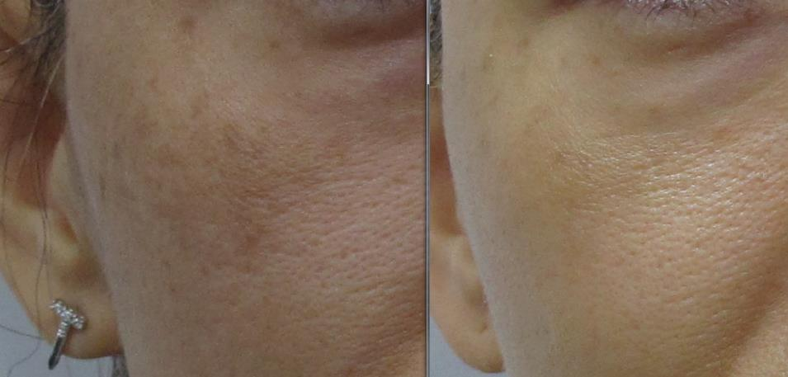
Courtesy by Dr. Y.H Hwang
After toning, skin tone is even. And skin is smoothen. When the skin texture is smoothen, it prevents a scattering of light so makes the skin looks more bright.
After toning, the dermis environment is improved so the pigment rebound rate can be firmly lower.
After laser treatment, skin become firmer and healthy.

Slide 46
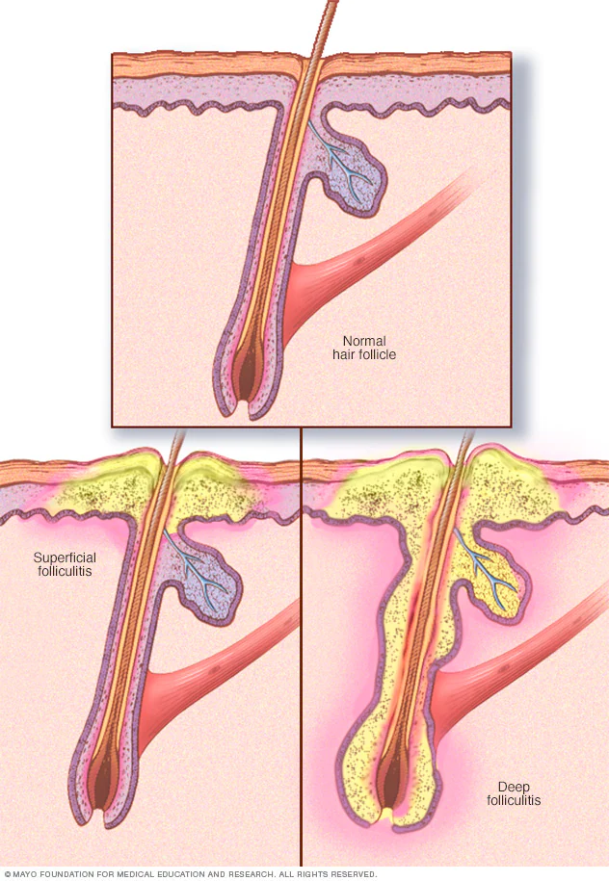
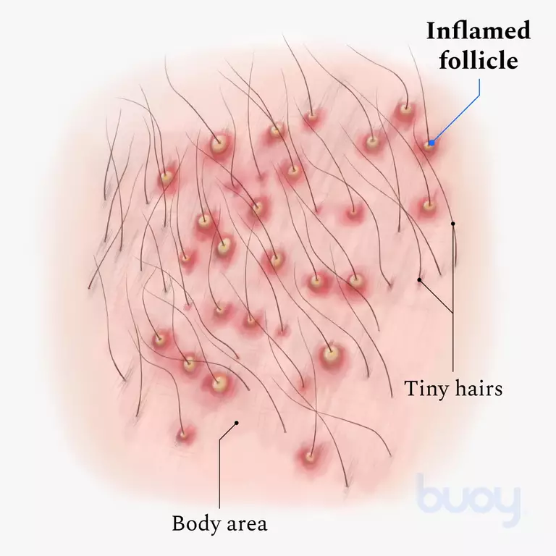
Folliculitis
Apply antibiotic ointment or hydrocortisone( ~ 1%), take medicine.

Slide 47
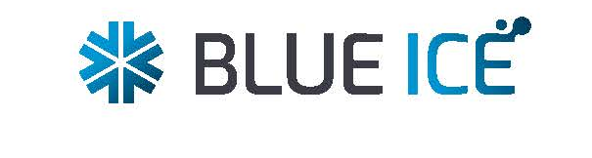
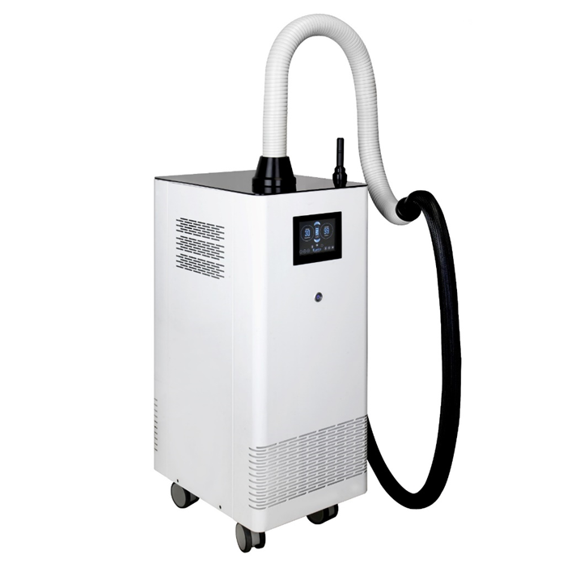
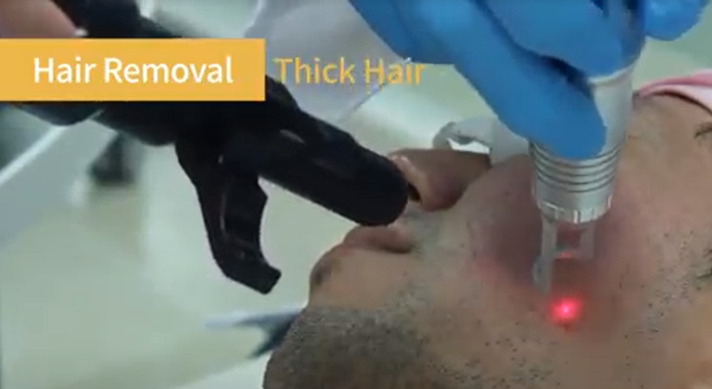
To protect Burning, Hyper pigmentation, Hypo pigmentation and reduce pain
The protection of epidermis by air cooling device could have provided high efficacy and low risk of side effects even in the lighter lesions with poor target pigments.

Slide 48
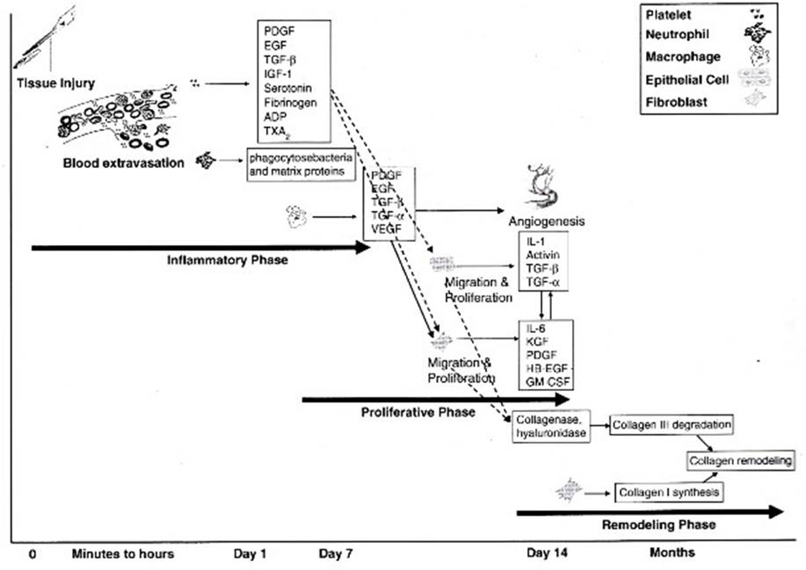
Bulla
Pigmentation – Care with Finebeam
Wavelength | Mode | Spot Size (mm) | Fluence (J/cm²) | Pulse Rate (HZ) | Pass | Interval (weeks) | Sessions
1064nm | QSW | 8 | 1.0 ~ 1.8 | 7 ~ 10 | Over 3 | 2 | 5 or more
It is quite important to prevent if it is developed to the depressed scar.
It takes around 5 to 21 days to cover the bulla with epidermis. And it means that after bulla is generated, it will
be cured whenever it is cared well in 3 weeks.

Slide 49
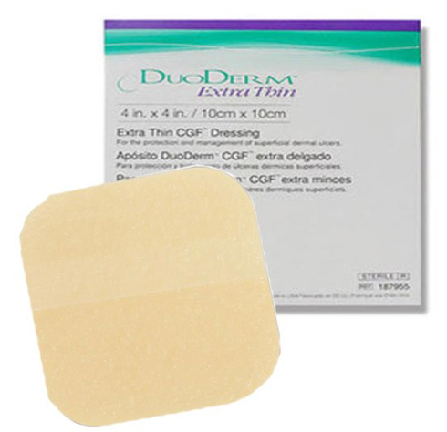
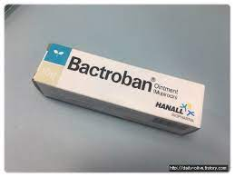
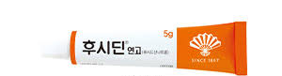
However in case skin is dark and the perilesional melanocyte is stimulated, pigmentation can be easily generated but it can be cured with laser.
It is the best to leave the small one with under of 5mm diameter and if it is bigger than it, burst with the sterilized needle and sterilize the lesion.
After that, slightly apply the ointment for scar like Bactroban, Fusidin, and put on a Duoderm to protect the lesion from air.

Slide 50
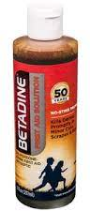
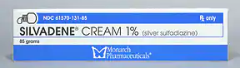
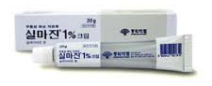
1) Block oxygen supply: Under the low air condition, the condition for blood vessel can be generated well so it will accelerate the scar recovery speed.
2) Moisturizing
3) Ointment: It increases the moisturizing effect and ooze from scar(a sore oozes, discharge from wound) is quite helpful. So the duoderm is so helpful for scar recovery.
Whenever the scar lesion is wide, you can’t apply Duoderm. After sterilizing with 1) cool physiological saline and 2) apply antibiotic ointment and cover with 3) gauze. And then cover with 4) duoderm so the adhesive areas should not contact with scar leasion.
And if you have a burn on your face, you should never use Betadine from Purdue Pharma USA. It does not only slows wound healing, it also creates pigmentation. Silverdine and Silmazine ointment are also not used on the face part because it makes pigmentation well.
If pigmentation occurs, the face can be removed in 6 months, the upper body for 1 year, and the lower body for up to 2 years. And if it isn’t removed, you can use laser.
(contents: Silver sulfadiazine – 10mg)

Slide 51

Frequent side effect of Long pulsed laser
Hair removal – Burn
Vessel – skin sink
To prevent this
You should check the photo sensitivity. Apply laser to the temple with the standard parameter considering the skin type(up or down) and wait 5 to 10 seconds. It is most proper between mild erythema and erythema. And you can know that the proper fluence level, lower or higher than the parameter or you can’t apply the laser to them.
2) Proper Cooling via Blue Ice(Air cooling device, Pre, delay and post)
3) Treat the vessels and Telangiectasia: Treat them to remove them with at least 5 sessions

Slide 52
Orally Administered Drugs
Name | Main Ingredient | General Indication
Necmoclean Tab | Amoxicillin Hydrate 500mg, Potassium Clavulanate Diluted212.73mg | abscesse, soft tissue infections, and wound infections
Beacla Tab | Amoxicillin Hydrate 500mg, Potassium Clavulanate Diluted212.73mg | abscesse, soft tissue infections, and wound infections
Topical Ointment
Name | Main Ingredient | General Indication
Esroban Ointment | mupirocin | Bacterial skin infections from trauma and burns
Bepanthen Ointment | Dexpanthenol | Supplementary treatment for wounds, burns, tears (dissociation of papillitis in water organic matter), pressure ulcers, rapid and chronic dermatitis, eczema, skin ulcers, diaper rash, sunburn (sunshine dermatitis), etc.

