Slide 1
Finexel Main indications parameter side effects care
Issue date: SEP. 19, 2022
Revision date: Aug. 18, 2023
Notes:
https://youtu.be/zujTUoE4bbA

Slide 2
Scars

Slide 3
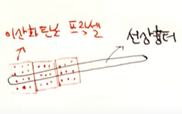
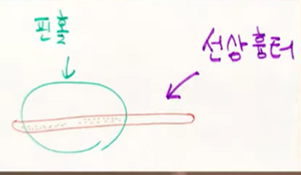
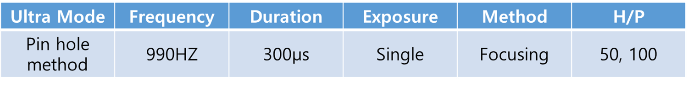
Linear scar
FRX – If the thickness is narrow, it damages to the normal lesion.
It is proper for the thick glandular scar.
PIN Hole – You are able to treat it very safely.
It makes hole and mechanically burn out.
The new collagens are generated
The collagen fibers are rearranged in that area. Then the hard collagen in the past is disappeared. And it become almost like normal skin.

Slide 4
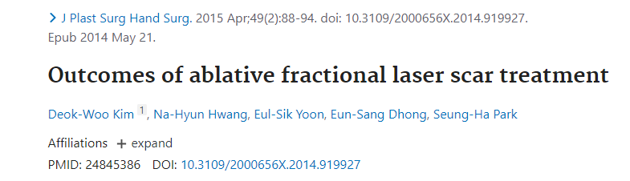
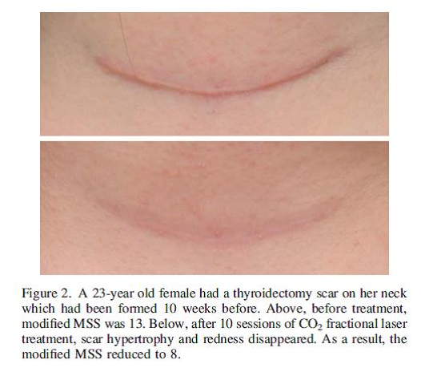
Source from
23-year old female
After thyroidectomy scar 10 weeks before
10 sessions CO2 Fractional laser treatment

Slide 5
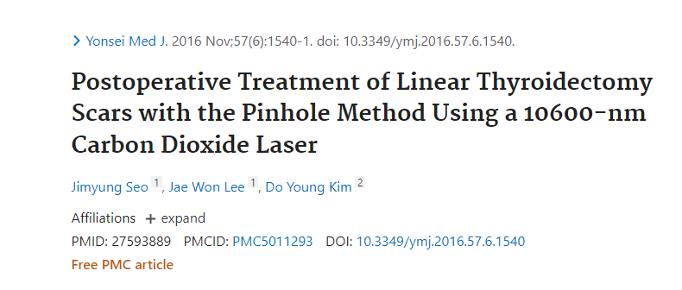
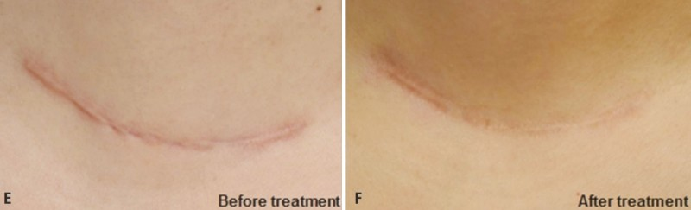
Female Korean patients. Marked improvement was observed after the treatment with the pinhole method. The pinhole method ensures scar flattening and successfully blurs the scar margins.

Slide 6
Main scar: CO2 laser Pinhole
Redness: Finebeam 595nm(Cutera Excel V)
Blurring the scar like remove with eraser: Finebeam MLA
* Pinhole method benefit comparing FRX.
Doctor is able to adjust the ablation depth and density depends on scar condition.

Slide 7
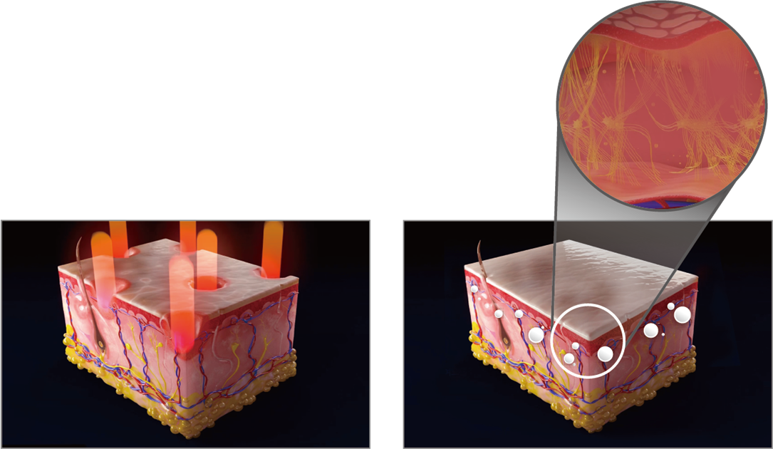
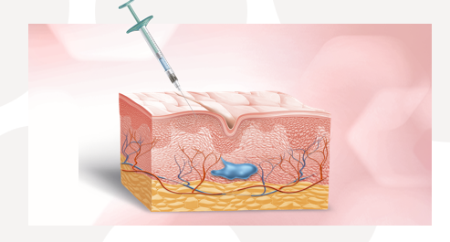
Scars upper the sebaceous gland is recovered 100%.
For removal mole, only remove it upper of sebaceous gland and remove the remains 6 ~ 8 weeks
Acne scar
Step 1) increase collagen: CO2 FRX step
Step 2) PDLLA(Poly D, L-lactide): Juvelook, Juvelook volume step
Step 3) Finebeam MLA
CO2 Fractional Mechanism
generate physical injury -> generate inflammation -> secrete cytokine -> generate various growing factors what stimulate fibroblast
Finebeam MLA
PDLLA

Slide 8
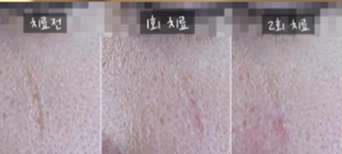
Acne scar: it is harden by repeating inflammation and recovery so inside of scar is hard.
Atrophic scar: it is occurred with only one event. Inside of scar is soft.
Filler for scar -> Juvelook volume -> Finebeam MLA
Atrophic scar: easy to remove
Before
After 1 session
After 2 session

Slide 9
Acne Scar

Slide 10
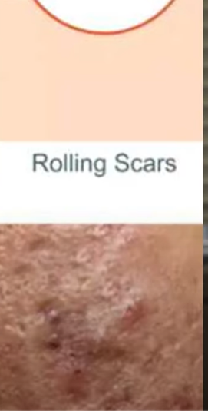
Rolling scars - scars that are very wide but shallow , and held down by bad collagen fibers.
No need to cut off the boundary.
CO2 Fractional
Inject Juvellook volume(PDLA) - inject enough amount using cannula
Finebeam MLA
Rolling Scars

Slide 11
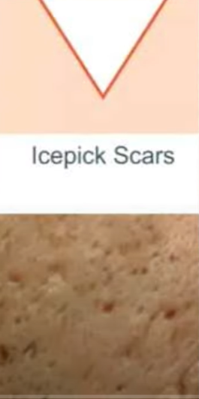
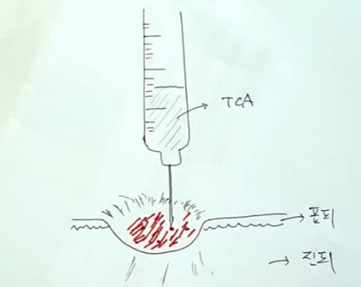
Entrance is so narrow and deep
The laser beam by FRX can be missed with high chance.
Apply TCA(Trichoroacetic acid) to the scar one by one. Inflammation can be occurred full enough
C02 Fractional
Finebeam MLA
Icepick Scars

Slide 12
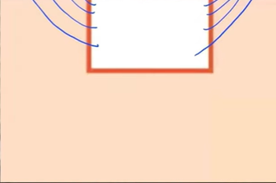
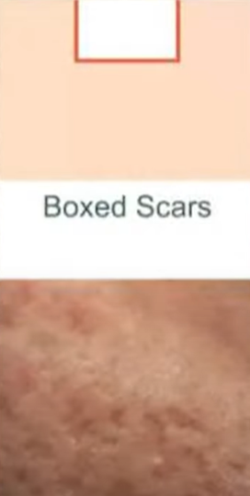
The shape is like mixing rolling scar + icepick scar
scars that are not too deep and not too wide.
It requires shouldering with CO2 Ultra pulse.
It should be careful treated considering side effect.
Boxed Scars
CO2 FRX
Juvellook volume(4 times bigger amount of Lactic acid than Juvellook )
The boundary is right angled as almost 90°.
Finebeam MLA

Slide 13
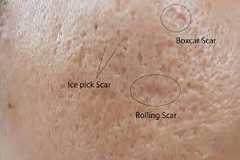
Deep boxcar scar
To remove fibrous tissue, treat with higher energy with 2 pass. However it isn’t necessary to remove all fibrous tissue, and the skin with fibrous tissue is a poorly regenerated area, so the distance between the beams should be bigger.
Fractional Mode | Energy | Density | Scanning size(mm) | Pass
Deep boxcar | 24 ~ 40mJ | 1.2 ~ 1.4mm | ≤ 5X5 | 2
After boxcar scar care, attach a Duoderm, advice to patient that sore fill in the Duoderm around 3 days, in case sore flow out from Duoderm only, change to the new one otherwise don’t change it.
3 or 4 days after, sore isn’t generated that much so keep the same one for 7 days.

Slide 14
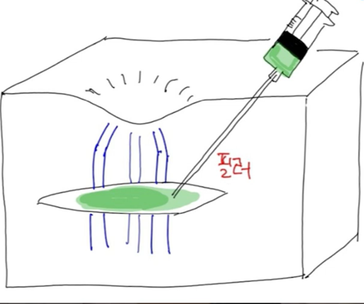
Acne scar – repeating with inflammation and recovery, the bottom of scar is harden and fibro bands firmly pull down the scar. It is recommend to cut the bands with nokor needle.
Atrophic scar will be returned almost to flat and micro scar stimulate fibroblast
Basic mechanism for acne scar
Generate Scar -> inflammation -> various cytokines are secreted
Cytokine effect to scars
=> widen the blood vessels so supply big amount of nutrient to the scars
=> activate fibroblast so generate neo collagen

Slide 15
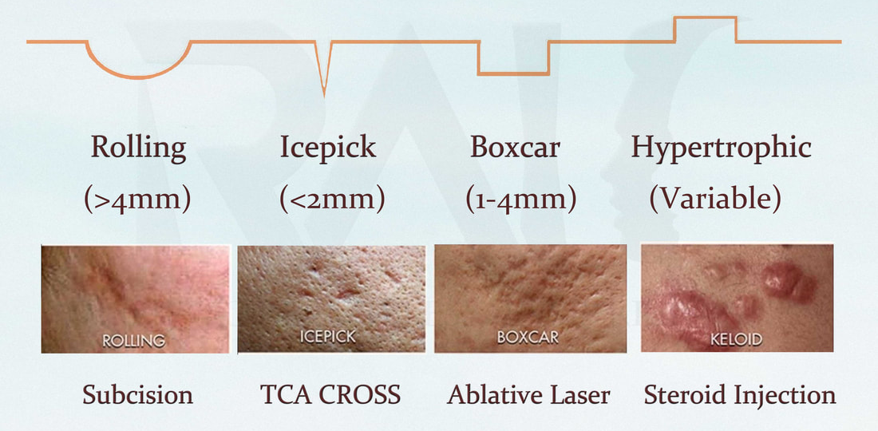
Depressed acne scars
Fractional Mode | Energy | Density | Scanning size(mm)
Rolling scar, Boxcar scar | 18 ~ 22mj | 0.8mm | ≤ 5X5
PIH and erythema can be followed, so it should give prior notice to patients.
It is only use for depressed acne scars.
Hypertrophic/ Keloidal scars - scars that protrude outwards due to overgrowth of collagen.

Slide 16
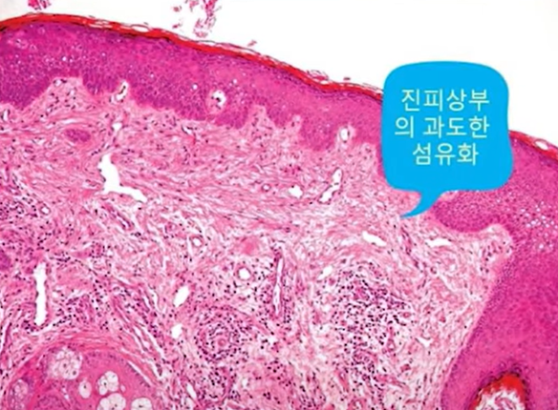
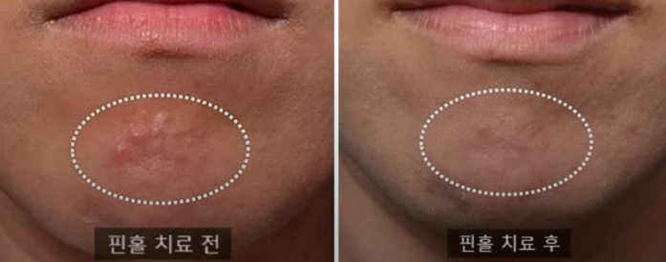
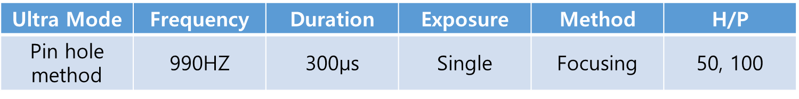
Papular acne scars
Source from Dr.Phalps
It is excessive fibrosis. The keloids composed in deeper layer.
Pin hole method: make hole in the normal skin and scar together.
Strong Benefit:
Side effect is low
The size is dramatically reduced with 5 ~ 6 holes.
Excessive fibrosis in the upper dermis
CO2: It goes deeper than Er:yag. So it can give better result than it for completely changed skin as like burn scar, deep atrophic scar etc.
Weaker point comparing Er:yag: redness extend longer

Slide 17
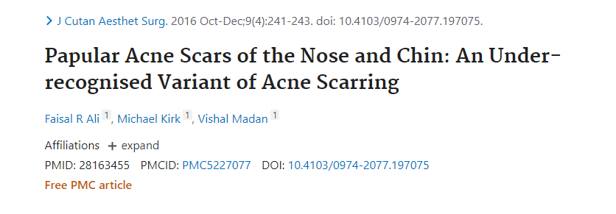
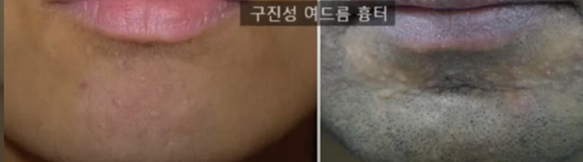
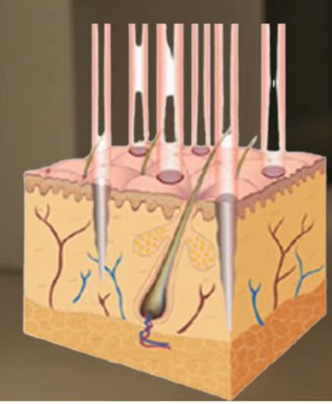
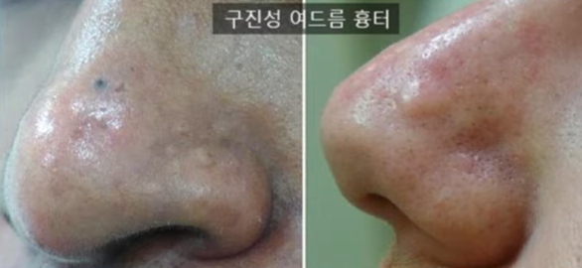
Source from
3 to 4 times 3 to 4 weeks interval

Slide 18
Hypertrophic scar
The purpose of laser care is reducing the scar size so treat it with higher energy.
Fractional Mode | Energy | Density | Scanning size(mm) | Pass
Hypertrophic Scar | 40mJ | 1mm | ≤ 5X5 | 1
 | 30mJ | 1.2mm | ≤ 5X5 | 1
 | 20mJ | 1.2mm | ≤ 5X5 | 2
Published by Haewon Jung MD, 2021

Slide 19


Interval to cure for acne scar for aggressive care -> 2 months term(treatment is so naturally generate collagen)
MLA – around 1 month interval(recommend to treat 3 to 6 sessions)
Acne scar is very difficult and challenging to the doctors.
Acne scar care need to be combination care. It can’t be treated with one way. However laser is the basic for scar care.
Side effect
Effect

Slide 20
Convex lesions on the face

Slide 21
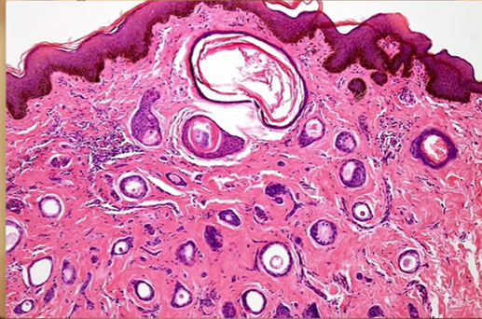
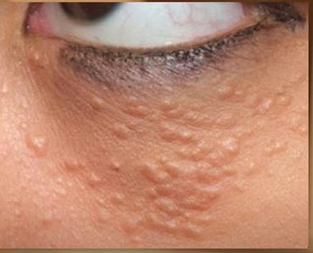
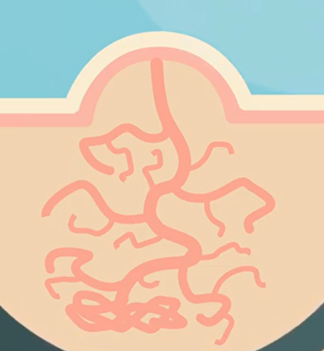
1. Syringoma
Cause: sweat gland excessively proliferate
Syringoma: Benign tumor
Most appear as skin-colored papules, which are 1-3 mm in size around the eyes, cheeks, and forehead, caused by sweat gland problems, and are common benign tumors that mainly occur in adult women.
Occur deep in the skin
Arise from sweat ducts

Slide 22
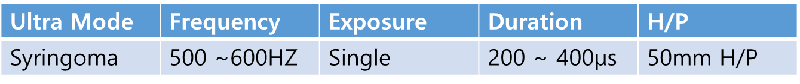
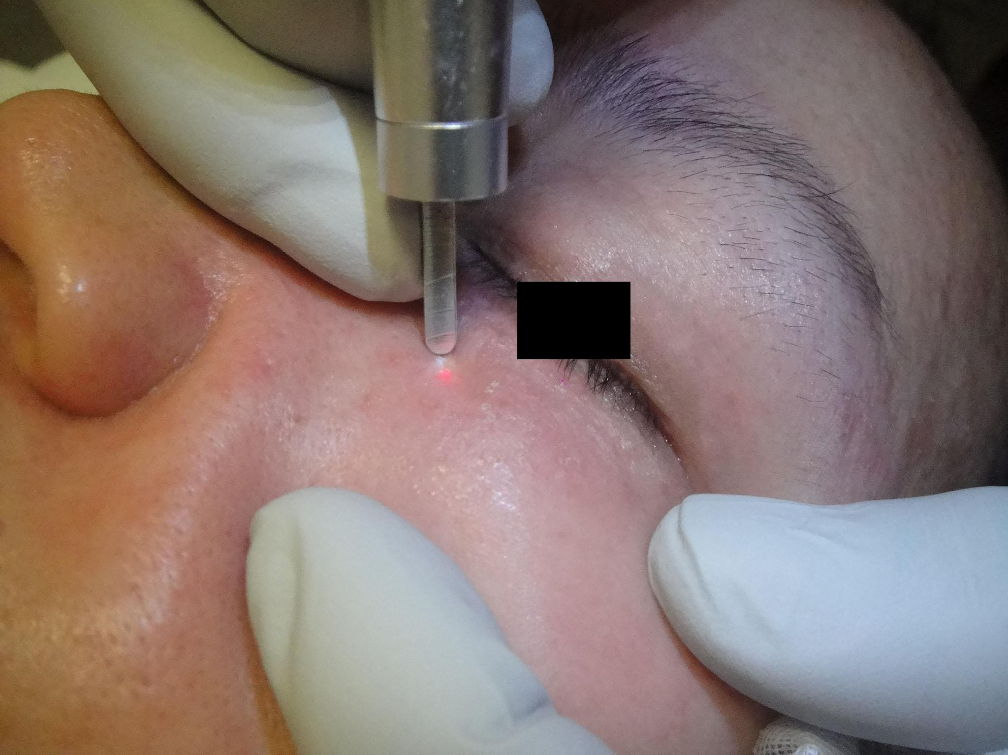
Pin hole method
Source from SNJ CO2 Laser
It is one of the indication what doctors dislike to treat, its root is in deep side so it will leave scar in case treat so strongly, or if it is treated with non-proper depth, it can be reoccurred.
Vaporize it up to hearing the sound from the lesion -> cooling
Recently, FRX approach also conducted.

Slide 23
CO2 Pinhole method
The pinhole method using a CO₂ laser creates multiple tiny holes penetrating from the epidermis to the deeper dermis. This improves the scar texture by inducing collagen bundle regeneration and realignment following the physical breakage and thermal damage.

Slide 24
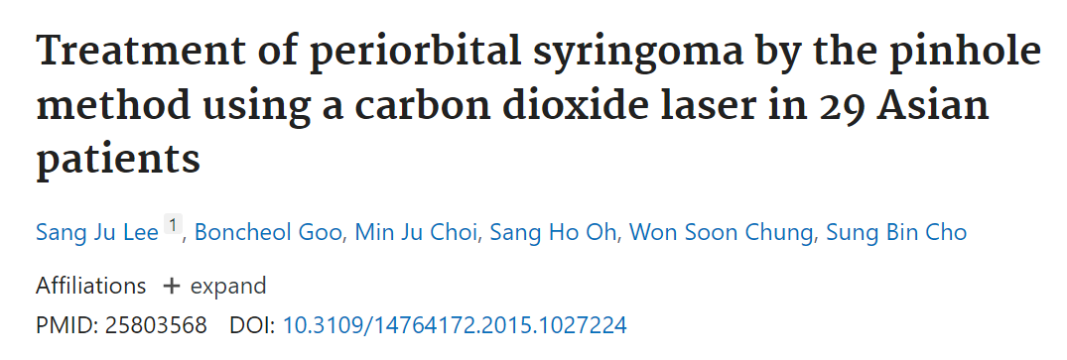
Abstract
Background: Pinhole method has been used to treat various types of scars and dermal tumors by making multiple small holes in target tissues of the deep dermis using an ablative 10,600-nm carbon dioxide (CO2) laser.
Objectives: We prospectively investigated the efficacy and safety of using a CO2 laser to treat periorbital syringomas via the pinhole method.
Methods: A total of 29 patients with periorbital syringomas were treated with two sessions of CO2 laser treatment using the pinhole method at two-month intervals. Laser fluences were delivered under the following settings: pulse duration of 200 μs, frequency of 50 Hz, on time of 0.04, and an off time of 0.01.
Results: Among the 29 patients, 13 patients (44.8%) presented with small discrete papular syringomas, 10 (34.5%) had plaque-type lesions, and six (20.7%) had mixed lesions. Evaluation of the clinical results at 2 months after the second treatment session revealed marked clinical improvement (51-75%) in 10 of the 29 patients (34.5%), moderate clinical improvement (26-50%) in eight (27.6%), near-total improvement (≥ 75%) in seven (24.1%), and minimal improvement (0-25%) in four patients (13.8%).
Conclusions: Our observations indicated that application of the pinhole method using a CO2 laser exerts positive therapeutic effects in Asian patients with periorbital syringomas.
Keywords: carbon dioxide; laser; pinhole; syringoma.

Slide 25
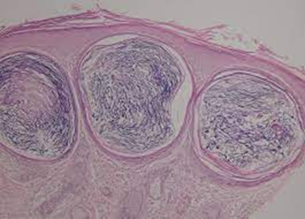
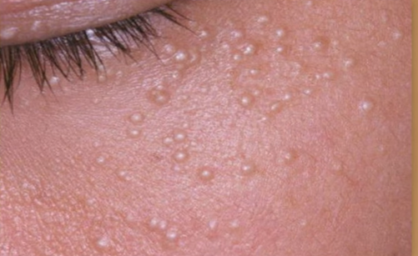
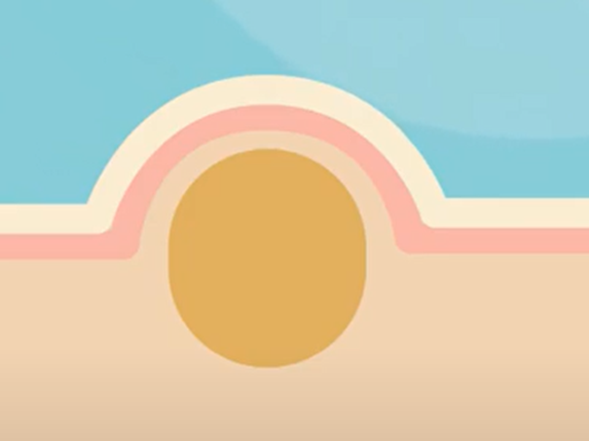
2. Millium
Cause: sebum stuck together
Milium:
Small keratin pouch with around 1mm size white or yellow color, it is generated in thin layer.
Very common
Lie on the skin
Easy to remove
Comedon is in it

Slide 26
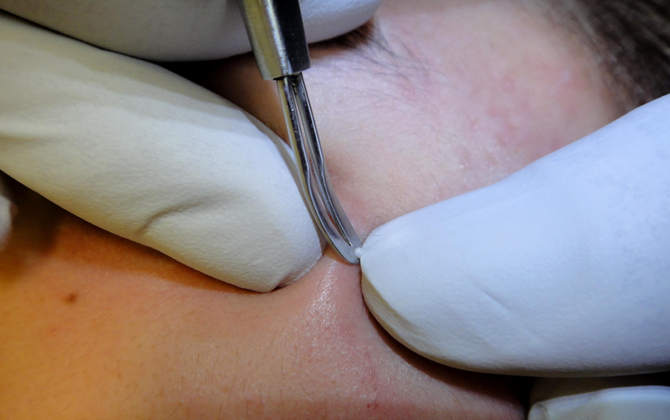
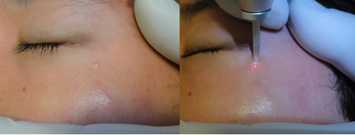
Milium
Source from SNJ CO2 Laser
Locate the H/P perpendicular to the skin surface and completely contact the h/p tip with skin, make hole in the center of lesion with focusing.
Extract the comedon using extractor, instead of pressing only with it, press with thumb as well so it will be more easily extracted.
When you can’t extract it, don’t assume if it is already burned. Actually it is the case that you don’t make hole in the center of it or laser energy reach to too shallow, so you should make hole again.
Ultra Mode | Frequency | Duration | Exposure | Method | H/P
Milium | 50 ~ 100HZ | 200 ~ 300µs | Continue | Focusing | 50 ~ 100

Slide 27
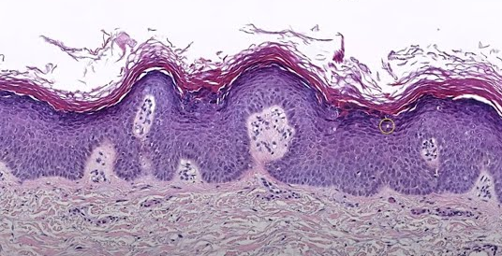
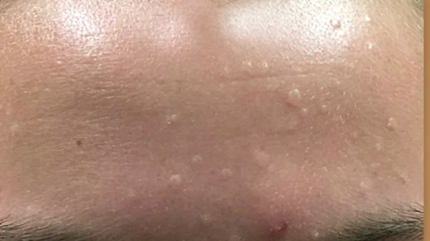
3. Verruca Plana(flat wart)
Cause: HPV-3 Virus

Slide 28
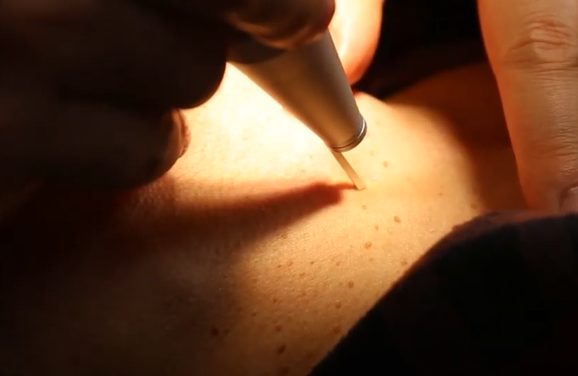
Ultra Mode | Frequency | Duration | Exposure | Method | H/P
Pin hole method | 990HZ | 300µs | Single | Focusing | 50, 100
1’st session: 95% is removed
6 weeks later
2’nd session: Missed one

Slide 29
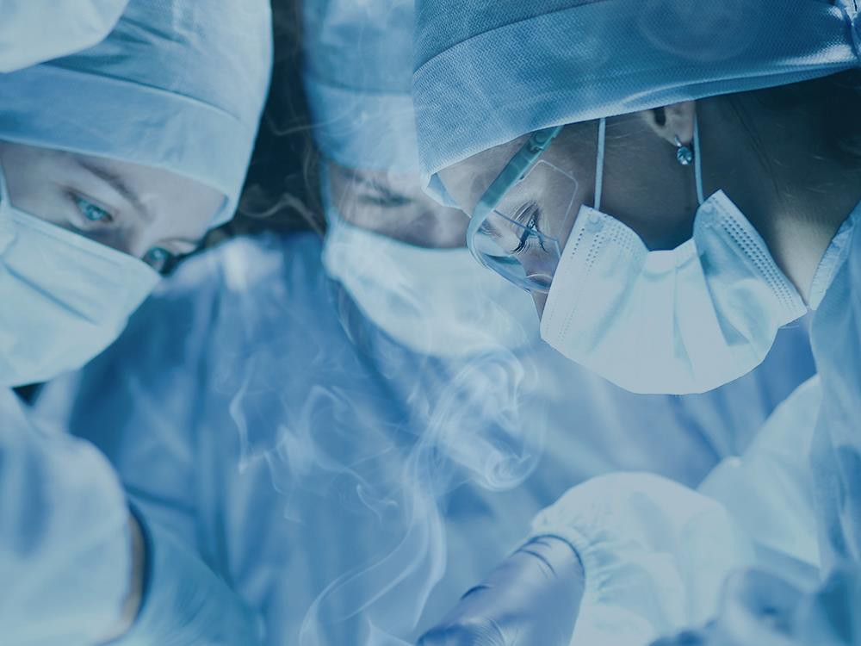

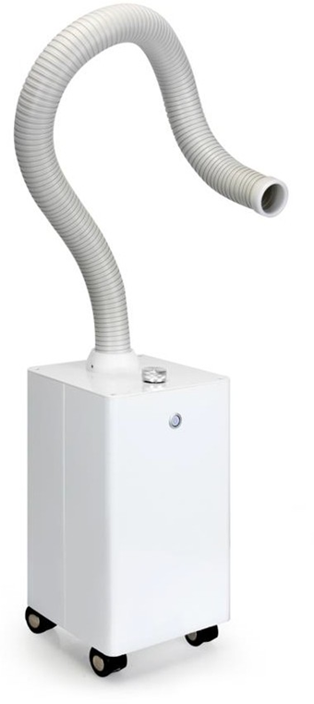
Smoke evacuator Blue Eva is required to prevent secondary infection
Increase Smoke Evacuator Availability
Chronic medical conditions
Among patients, surgeons, surgical staff
Potential risks for surgeons, nurses, anesthesiologists, and technicians in the operation room due to long term exposure of smoke
Surgical Plume Inhalation

Slide 30
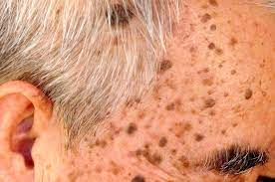
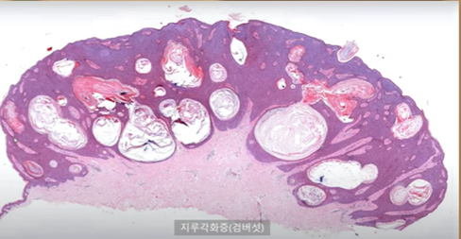
4. Seborrheic keratosis
Cause: not clearly known
genes, age, too much sun exposure to UV etc.

Slide 31
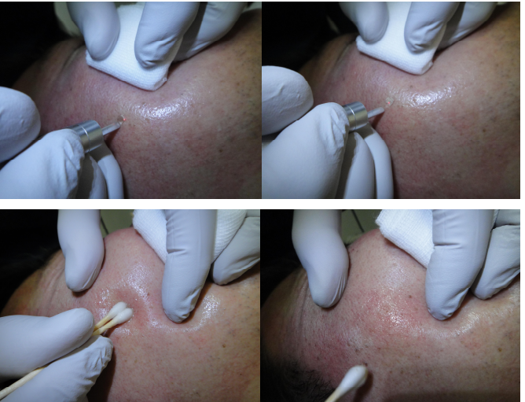
Nurse clean the evaporated tissues with the cotton swab soaked in cool saline solution at the fast to check out if it is evaporated enough at the targeted depth.
Ultra Mode | Frequency | Duration | Exposure | Method | H/P
Seborrheic keratosis | 200 ~ 300HZ | 200 ~ 300µs | Continue | Focusing | 50 ~ 100

Slide 32
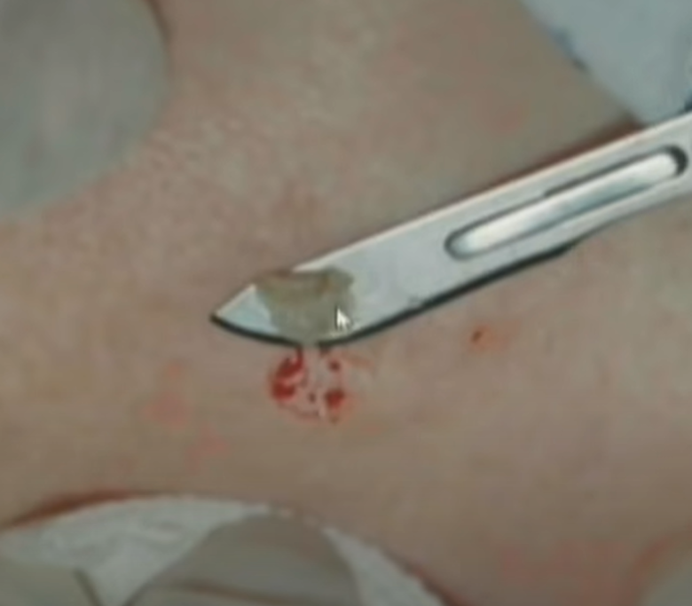
Blade, electric surgical unit may cause of blood and damage the dermal area what can leave PIH
Seborrheic keratosis with CO2 laser clinical report by Dr.Park and Dr.Ham
Its effect is good or better: 92.8%

Slide 33
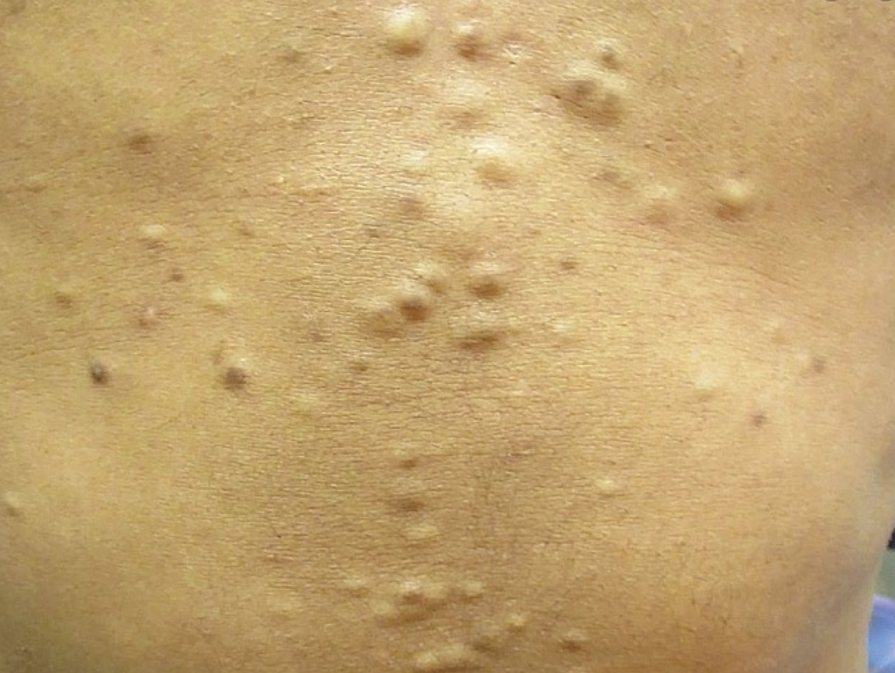
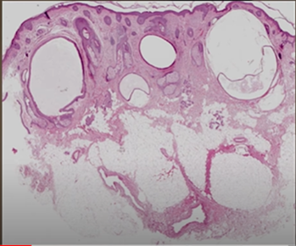
5. Steatocystoma multiplex
Steato – sebum
Cystoma – pocket
Multiplex – multiple

Slide 34
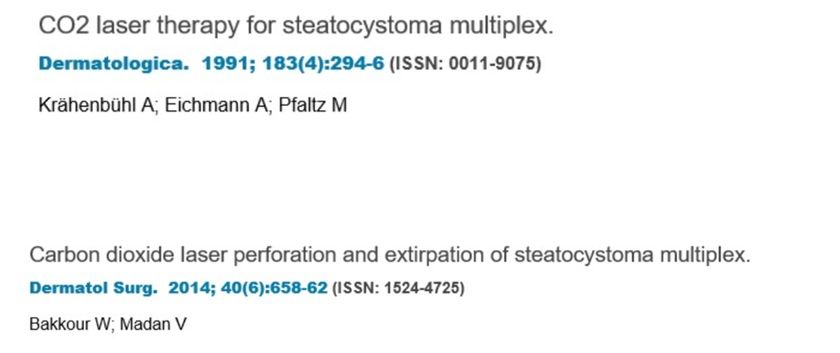
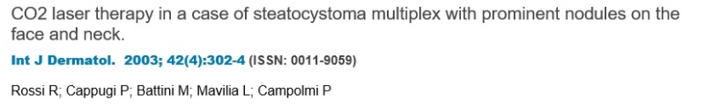
Several clinical reports are released the CO2 laser therapy for steatocystoma multiplex

Slide 35
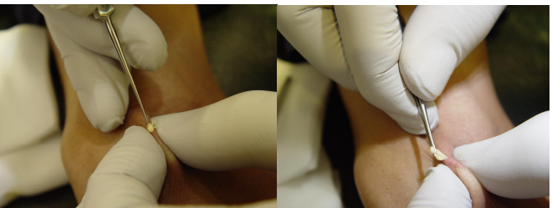
Make hole on the center and then extract the cyst using ophthalmic curette(meyerhoefer chalaziune curette) with Adson forceps
Dressing 2 days later
Remove it around 10 pcs a day
No need suture, no side effect
Ultra Mode | Frequency | Duration | Exposure | Method | H/P
Cystoma | 50 ~ 100HZ | 200 ~ 300µs | Continue | Focusing | 50 ~ 100

Slide 36


Whenever the size of steatocytoma is big, use the blade no. 11.

Slide 37
Age Spot
Ultra Mode | Size | Frequency (HZ) | Duration | Exposure | Method | Hand piece
Small Age Spot | Below 10mm | 20 ~ 50HZ | 200 ~ 300µs | Continue | Focusing | 100mm
Big Age Spot | Over 10mm | 20 ~ 100HZ
After evenly emit laser all over the age spot without missing area and slide with gauze(dermoepidermal sliding method).
Fractional Mode | Energy | Density | Scanning size(mm) | Pass
Big and thick Age spot | 5mJ | 0.2mm | Depends on the Age spot size | 1 Dermoepidermal sliding method

Slide 38
Skin Booster
Fractional Mode | Energy | Density | Scanning size(mm) | Pass
Skin Booster | 5mJ | 2.0 mm | 20X20 | No crust or formation of micro crust

Slide 39

M.D. Jung Jong-Young Marybeth Clinic(http://marybeth.co.kr/)
Book Publication
Writer
M.D. Jung Jong-Young
Current: Marybeth Clinic Owner, Representative Doctor
President of Korea Melasma Association
President of Korea Clinical Skin Care Association
Before: President of Korea Clinical Laser Association

Slide 40



Pyogenic granuloma
Under the bleeding condition, CO2 laser beam is absorbed in the blood so lesion is not evaporated at all, in this case, assistant should press the lesion with cotton swab to stop the bleeding and fatly evaporate the lesion at the moment of lesion is appeared gradually.
1'st: For speedy removal of lesion and good hemostasis, Ultra pulse mode Frequency: 200HZ(adjust the frequency depends on the response of lesion), Duration: 200µs
2'nd: For coagulation and contraction, CW mode: 1W ~ 2W depends on the distance, fine control the power.
Source from SNJ CO2 Laser

Slide 41



Slide 42



Pin hole method mechanism
Emit strong energy with CO2 laser
Make small hole in the scar area, disconnect fibro blast and rearrange the collagen in the dermis
Induce the skin regeneration
Finebeam MLA
Indication | Mode | Spot Size | Fluence(j/㎠) | Hz | Repeatation | pass | Hand piece
Regeneration Pore Scar | 1064 single | 10 | Over 1 | 1~5 | 10 | 1 pass | MLA ZOOM If the symptoms are severe, stacking is performed up to 3 times. After 1 minute and 30 seconds, petechiae can be observed.

Slide 43

Pin hole method
5 weeks later
The neo collagen is generated in the micro hole after 5 days passed, it change the surrounding scar tissue to neo collagen
Depressed area is filled with tissue so it become flat. Thick and harden scar become soften, flat and smoothen
Source from Renewme skin clinic
http://m.rnmeskin.com/clinic101/

Slide 44


Pin hole method combined burn scar care
DNA Dermal
Regeneration method
- Inject DNA medicine in to dermis
RF Needle care
- Generate RF Heat in the scar area, induce collagen
Finebeam MLA
Disconnect fibroblast like subsion effect + neo collagen generate in
vacuoles
Pin hole method
Finebeam MLA
Source from Renewme skin clinic

Slide 45
Reference
Lee Jae-Dong, Lasers in dermatology: Parameters and choice: Mdworld 2021
Jung Jong-Young, SNJ CO2 Laser: 2021
Dr.Yoo Dong Gyu Blog and Youtube channels

