Slide 1
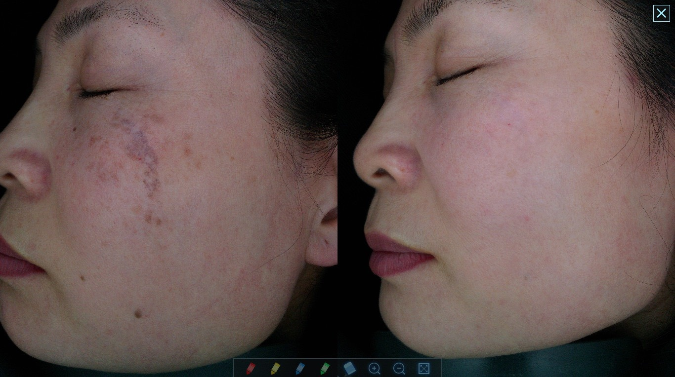
Clinical Results
Mode: QSW Single
H/P Type: ZOOM
1’st
Spot: 10mm
Energy: 1,000mJ
Frequency: 3
2’nd
Spot: 6mm
Energy: 700mJ
Frequency: 3
3’rd
Spot: 4mm
Energy: 450mJ
Frequency: 3

Slide 2
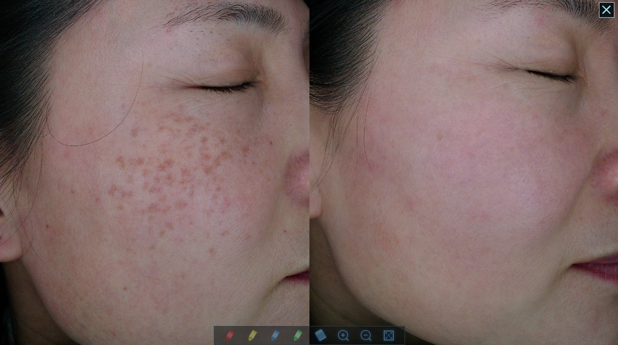
Clinical Results
Freckle, Blemish
Mode: QSW Single
H/P Type: ZOOM
1’st
Spot: 10mm
Energy: 1,000mJ
Frequency: 3
2’nd
Spot: 6mm
Energy: 700mJ
Frequency: 3
3’rd
Spot: 4mm
Energy: 450mJ
Frequency: 3

Slide 3
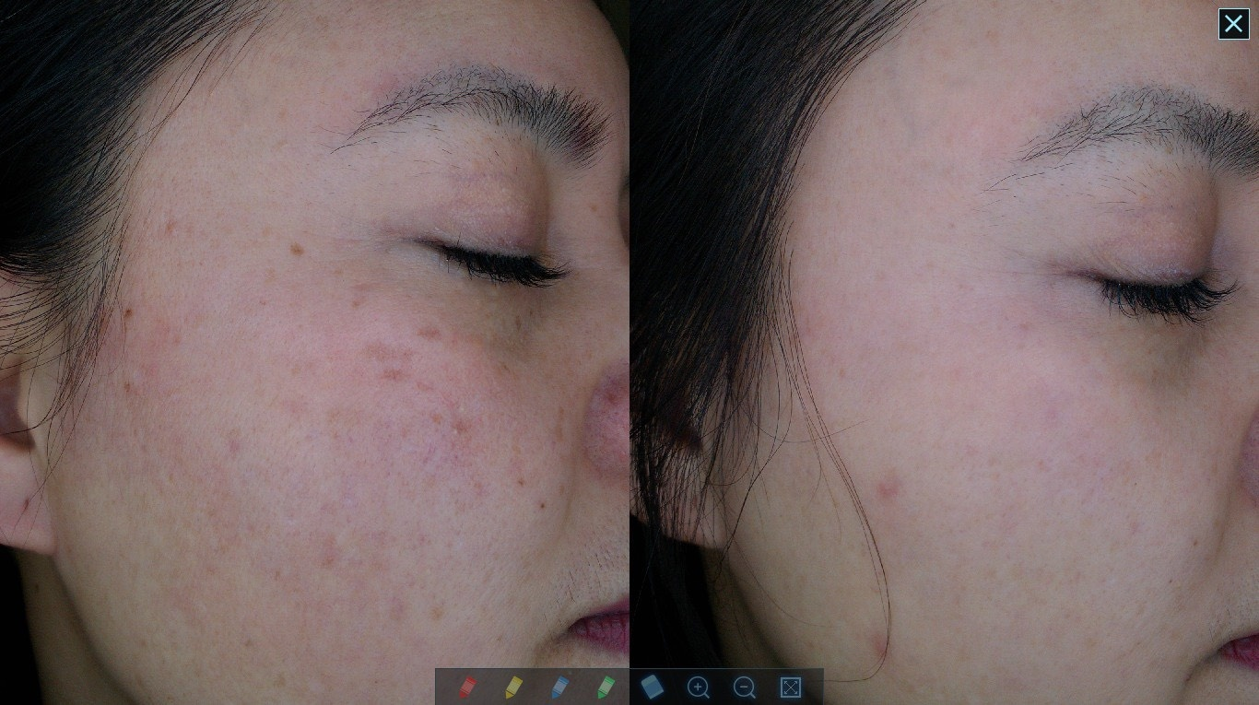
Clinical Results
Blemish
Mode: QSW Single
H/P Type: ZOOM
1’st
Spot: 10mm
Energy: 1,000mJ
Frequency: 3
2’nd
Spot: 6mm
Energy: 700mJ
Frequency: 3
3’rd
Spot: 4mm
Energy: 450mJ
Frequency: 3

Slide 4
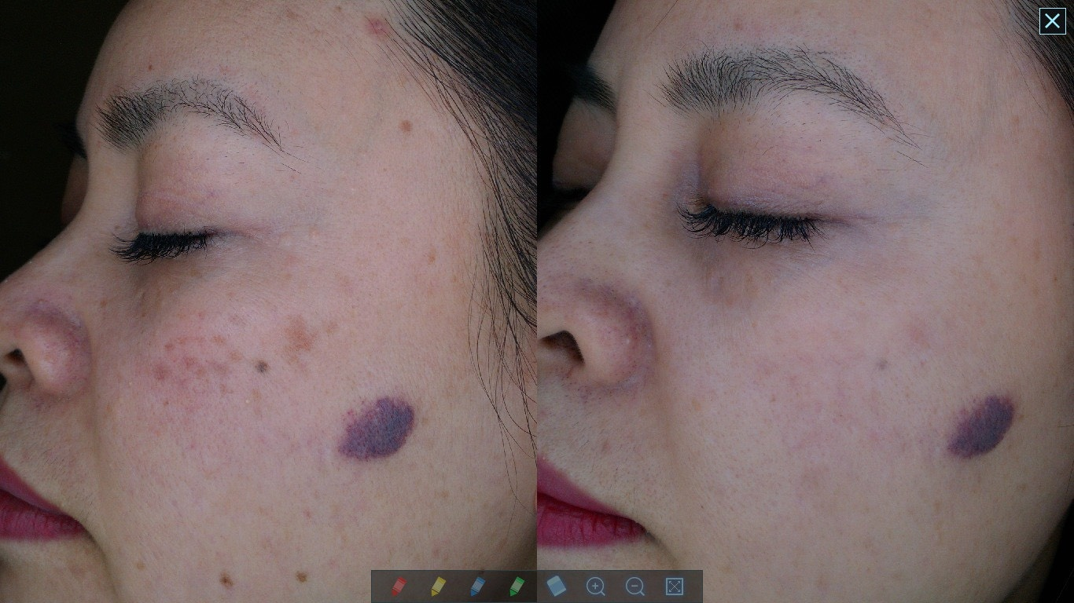
Clinical Results
Blemish
Mode: QSW Single
H/P Type: ZOOM
1’st
Spot: 10mm
Energy: 1,000mJ
Frequency: 3
2’nd
Spot: 6mm
Energy: 700mJ
Frequency: 3
3’rd
Spot: 4mm
Energy: 450mJ
Frequency: 3

Slide 5
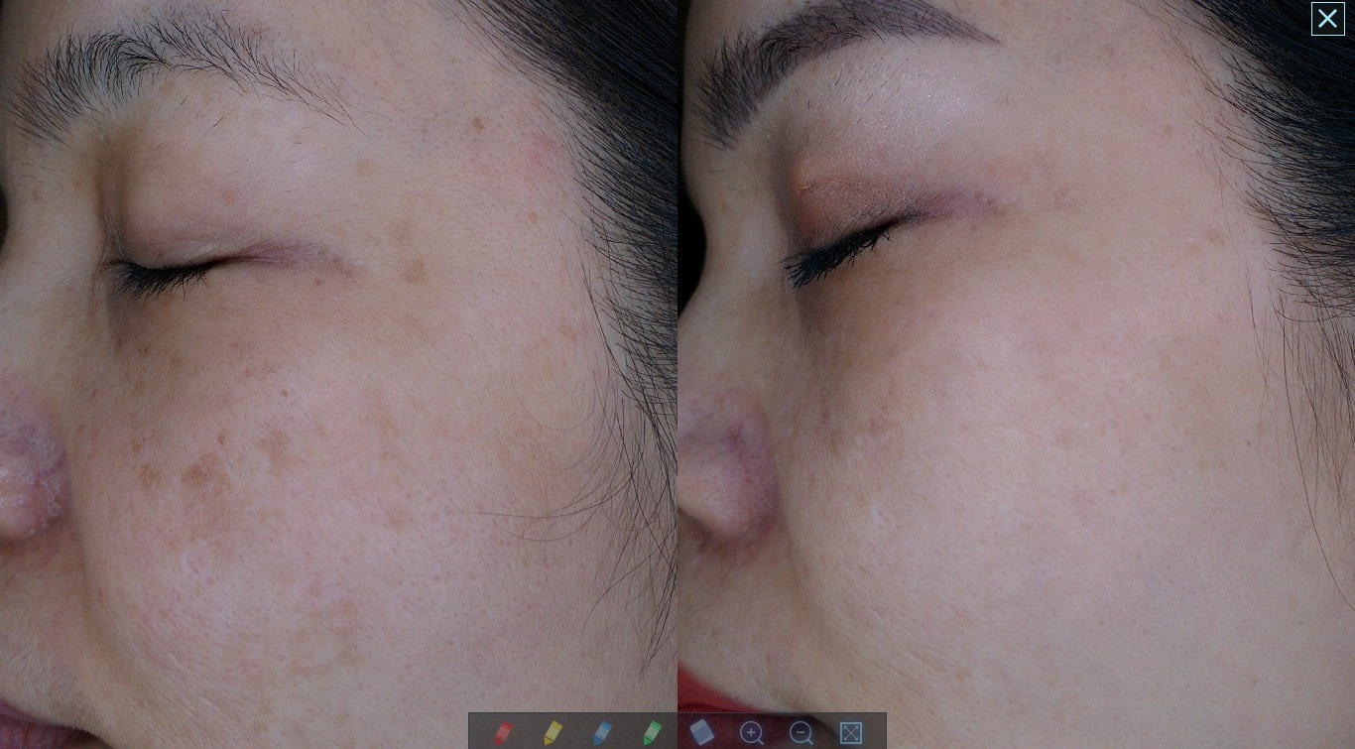
Clinical Results
Blemish
Mode: QSW Single
H/P Type: ZOOM
1’st
Spot: 10mm
Energy: 1,000mJ
Frequency: 3
2’nd
Spot: 6mm
Energy: 700mJ
Frequency: 3
3’rd
Spot: 4mm
Energy: 450mJ
Frequency: 3

