Slide 1
Issue date: Aug. 26, 2021

Slide 2
Tri Full Toning Process
Toning
Overcome the conventional toning’s limit, it accurately but so gently treat the scattered pigment disease with Fine beam.
Genesis
Improving the dermis layer environment, it helps the fundamental pigment care so it prevents reoccurrence of pigment disease. And also it is capable of fine wrinkle, elasticity, pore tightening, blood vessel improvement.
MLA Pore Toning
The laser passing through hive shape special lens makes several micro spaces in dermis. Through this process, it is induced skin regeneration and new flesh fills the scar area
The laser passing through hive shape special lens makes several micro spaces in dermis. Through this process, it is induced skin regeneration and new flesh fills the scar area

Slide 3
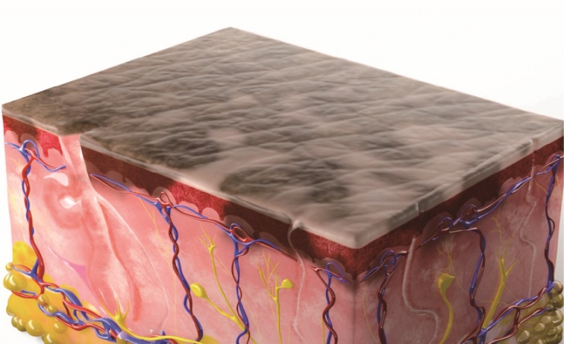
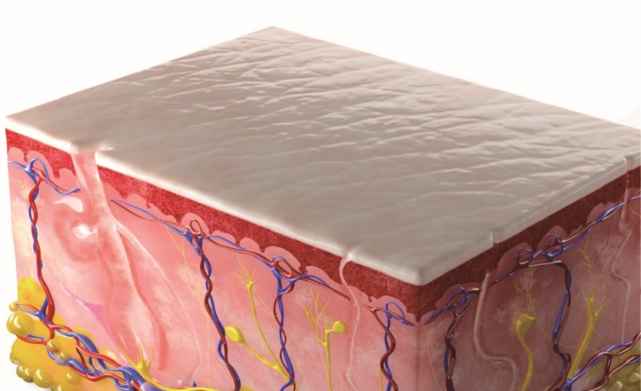
Q-Switch
MLA
Parameter
~1.04
General concept of Toning
: It is not to break melanin cell itself, it reduces the quantity of dendrites with weak energy.
Treatment
Treat the face with above parameter until a slight redness is appeared in the face. 1,000 ~ 2,000 Shot
Side Effect and Cure managing method
Dry sensation is commonly found due to sebum amount reducing.
Acne rash is often found similar rate with the after hair loss care.
In case there is many fine hairs in the face, it is recommended to take hair removal first.
Petechia and Melasma color is darker -> Lower energy.
No response -> There is many cases the epidermal pigment doesn’t response so lower the energy and proceed the dermal pigment treatment

Slide 4
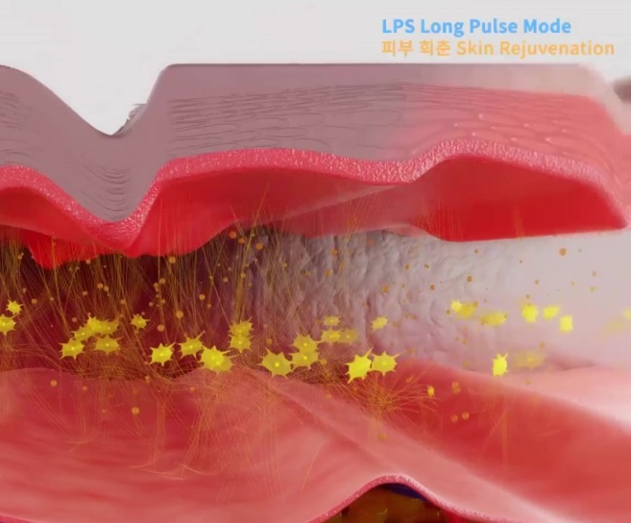
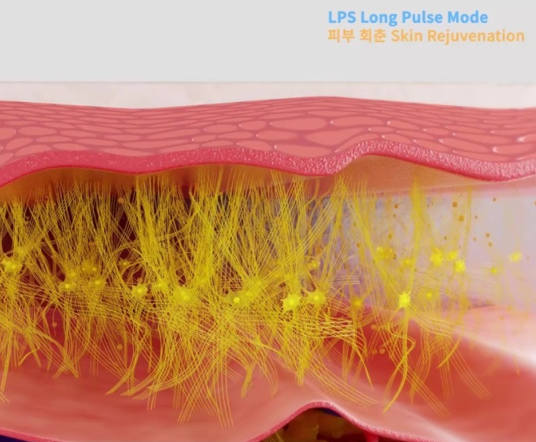
Long-Pulsed Genesis
Parameter
Genesis technique Concept
After treatment, a slim heat feeling(skin surface temperature 40~48’C) →
Reducing of scar, improving skin texture, reducing blemish, inflammation and pigmentation by collagen synthesis effect
Treatment
Treat the face while checking the skin temperature by touch it with your hand. Average 1,000 shot ~ 2,000 shot.
Melasma care is the completed indication which has many causes to make it like inflammation, damage, hormone etc. not a simple indication what can be solved by break the pigment only. So it is not enough to cure only with Q-Switch. Skin damage is restored and dermal environment is improved by long-pulse so it can lower the recurrence of pigment.

Slide 6
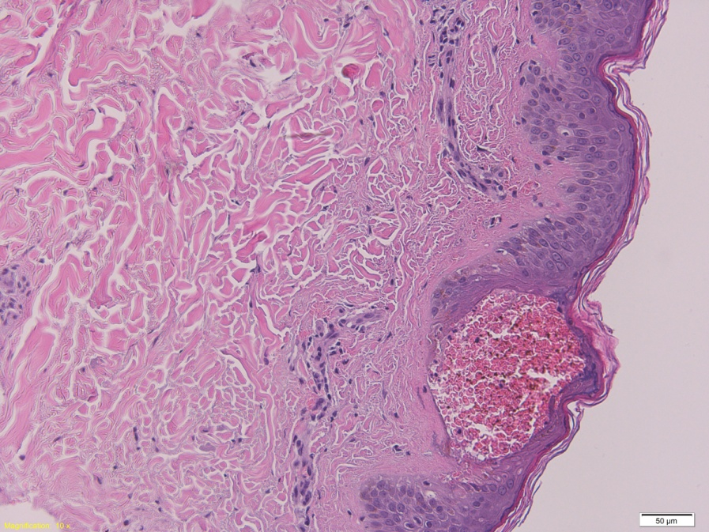
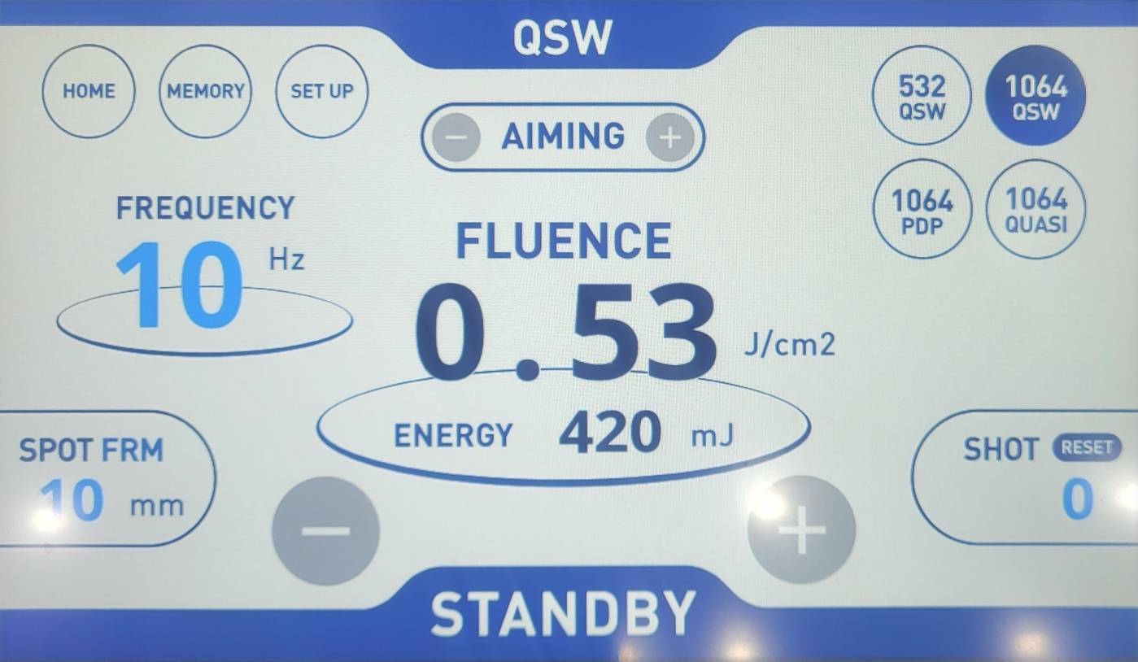
MLA
Finebeam MLA H/P
~ 0.63
According to the clinical test conducted by Finebeam, we can find the several micro space is made at first and it is filled with neo-collagen without epidermal damage. There is no skin damage in the skin surface but petechia is found in dermis. And it is disappeared within couple of days.
Without the epidermis damage, inside of epidermis and dermis, micro space is made caused by plasma effect made by the MLA H/P. The pigment in those spaces are disappeared, because the pigment breaks by explosion. And the thanks to natural skin reproduction process, it is filled with neo collagen. We called this Laser Induced Optical Breakdown(LIOB). It is effective for scar, pore, skin texture improving. It is less painful comparing conventional fractional laser, it doesn’t damage in the epidermis, so it is called as non marking Fractional laser or pore laser without scab.
Treatment
With above parameter 1 pass

Slide 7
Treatment cost in Korea
Genesis toning
Clinic / Session | Genesis Toning (1session) | Genesis Toning (5sessions) | Genesis Toning alon (10sessions)
May pure clinic in GuangMyung | USD18 | USD85 | USD160
So ye Dermatology clinic In GuangMyung | USD115 (Vitamin +Genesis) | USD580 (Vitamin + Genesis) | USD1,150 (Vitamin + Genesis)
MB Clinic In Chulsan | USD155 | USD770 | USD1,540
MLA + Genesis
Clinic / Session | 1 session | 3 session | 5 session | 10 sessions
Vincent Clinic In Magok | USD220 Around of NOSE MLA+Geneis+Cryo | USD525 Around of Nose MLA+Genesis+Cryo
The Jiwoom Clinic In Incheon |  | USD350
Wellspa Dermatolog In Paju |  |  | USD525 | WHOLE Face USD1,050
BB Clinic In Anyang | Around of Nose USD87 |  | USD1,050 (Regeneration + Sedation))

Slide 8
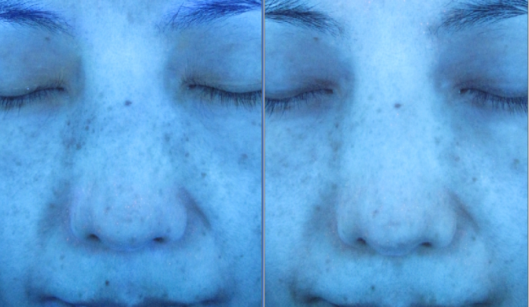
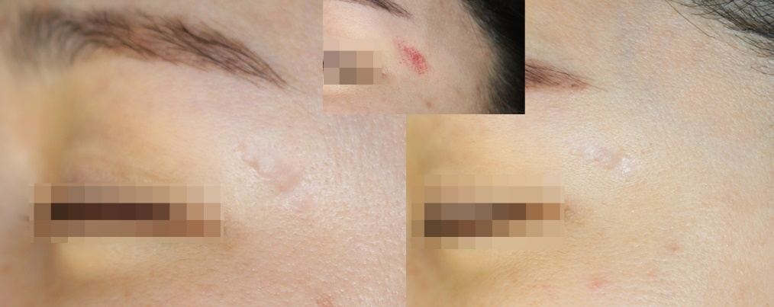
Clinical Effect
Skin Tone
Texture
TriFull toning is differently with conventional toning, it improve skin tone and skin texture at the same time. And also differently with the conventional toning which is required several sessions, it is possible to see the skin texture improving effect with fewer sessions than it.
It cure pigment with Q toning, it makes skin healthy by dermal environment improving with Genesis, it cure the bumpy skin.

Slide 9
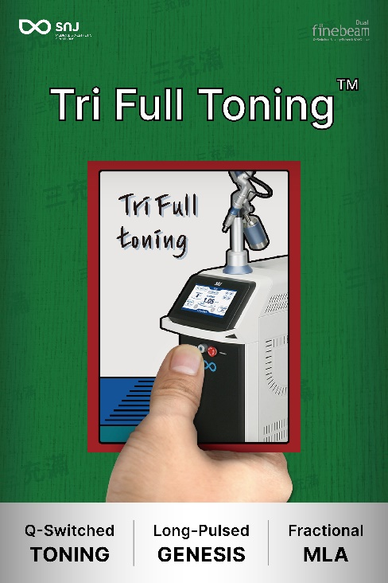
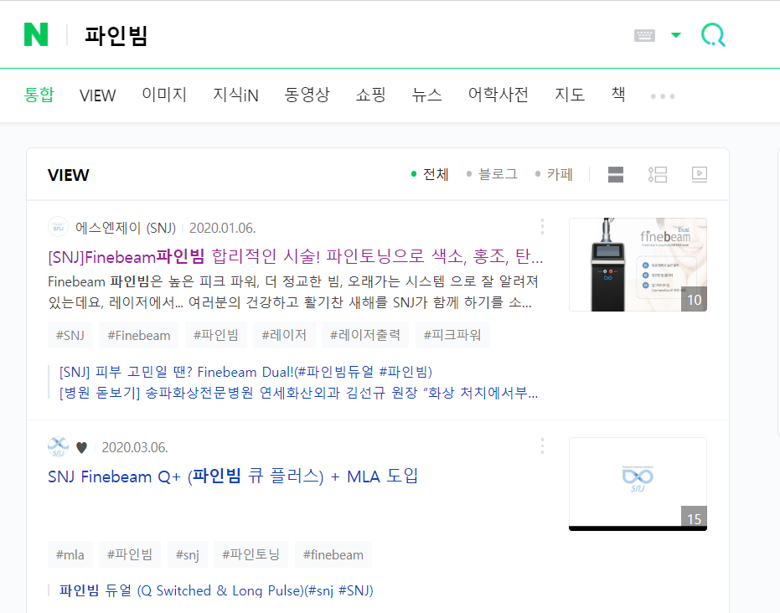
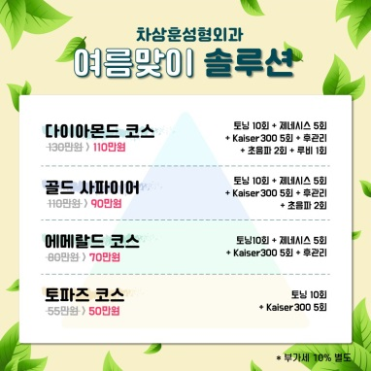
Marketing
Tri Full Toning
: Comparing general triple toning and dual toning, its key word is less competitive and the term is new and sensuous.
Time Table
Second half of
2021
September-
September-
Advertise in magazine, congress as off line
Appear at the top of search engines and article
Reach to Goal

