Slide 1


Gold PTT
PTT(Photo Thermal Therapy) with Finebeam Dual
Issue date: Aug. 19, 2023

Slide 2
PTT(Photo Thermal Therapy)
Photo: Laser light
With Gold
Thermal: Heat
Therapy

Slide 3

Light and Heat therapy with Gold

Slide 4
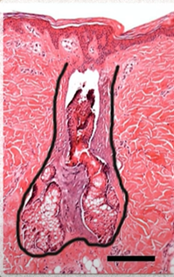
Acne
Pore is Blocked
Excessively overgrown sebaceous glands

Slide 5
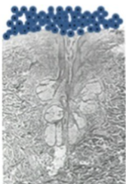
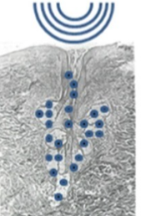
Gold PTT Mechanism
Ultrasound vibration
Light and Heat with Long pulsed laser
Gold Powder

Slide 6
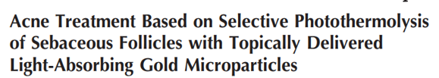
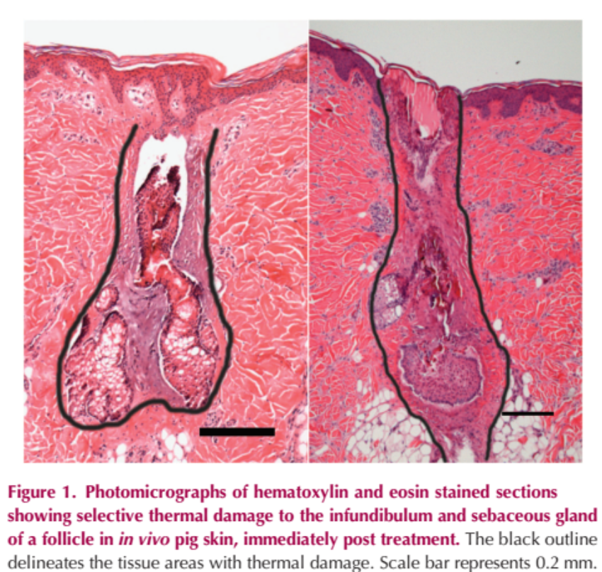
After Gold PTT
Source from
Sebaceous gland is normalized, break through the pore

Slide 7

Patients treated Gold PTT from other clinics and no effect
CHECK POINTS
0.3ms Quasi mode
1. 7 to 10 sessions with low pain
30ms long pulse laser
PULSE DURATION
Ultrasound frequency “MHZ”
2. Ultra Sound frequency
“KHZ”

Slide 8
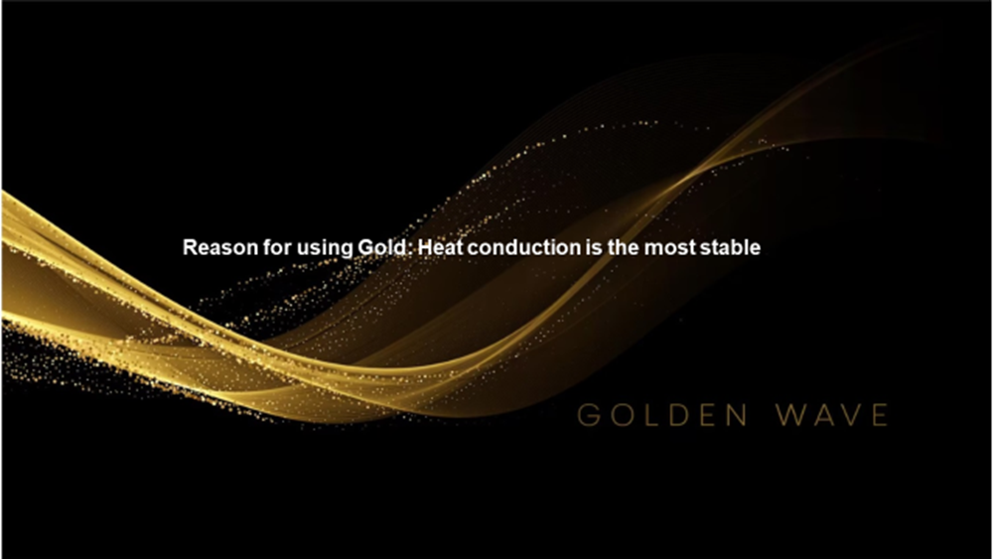

Slide 9
Selective phtothermolysis
30ms – it break only the excessively enlarged sebaceous gland. It doesn’t damage the normal ones.
Indications |  | Handpiece | Wavelength | Spot size (mm) | Fluence (J/cm²) | Frequency (Hz) | Count | Endpoint | Interval | Session | Remarks
Gold powder laser | Q-plus | Blue Zoom 10HZ | 1064 Quasi | 8 | ~3.98 | 10 (overlap ~80%) | ~7,500 shots | warm, reddish | 2 weeks | 5~7 | First use 10-15 minutes of ultrasound to introduce 3-5ml of gold powder treatment solution (applied on the whole face), then wipe it off with wet cotton and dry it, then perform laser treatment, and finally clean it with wet cotton and apply a soothing mask.
 | Dual | Blue Zoom | 1064 LP (3ms) | 8 | ~9.9-10.9 | 5 (overlap ~30%) | ~4,000-5,000 shots | warm, reddish | 2 weeks | 5
 | Dual-Standard | Blue Zoom 2HZ | 1064 LP (30ms) | 10 | ~21.6-24.2 22.9 | 1-2(overlap ~50%) | ~2 Pass Around 500 shot | warm, reddish | 2 weeks | 3 ~ 5

Slide 10
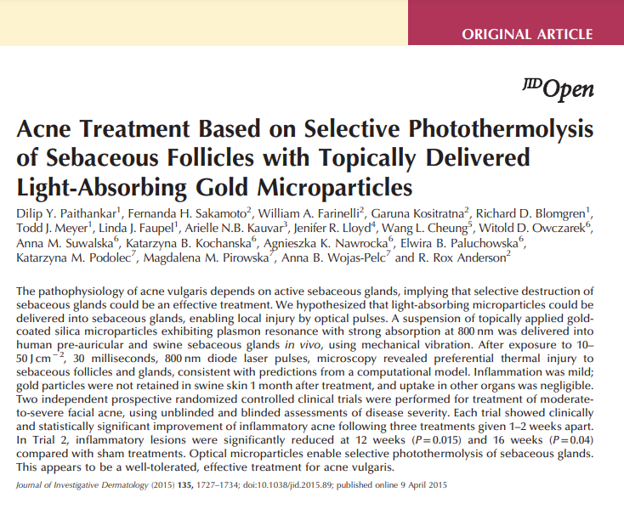
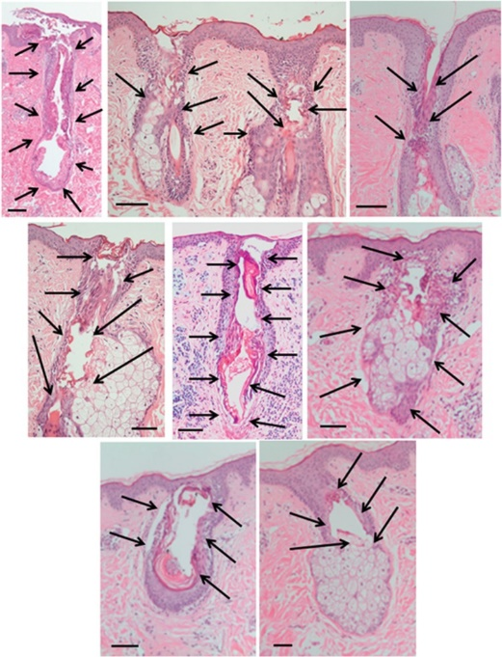
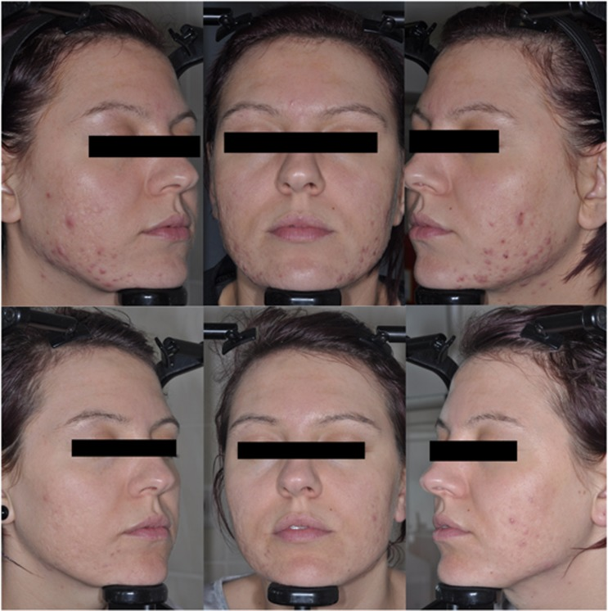
The study about GOLD PTT was introduced at first by Rox Anderson from Harvard university medical center
Published in 2015’
Notes:
Source paper
https://doi.org/10.1038%2Fjid.2015.89
Photos description
Skin biopsier above
Collage of photomicrographs of immediate post-treatment pre- and post-auricular human skin biopsies showing examples of thermal damage to the infundibulum and sebaceous gland (hematoxylin and eosin stain). The black arrows point to the areas of thermal damage. Scale bar represents 0.1 mm.
Face Figure
Baseline (top row) and 24-week post-baseline (bottom row) photographs of a subject in the treated arm from Trial 1 showing a reduction in inflammatory lesion burden on the cheeks. Subject gave permission to have her de-identified images published.

Slide 11
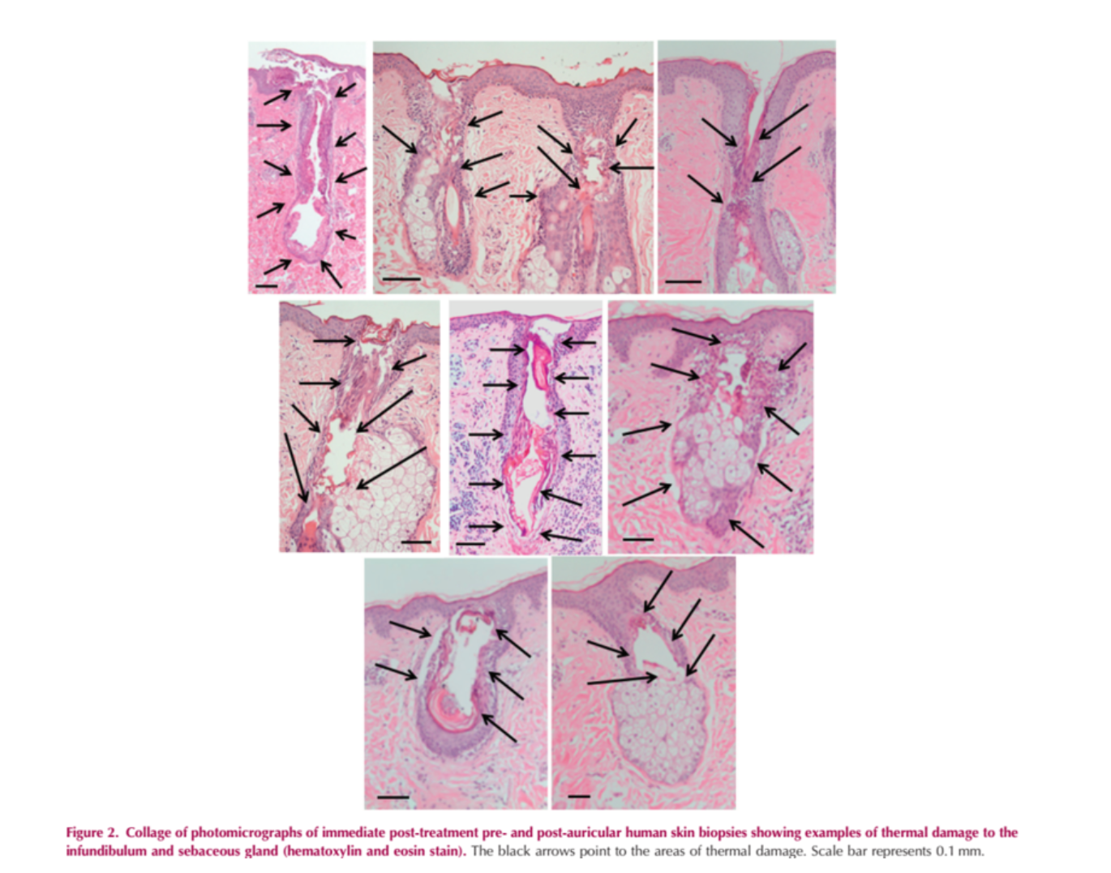
Human skin – the black arrow is the damaged part

Slide 12
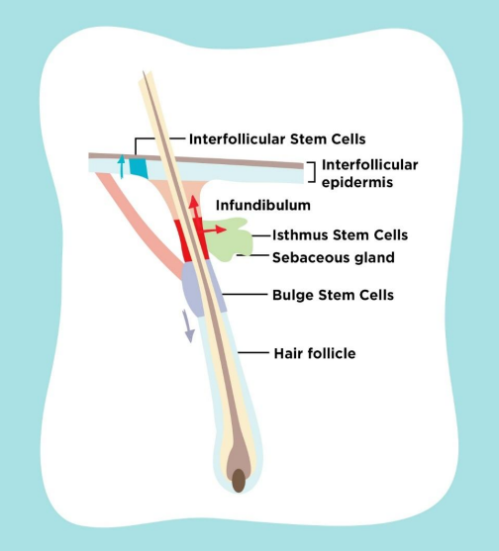
Infundibulum thermal damage – 84%
Sebaceous gland thermal damage – 47%
Epidermal damage – no
Follicle damage – no
Irritation feeling – a little bit

Slide 13
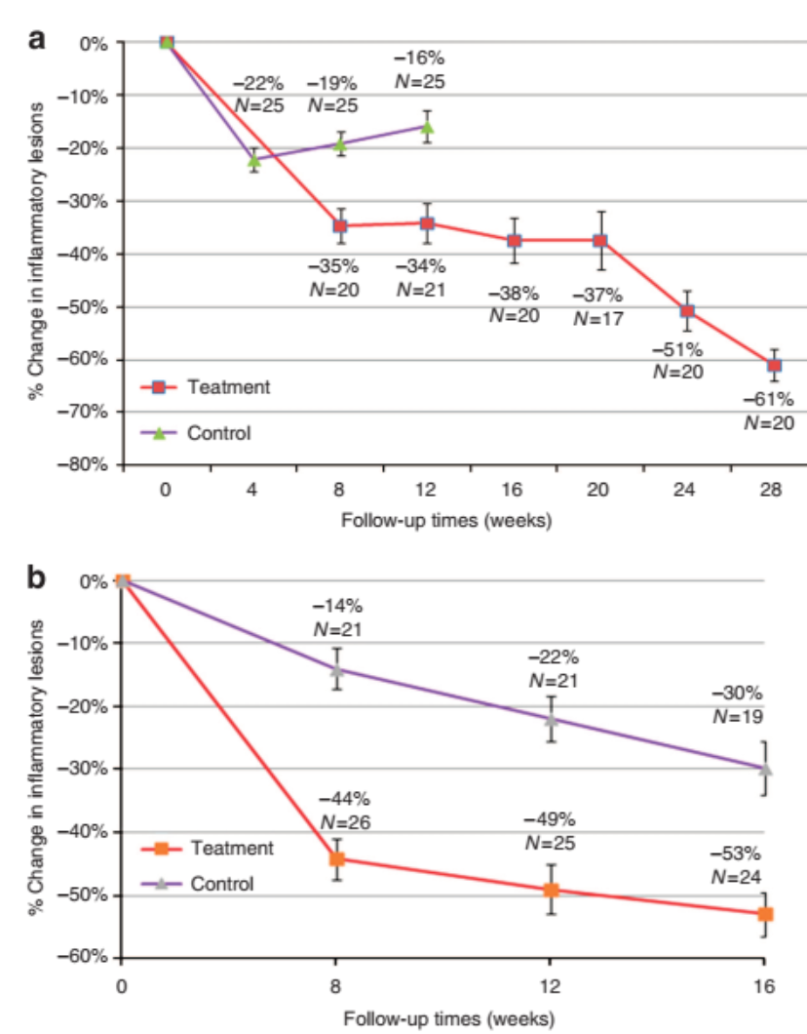
The q’ty of inflammatory lesions are reduced

Slide 14
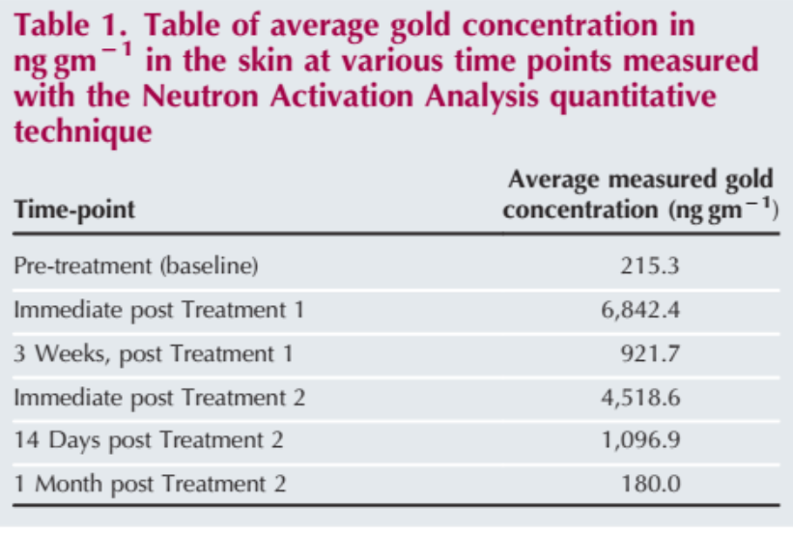
What happen the gold particles penetrated in the pores?
It isn’t absorbed into the skin. - SAFE
It is remained sebaceous gland and hair follicle road, it is slightly comes out of pre with sebum.
It is discharged in 1 month.
If you treat PTT again within 1 month, the effect can be better with the remained PTT particles and newly penetrated particles in to skin.
Remained PTT Particles
Newly penetrated
PTT Particles
Better
Effect

Slide 15
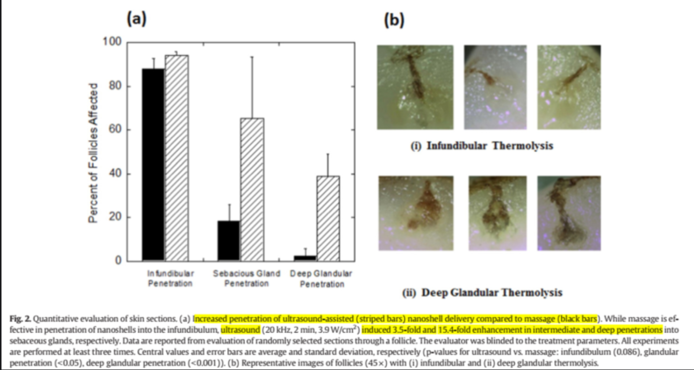
How effectively penetrate the gold PTT particles into pores?
Black bar – massage with hands
Hatch marked bar - ultrasound
Result:
Similar up to the infundibulum(shallow layer)
Middle layer – 3.5 times
Deep layer – 15.4 times
** Ultrasound treated part has much higher penetration late than hands massage.
40khz ultrasound is a little bit better penetration effect than 20khz, 80khz, 1Mhz

Slide 16
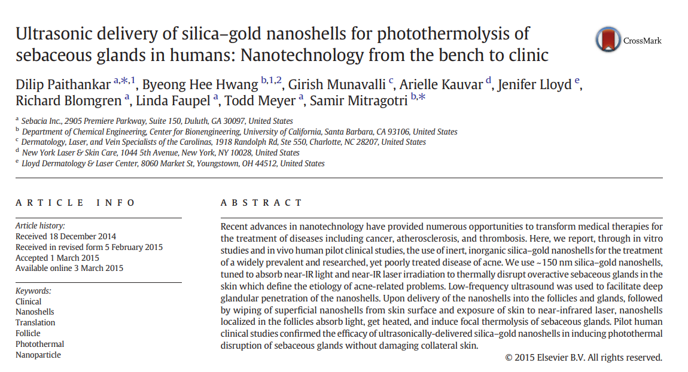
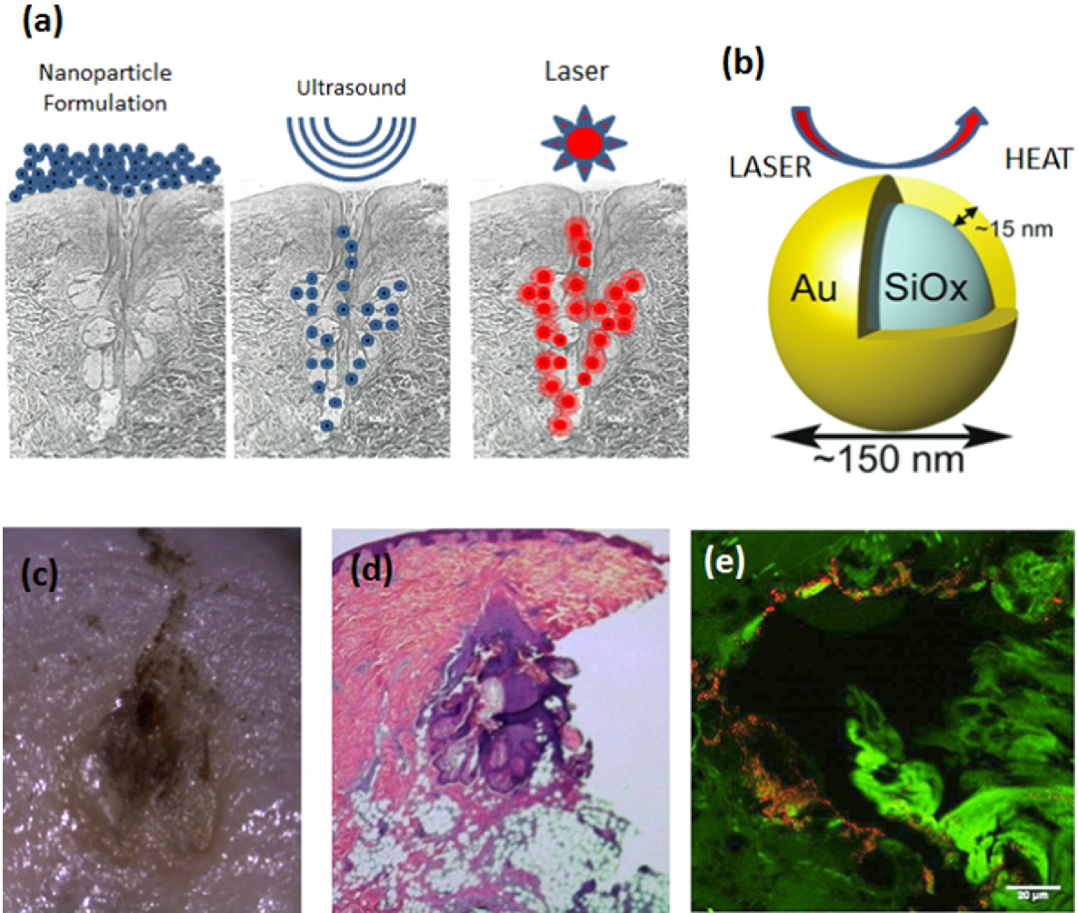
Proven GOLD PTT Efficiency, Safety with several clinical study
Notes:
Figure description
Fig. 1. Schematic representation of the therapy. (a) Delivery of nanoshells into sebaceous follicle with ultrasound and laser treatment to achieve localized heating of the follicle, (b) silica– gold nanoshells interactingwith light to produce heat, (c) example of thermally damaged sebaceous gland under a dissectingmicroscope, (d) example of H&E stained section demonstrating localized thermal damage to a sebaceous gland, (e) example of two-photon induced photoluminescence image showing the presence of nanoshells (orange)within a sebaceous gland. (For interpretation of the references to color in this figure legend, the reader is referred to the web version of this article.)
Paper
http://www.nylaserskincare.com/images/stories/Kauvar_JControlrelease_sebaceousglandMarch2015.pdf
https://doi.org/10.1016/j.jconrel.2015.03.004

Slide 17
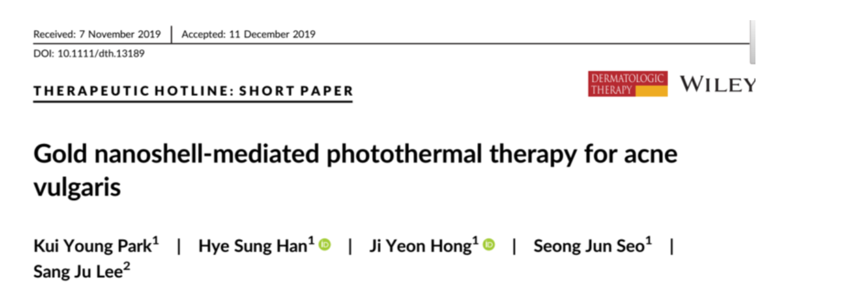
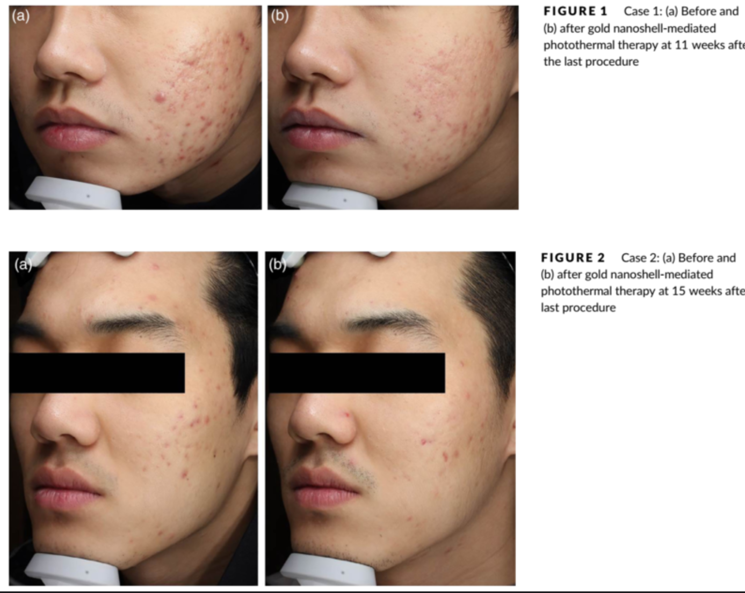

Slide 18
Selective photothermolysis
Pulse Duration
30ms – it destroys the excessively grown sebaceous gland only.

Slide 19
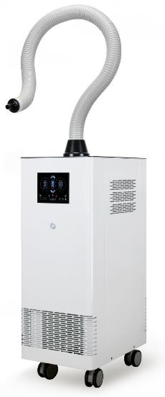
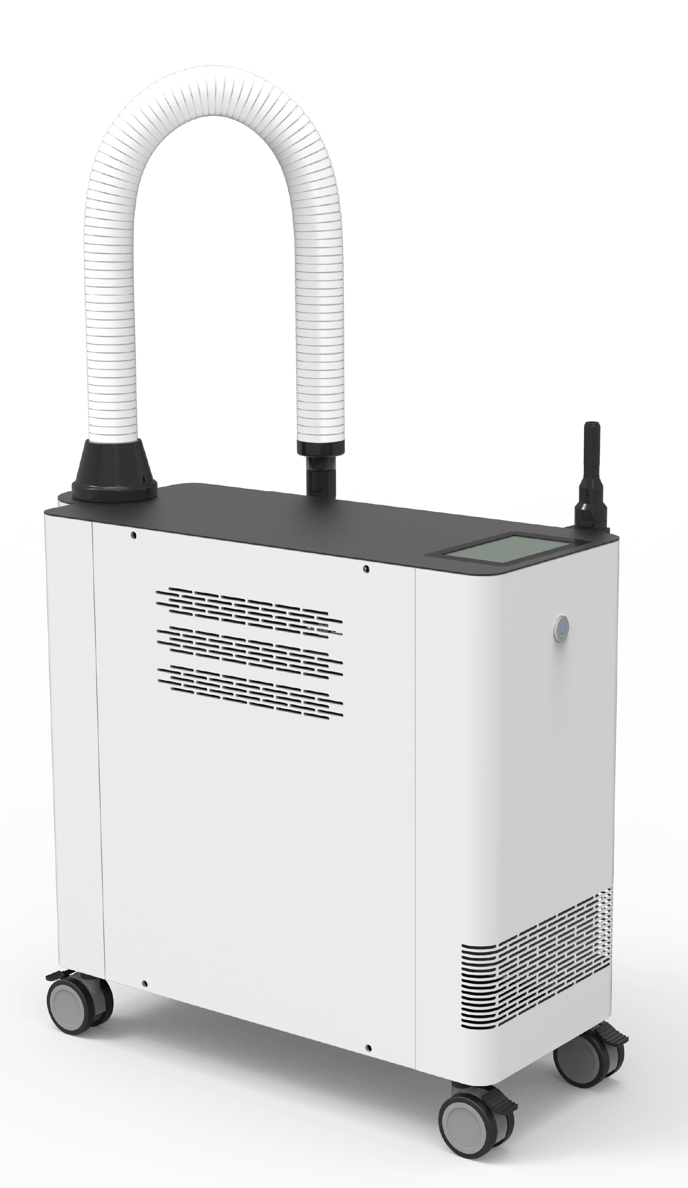

30ms
5min.
500 shots
85°C
AIR COOLING is necessary

Slide 20


Gold PTT Cycle
Prescribe
Oral antibiotics for 2 weeks max. 3 weeks
3 Sessions
2 weeks interval
60 ~ 80% of patients are improved
5 Sessions
Serious acne level
Extrusion and skin scaling
6 ~ 8 weeks interval
Treat PTT another
3 sessions
After 6 months, the sebaceous gland gets bigger again
but the acne serious is much lower than PTT

Slide 21
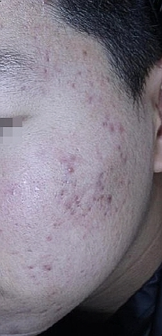
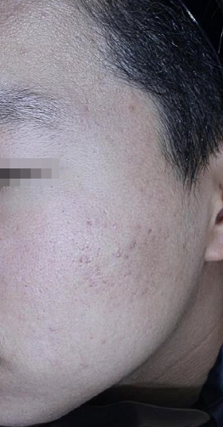


Mini Thermage effect
Acne removal
Heat stimulation to the surrounding tissues
Skin texture improving
Heat damage to the excessively grown sebaceous gland
Neo collagen generation
Effective for
Melanin improving effect
Pore size minimization
** Mini Thermage effect and better than Thermage effect for some cases
Source from
Irvine dermatology clinic
Dr.Yoo Blog

Slide 22
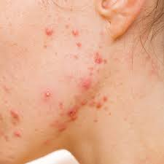
PTT(Photo Thermal Therapy) is recommended to:
A person who
concerned about flushing and pigmentation
worried about repeated acne
want to maintain effective treatment for a long time
wants to treat acne without taking medicine
resolve the fundamental cause of ance
mid age persons

Slide 23
Combination treatment
MLA Treatment
RF Needle
Gold PTT
3 ~ 5 sessions
Sebaceous gland
size is normalized
Pore size
reduced

Slide 24
Radical cure for Acne (Reducing Sebum glands)
So, if you look at the treatment that has been demonstrated targeting the number one, there is a sebum control drug called “Roaccutane”
1450nm laser to reduce Sebaceous glands but it dry the skin
PDT which is Photo Dynamic Therapy
: Photosensitizer (ALA): A lot of treatments have been done to penetrate and expose to light, selectively destroying sebaceous glands.
Notes:
Sebaceous glands:
A small gland in the skin which secretes a lubricating oily matter (sebum) into the hair follicles to lubricate the skin and hair.

Slide 25
PDT VS PTT
It is almost the same as PDT. You wonder what is the difference is, right?
The difference between the two is that the reaction source is (PTT) gold particles/ (PDT) photosensitive agent.
Ten or fifteen years ago, PDT was so popular. Those who have received the PDT know that the procedure itself is so simple and no pain, but the persons after PDT should strictly avoid the sunlight after the procedure.
Therefore the person had to completely close the sunblock curtains at home.
The principle of PDT can give good result, but it gradually disappeared from the market due to this discomfort.
Gold PTT doesn’t have the restriction for sunblock so it is much more comfortable in every day life.

Slide 26
PDT VS PTT
Gold PTT(Premium) | VS | Traditional Acne Treatment PDT (Photo dynamic therpy)
10 min. – absorption Gold PTT with Ultrasound 4 min. – Long pulse treatment | Treatment time | apply ALA and wait 30 min. ~ 1 hour for absorption
It is a specially designed gold micro-particles target and destroy Cortical glands and Acne bacteria | Principle | Apply a light-sensitive agent (ALA) to the epidermis and break it down after absorption
No restrictions on daily life, no UV effects | Everyday life | UV protection for 24 to 48 hours after treatment Inflammation & pigmentation
Non Penetrates the skin, has less effect on the epidermis | Light sensitivity | Yes Partial flushing and possible pigmentation
Treatment deep into the skin, reducing excessive acne and inhibiting recurrence | Effect | Acne reduction

Slide 27
6 stages of Acne
Source from Oracle Dermatology clinic

Slide 28
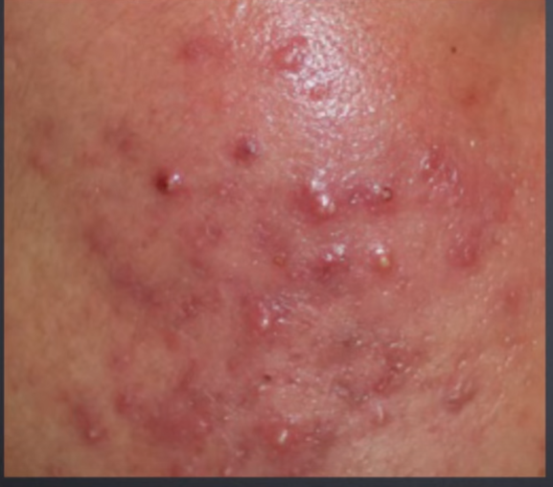
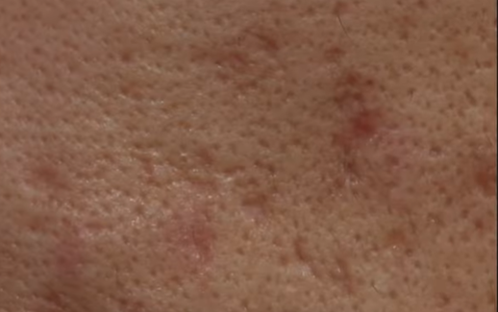
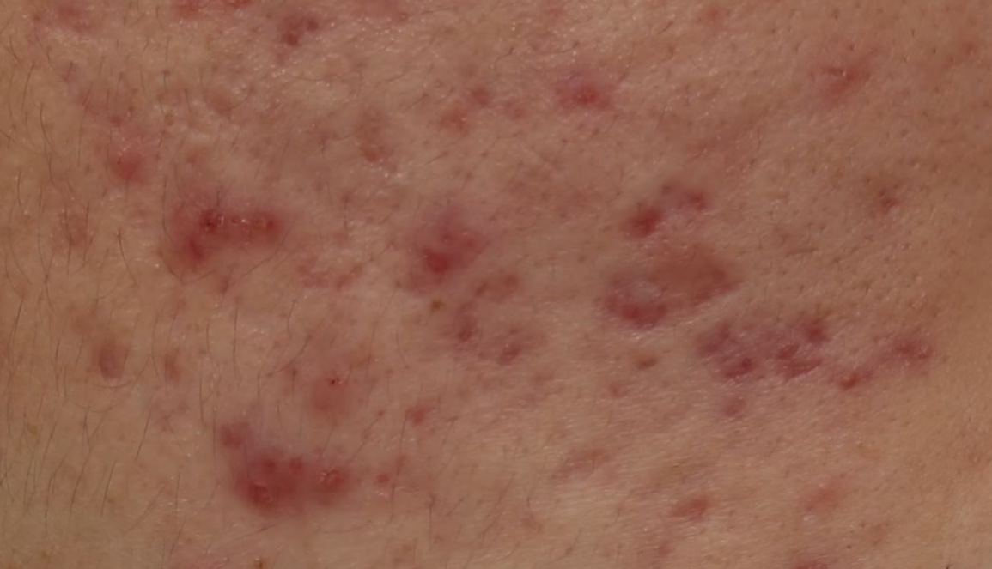
Stage 5 to 6
Progress
Skin colored acne scar
Takes longer time to treat
More aggressive method is required
Much More painful to treat
Stage 5: Cystic lesion, red hypertrophic acne scar

Slide 29
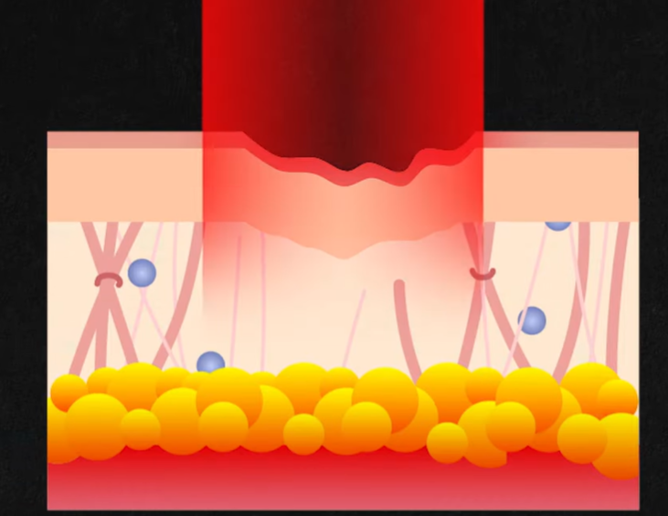
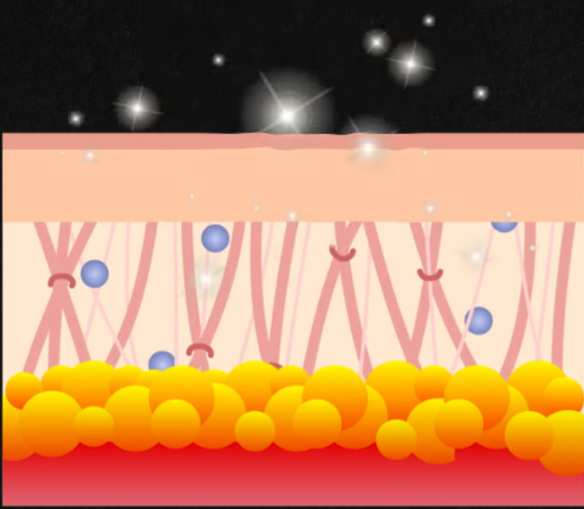
Finebeam 595nm Gold Dye H/P
Laser Toning
Shrink the aged blood vessel and generate new blood vessel. Stimulate the collagen to induce the neo collagen
Effective for pigmented lesion
Genesis
Gold PTT
It is effective for acne scar by generating neo collagen
Break the sebaceous gland so it reduce the acne rebound
Generate heat surrounding tissues
Source from Oracle Dermatology clinic

